Slide 1
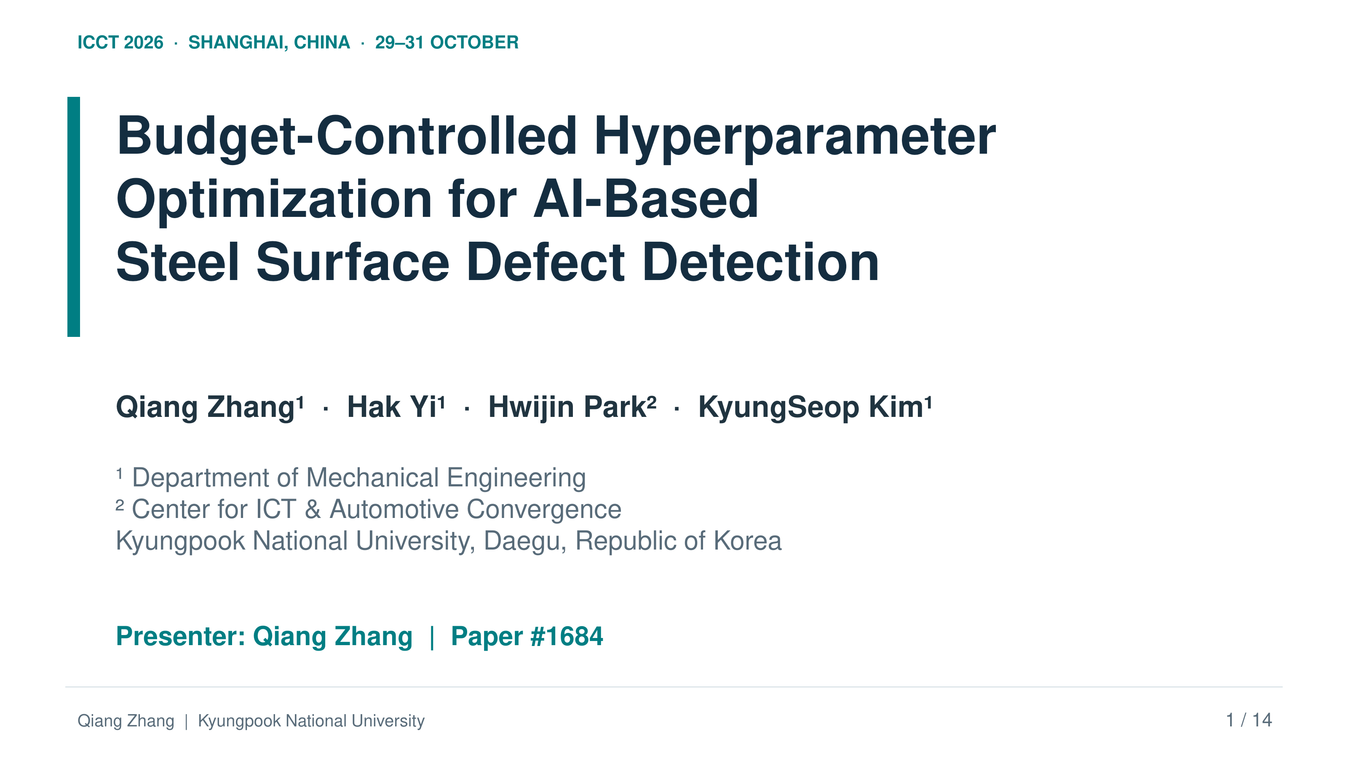
ICCT 2026 · SHANGHAI, CHINA · 29–31 OCTOBER
Budget-Controlled Hyperparameter
Optimization for AI-Based
Steel Surface Defect Detection
Qiang Zhang¹ · Hak Yi¹ · Hwijin Park² · KyungSeop Kim¹
¹ Department of Mechanical Engineering
² Center for ICT & Automotive Convergence
Kyungpook National University, Daegu, Republic of Korea
Presenter: Qiang Zhang | Paper #1684
Qiang Zhang | Kyungpook National University
1 / 14
Notes:
Slide 1: Budget-Controlled Hyperparameter Optimization for AI-Based Steel Surface Defect Detection
Target time: 40 seconds
ENGLISH SCRIPT
Hello, everyone. My name is Qiang Zhang, from Kyungpook National University. Today I will present our work on budget-controlled hyperparameter optimization for steel surface defect detection. We compare several search strategies under the same evaluation budget. The main question is whether a staged pipeline can improve detection and localization, and what the evidence tells us about each stage. This work was conducted with Hak Yi, Hwijin Park, and KyungSeop Kim.
中文讲稿
大家好。我是庆北国立大学的张强。今天汇报的工作是面向钢铁表面缺陷检测的预算受控超参数优化。我们在相同的评估预算下比较多种搜索策略。核心问题是：分阶段流程能否改善检测与定位，以及实验依据能够说明各阶段发挥了什么作用。这项工作由我与 Hak Yi、Hwijin Park 和 KyungSeop Kim 共同完成。
SOURCE / EVIDENCE
Title and author block; Section I, Introduction

Slide 2
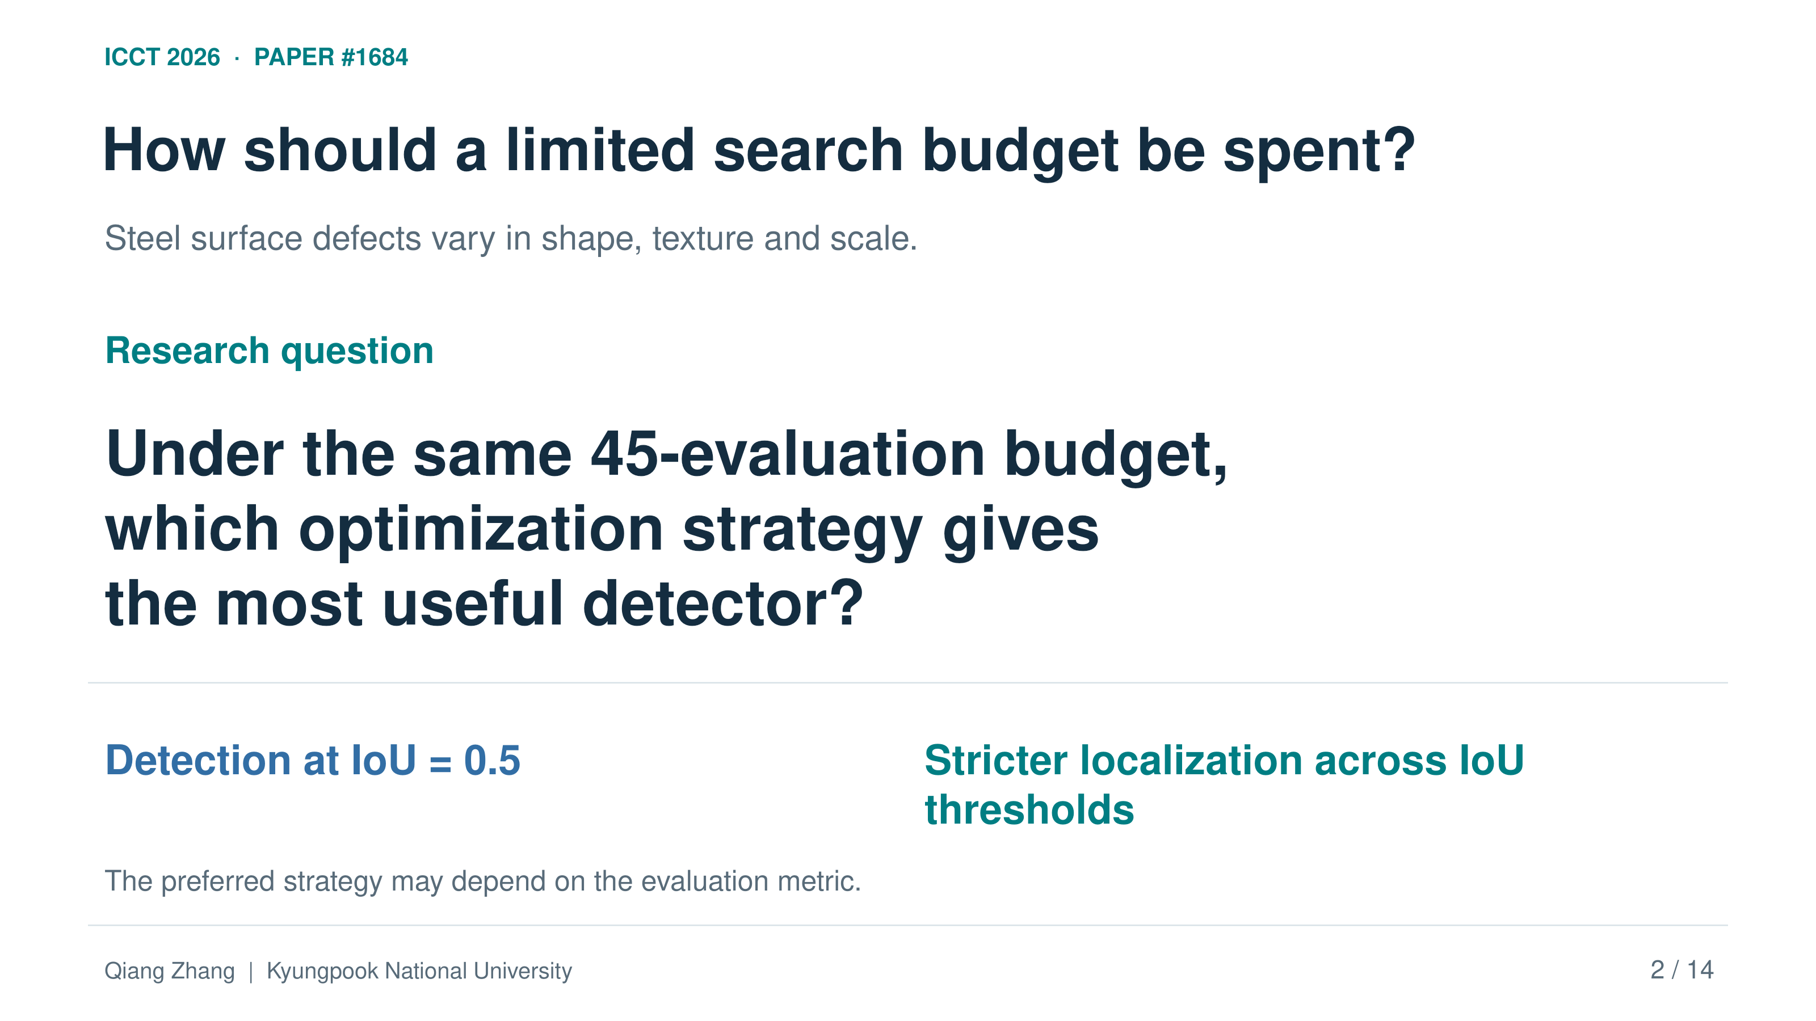
ICCT 2026 · PAPER #1684
How should a limited search budget be spent?
Steel surface defects vary in shape, texture and scale.
Research question
Under the same 45-evaluation budget,
which optimization strategy gives
the most useful detector?
Detection at IoU = 0.5
Stricter localization across IoU thresholds
The preferred strategy may depend on the evaluation metric.
Qiang Zhang | Kyungpook National University
2 / 14
Notes:
Slide 2: Research question: what helps under the same budget?
Target time: 45 seconds
ENGLISH SCRIPT
Steel defects differ in shape, texture, and boundary clarity. A model may find a defect but still place its box imprecisely. Therefore, we report two metrics. The first is mAP at an IoU threshold of zero point five. The second averages mAP over thresholds from zero point five to zero point nine five. We call this the strict metric. Our question is: under the same search budget, which strategy gives the best tradeoff between permissive detection and stricter localization?
中文讲稿
钢铁缺陷在形状、纹理和边界清晰度上存在差异。模型可能找到了缺陷，却没有准确地定位边界框。因此，我们报告两个指标。第一个是 IoU 阈值为 0.5 时的 mAP；第二个是从 0.5 到 0.95 的多个阈值上的平均 mAP，我们将其称为严格指标。我们的研究问题是：在相同搜索预算下，哪一种策略能在宽松检测和更严格的定位之间取得更好的平衡？
SOURCE / EVIDENCE
Section I, Introduction; Section VI, Conclusion

Slide 3
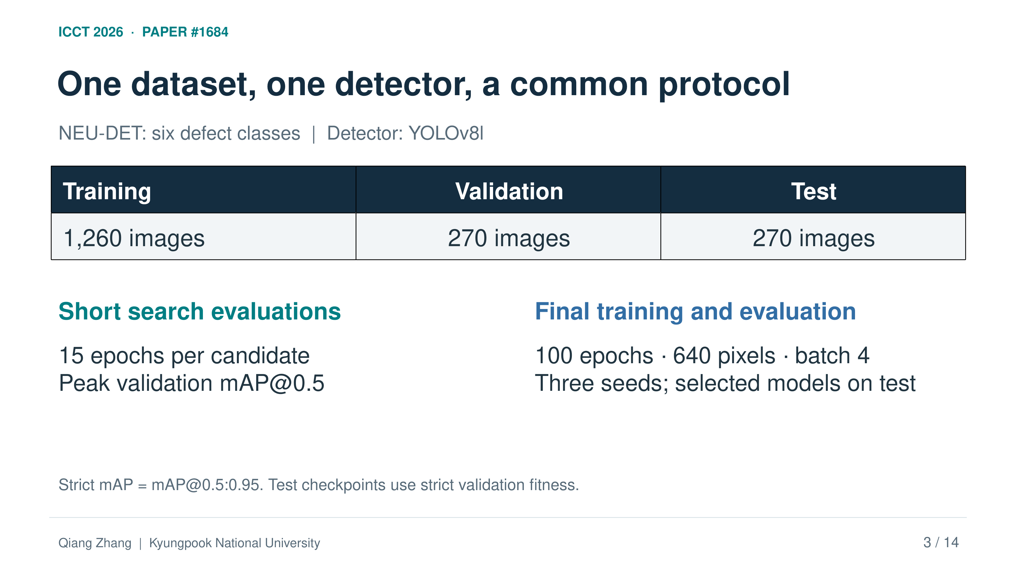
ICCT 2026 · PAPER #1684
One dataset, one detector, a common protocol
NEU-DET: six defect classes | Detector: YOLOv8l
Training | Validation | Test
1,260 images | 270 images | 270 images
Short search evaluations
Final training and evaluation
15 epochs per candidate
Peak validation mAP@0.5
100 epochs · 640 pixels · batch 4
Three seeds; selected models on test
Strict mAP = mAP@0.5:0.95. Test checkpoints use strict validation fitness.
Qiang Zhang | Kyungpook National University
3 / 14
Notes:
Slide 3: Dataset and common evaluation protocol
Target time: 60 seconds
ENGLISH SCRIPT
We use YOLOv8l on NEU-DET, which contains six steel defect classes. The fixed split has one thousand two hundred sixty training images, two hundred seventy validation images, and two hundred seventy test images. Each search candidate is trained for fifteen epochs. After search, its selected settings are frozen and retrained for one hundred epochs, with image size six hundred forty and batch size four. Validation guides selection. The held-out test split evaluates the final models. Original comparisons use three training seeds; selected configurations are later extended to five. The test checkpoint is selected using strict validation fitness.
中文讲稿
我们在 NEU-DET 数据集上使用 YOLOv8l，数据集包含六类钢铁缺陷。固定划分为 1,260 张训练图像、270 张验证图像和 270 张测试图像。每个搜索候选训练 15 个 epoch。搜索结束后，将选出的超参数固定，统一重新训练 100 个 epoch，图像尺寸为 640，批量大小为 4。验证集用于指导选择，独立保留的测试集用于评估最终模型。原始比较采用三个训练随机种子，之后将部分固定配置扩展到五个种子。测试所用检查点根据严格验证指标的 fitness 选择。
SOURCE / EVIDENCE
Section III.A, Search Budget and Proxy Objective; Section IV, Experimental Setup

Slide 4
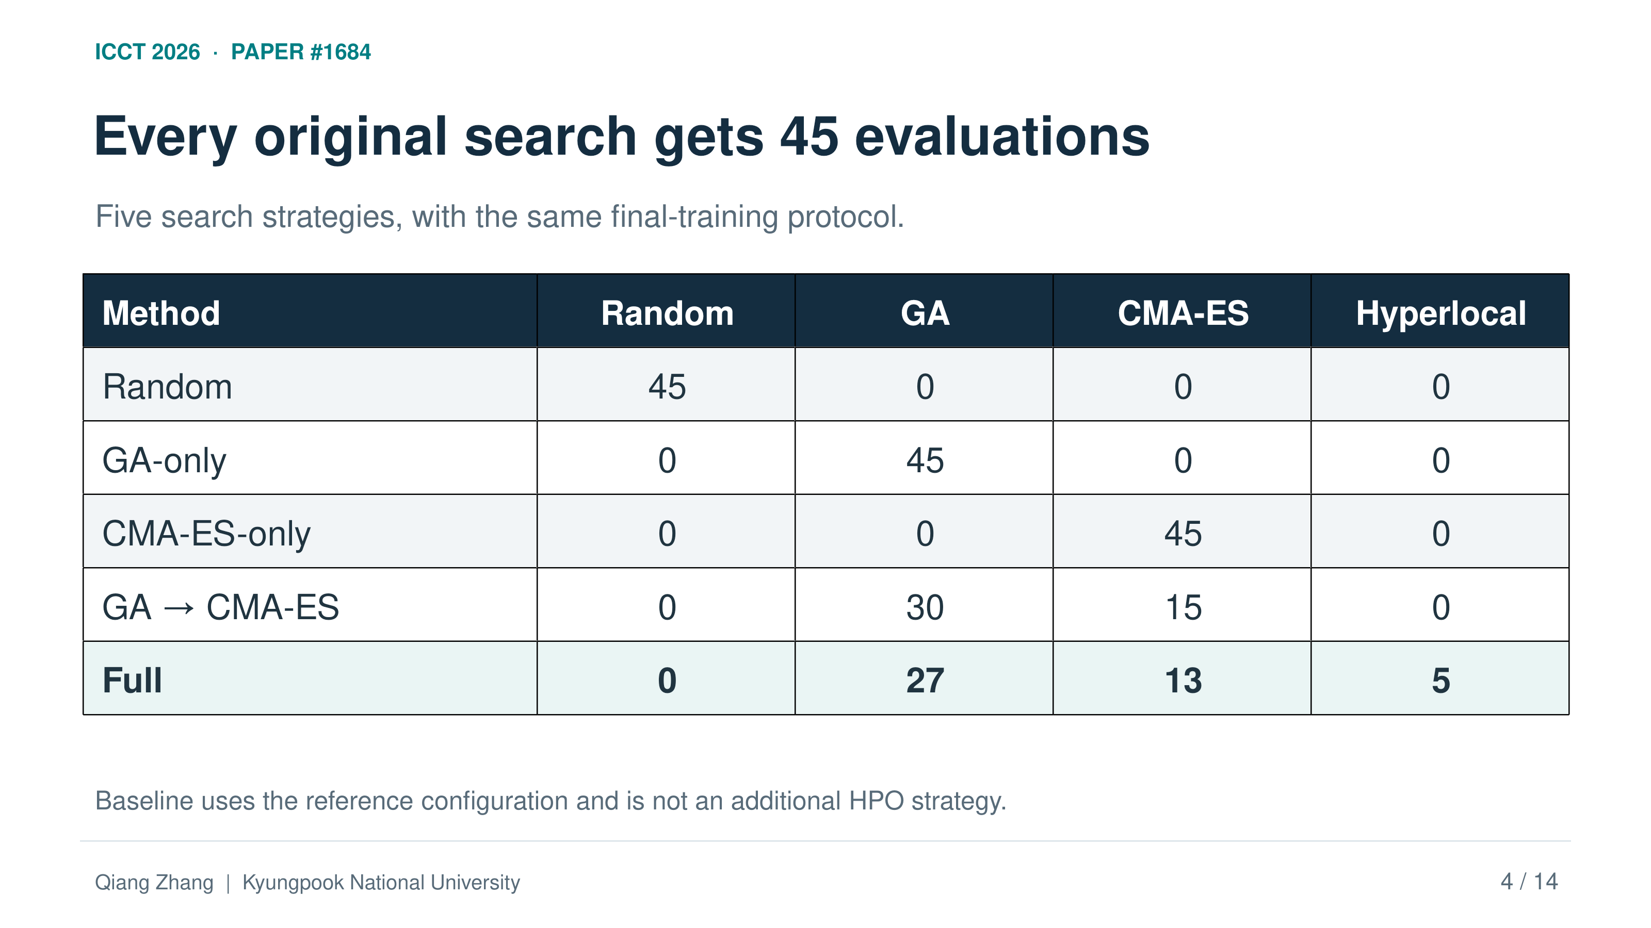
ICCT 2026 · PAPER #1684
Every original search gets 45 evaluations
Five search strategies, with the same final-training protocol.
Method | Random | GA | CMA-ES | Hyperlocal
Random | 45 | 0 | 0 | 0
GA-only | 0 | 45 | 0 | 0
CMA-ES-only | 0 | 0 | 45 | 0
GA → CMA-ES | 0 | 30 | 15 | 0
Full | 0 | 27 | 13 | 5
Baseline uses the reference configuration and is not an additional HPO strategy.
Qiang Zhang | Kyungpook National University
4 / 14
Notes:
Slide 4: Equal evaluation budgets make comparisons interpretable
Target time: 50 seconds
ENGLISH SCRIPT
The baseline uses the original training settings without an HPO search. We compare it with five search strategies: random search, GA-only, CMA-ES-only, GA followed by CMA-ES, and the Full pipeline. Every search strategy receives forty-five evaluations. Full allocates twenty-seven evaluations to GA, thirteen to CMA-ES, and five to hyperlocal tuning. The two-stage method instead uses thirty and fifteen. This difference matters: comparing the two final winners alone cannot isolate the effect of adding hyperlocal tuning. We address that issue with a separate matched control.
中文讲稿
Baseline 使用原始训练设置，不进行超参数搜索。我们将它与五种搜索策略比较：随机搜索、仅 GA、仅 CMA-ES、GA 后接 CMA-ES，以及 Full 完整流程。每种搜索策略都使用 45 次评估。Full 分配 27 次给 GA、13 次给 CMA-ES、5 次给超局部微调。两阶段方法则采用 30 次和 15 次。这一区别非常重要：仅比较两个流程最终选出的配置，不能单独确定增加超局部微调的作用。因此，我们另外设计了匹配对照实验。
SOURCE / EVIDENCE
Section III.A; Table 1, Original search budgets

Slide 5
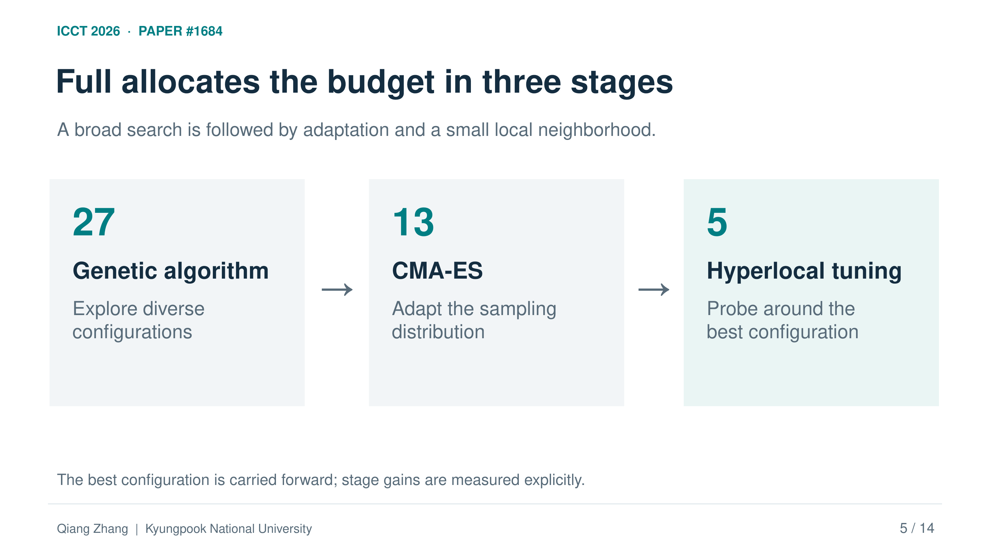
ICCT 2026 · PAPER #1684
Full allocates the budget in three stages
A broad search is followed by adaptation and a small local neighborhood.
27
13
5
Genetic algorithm
→
CMA-ES
→
Hyperlocal tuning
Explore diverse
configurations
Adapt the sampling
distribution
Probe around the
best configuration
The best configuration is carried forward; stage gains are measured explicitly.
Qiang Zhang | Kyungpook National University
5 / 14
Notes:
Slide 5: Full: exploration, refinement, and hyperlocal tuning
Target time: 55 seconds
ENGLISH SCRIPT
Full combines three intended roles. GA explores a broad region through selection, crossover, and mutation. CMA-ES then adapts a continuous search distribution around the best GA candidate. Finally, hyperlocal tuning samples a smaller neighborhood around the current best point. Candidates use the same requested search space, covering optimization, loss, and augmentation settings. In the original experiment, the outer objective is peak validation mAP at zero point five. The fifteen-epoch training run is the main cost-saving approximation. These stage roles are design intentions; their actual value must be checked from the observed stage results.
中文讲稿
Full 将三个预期作用结合起来。GA 通过选择、交叉和变异探索较大范围；随后，CMA-ES 围绕最佳 GA 候选自适应调整连续搜索分布；最后，超局部微调在当前最佳点周围的更小邻域内采样。各候选使用相同的请求搜索空间，涵盖优化设置、损失权重和数据增强参数。原始实验的外层目标是验证集 mAP@0.5 的峰值。主要的计算近似来自每次仅训练 15 个 epoch。这些阶段作用属于设计意图，实际贡献还需要通过观测到的阶段结果验证。
SOURCE / EVIDENCE
Sections III.A–B; Section III.C for algorithm details; Section V.F

Slide 6
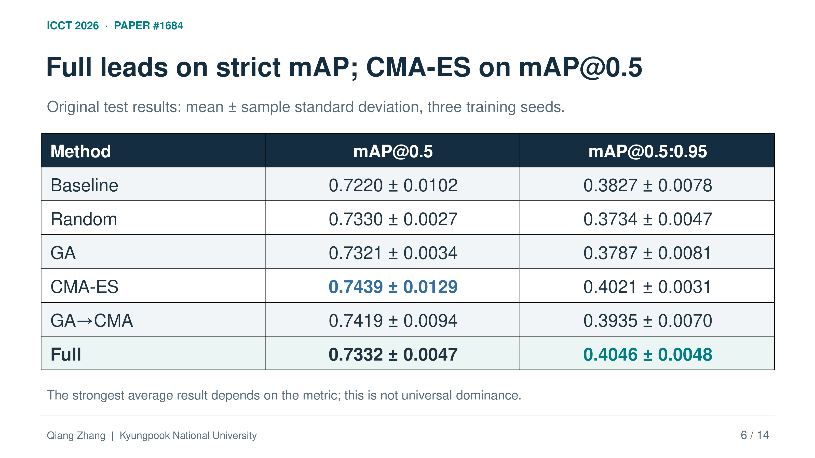
ICCT 2026 · PAPER #1684
Full leads on strict mAP; CMA-ES on mAP@0.5
Original test results: mean ± sample standard deviation, three training seeds.
Method | mAP@0.5 | mAP@0.5:0.95
Baseline | 0.7220 ± 0.0102 | 0.3827 ± 0.0078
Random | 0.7330 ± 0.0027 | 0.3734 ± 0.0047
GA | 0.7321 ± 0.0034 | 0.3787 ± 0.0081
CMA-ES | 0.7439 ± 0.0129 | 0.4021 ± 0.0031
GA→CMA | 0.7419 ± 0.0094 | 0.3935 ± 0.0070
Full | 0.7332 ± 0.0047 | 0.4046 ± 0.0048
The strongest average result depends on the metric; this is not universal dominance.
Qiang Zhang | Kyungpook National University
6 / 14
Notes:
Slide 6: Original test results: the preferred method depends on the metric
Target time: 60 seconds
ENGLISH SCRIPT
Here are the original test results across three training seeds. CMA-ES-only has the highest permissive mAP, at zero point seven four three nine. Full has the highest strict mAP, at zero point four zero four six. Baseline reaches zero point three eight two seven on the strict metric. Therefore, Full is promising when stricter localization is the priority, while CMA-ES-only is a strong simpler alternative. The Full margin over CMA-ES is small, about zero point two five percentage points, and its uncertainty interval includes zero. We do not interpret this as general optimizer superiority.
中文讲稿
这里展示原始三个训练随机种子的测试结果。仅 CMA-ES 的宽松 mAP 最高，为 0.7439；Full 的严格 mAP 最高，为 0.4046；Baseline 的严格指标为 0.3827。因此，在更重视严格定位时，Full 是有潜力的选择，而仅 CMA-ES 是一个有竞争力且更简单的替代方案。Full 相对 CMA-ES 的领先幅度很小，约为 0.25 个百分点，其不确定性区间包含零。我们不会将其解释为优化器具有普遍优势。
SOURCE / EVIDENCE
Section V.A; Table 3; Figure 1; paired original strict-test difference 0.249 pp, 95% interval [−1.596, 2.094]

Slide 7
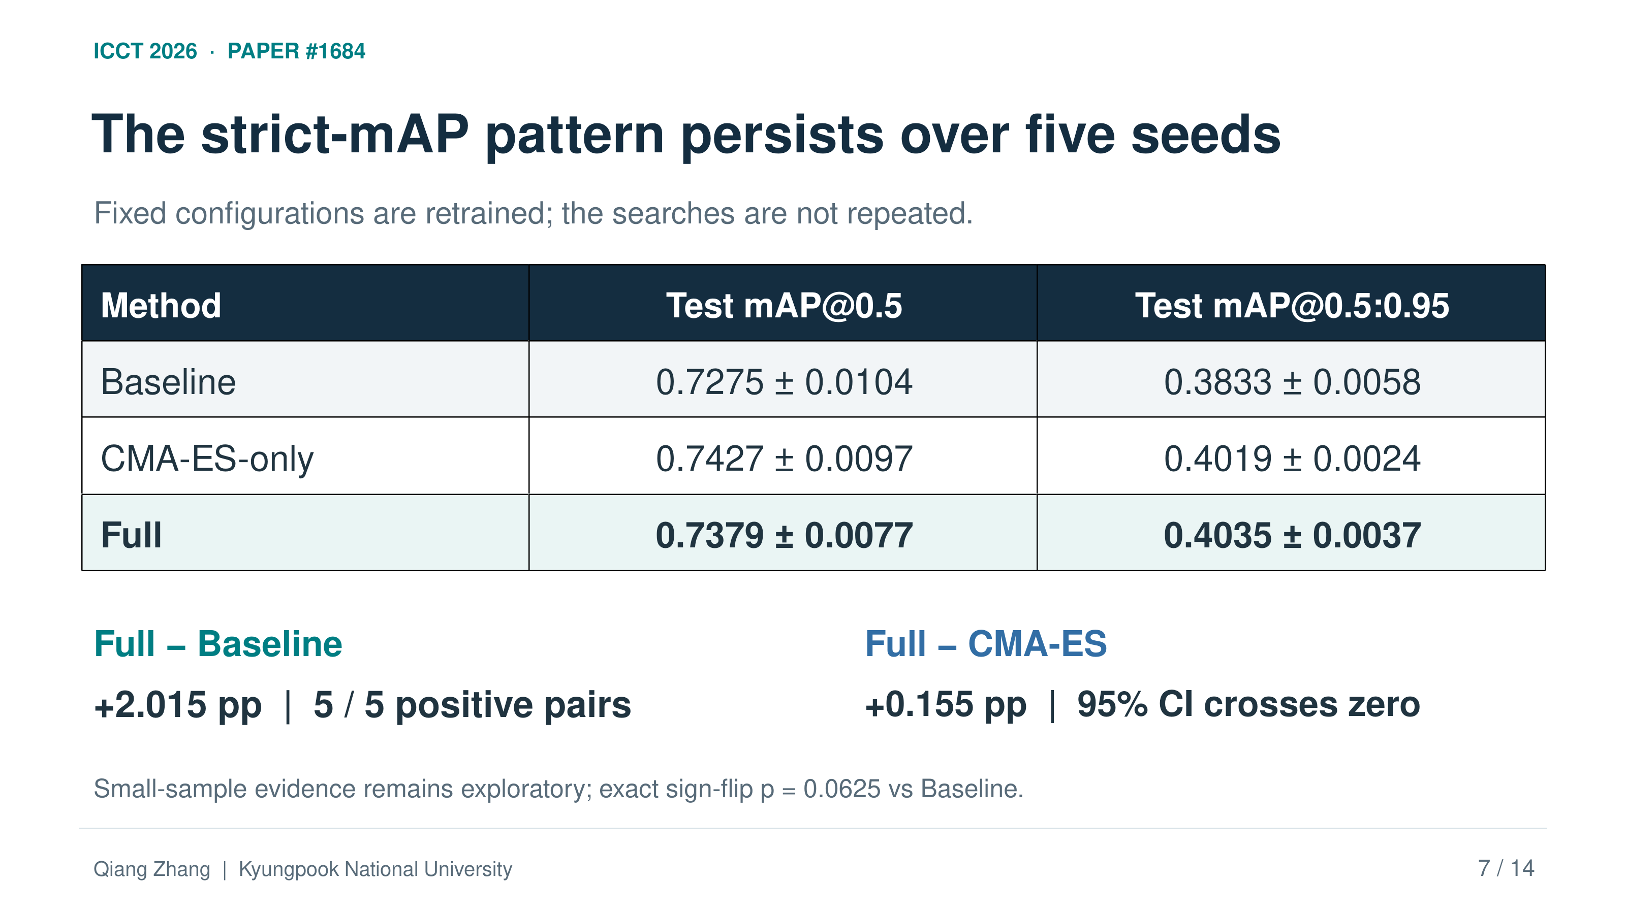
ICCT 2026 · PAPER #1684
The strict-mAP pattern persists over five seeds
Fixed configurations are retrained; the searches are not repeated.
Method | Test mAP@0.5 | Test mAP@0.5:0.95
Baseline | 0.7275 ± 0.0104 | 0.3833 ± 0.0058
CMA-ES-only | 0.7427 ± 0.0097 | 0.4019 ± 0.0024
Full | 0.7379 ± 0.0077 | 0.4035 ± 0.0037
Full − Baseline
Full − CMA-ES
+2.015 pp | 5 / 5 positive pairs
+0.155 pp | 95% CI crosses zero
Small-sample evidence remains exploratory; exact sign-flip p = 0.0625 vs Baseline.
Qiang Zhang | Kyungpook National University
7 / 14
Notes:
Slide 7: Five retraining seeds: improvement over Baseline, uncertain margin over CMA-ES
Target time: 50 seconds
ENGLISH SCRIPT
We next extend the fixed Baseline, CMA-ES-only, and Full configurations to five training seeds. Their mean strict test scores are zero point three eight three three, zero point four zero one nine, and zero point four zero three five. Full improves on Baseline by two point zero one five percentage points, with a positive difference in all five matched pairs. Its margin over CMA-ES is only zero point one five five points, and the interval crosses zero. These repetitions assess training variability for fixed configurations. They are not five independent searches.
中文讲稿
接下来，我们将已经固定的 Baseline、仅 CMA-ES 和 Full 配置扩展到五个训练随机种子。它们的平均严格测试指标分别为 0.3833、0.4019 和 0.4035。Full 相对 Baseline 提升 2.015 个百分点，在五组成对比较中都为正。它相对 CMA-ES 仅提升 0.155 个百分点，且区间跨越零。这些重复实验评估的是固定配置下的训练波动，并不代表五次独立的超参数搜索。
SOURCE / EVIDENCE
Section V.B; Table 4; paired intervals and exact sign-flip checks in Section V.B

Slide 8
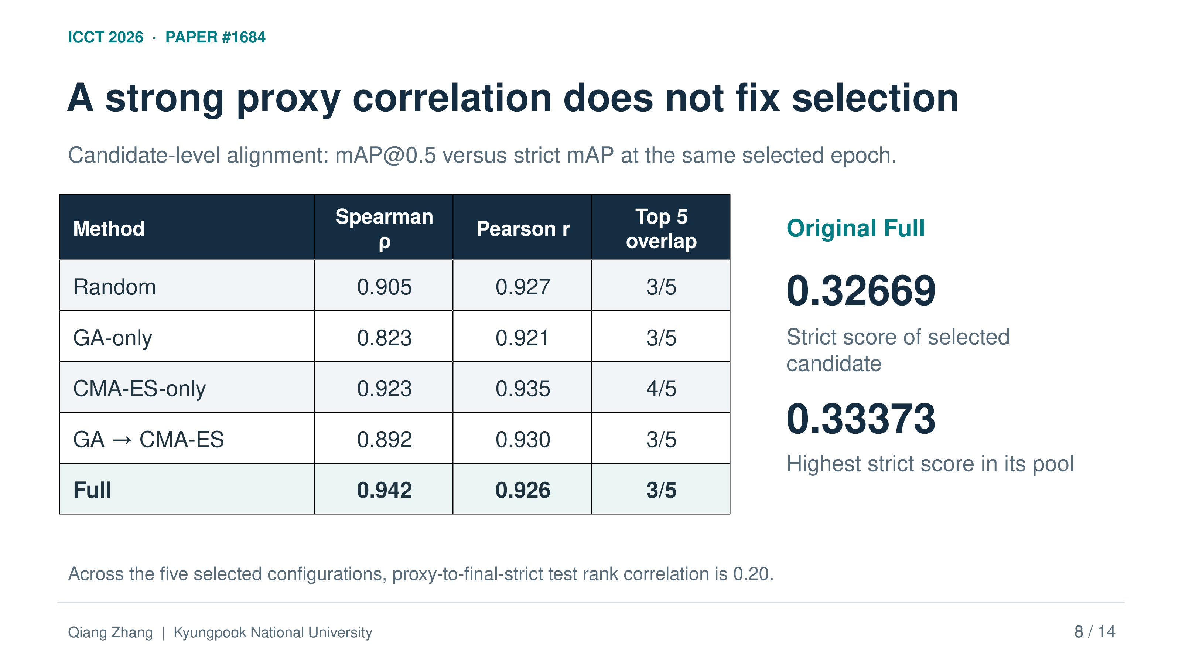
ICCT 2026 · PAPER #1684
A strong proxy correlation does not fix selection
Candidate-level alignment: mAP@0.5 versus strict mAP at the same selected epoch.
Method | Spearman ρ | Pearson r | Top 5 overlap
Random | 0.905 | 0.927 | 3/5
GA-only | 0.823 | 0.921 | 3/5
CMA-ES-only | 0.923 | 0.935 | 4/5
GA → CMA-ES | 0.892 | 0.930 | 3/5
Full | 0.942 | 0.926 | 3/5
Original Full
0.32669
Strict score of selected candidate
0.33373
Highest strict score in its pool
Across the five selected configurations, proxy-to-final-strict test rank correlation is 0.20.
Qiang Zhang | Kyungpook National University
8 / 14
Notes:
Slide 8: Strong proxy correlation does not guarantee the same winner
Target time: 55 seconds
ENGLISH SCRIPT
The original search optimizes permissive mAP, so we check how well it aligns with strict mAP. Within the Full candidate pool, Spearman correlation is zero point nine four two and Pearson correlation is zero point nine two six. However, only three candidates appear in both top-five sets. The selected candidate also falls below the pool's best same-epoch strict score. Across the five selected optimizer configurations, correlation with final strict test performance is only zero point two zero. Strong candidate-level alignment therefore does not guarantee the same winner or reliable prediction after longer training.
中文讲稿
原始搜索优化的是宽松 mAP，因此我们检查它与严格 mAP 的一致程度。在 Full 的候选集合内，Spearman 相关系数为 0.942，Pearson 相关系数为 0.926。但两个前五名集合只有三个候选重合，所选候选的同一 epoch 严格指标也低于候选池中的最佳值。在五个优化器最终选出的配置之间，代理目标与最终严格测试表现的 Spearman 相关系数仅为 0.20。因此，候选层面的强相关并不能保证选出同一个最佳配置，也不能保证准确预测更长训练后的表现。
SOURCE / EVIDENCE
Section V.E; Table 6; original Full selected same-epoch strict 0.32669 versus pool maximum 0.33373

Slide 9
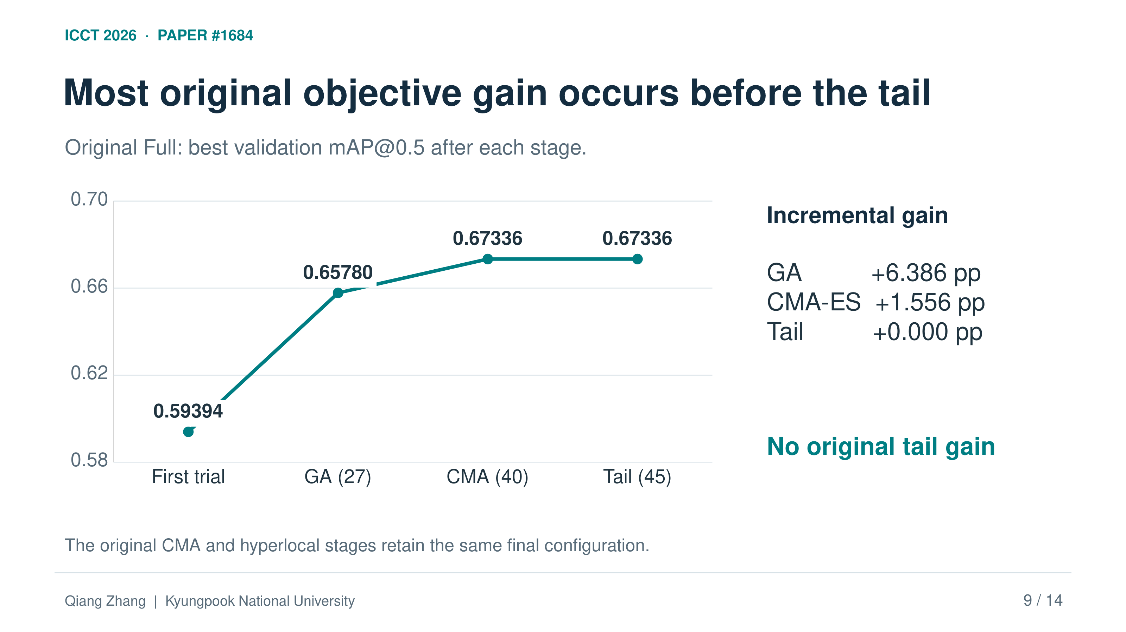
ICCT 2026 · PAPER #1684
Most original objective gain occurs before the tail
Original Full: best validation mAP@0.5 after each stage.
Incremental gain
GA +6.386 pp
CMA-ES +1.556 pp
Tail +0.000 pp
No original tail gain
The original CMA and hyperlocal stages retain the same final configuration.
Qiang Zhang | Kyungpook National University
9 / 14
Notes:
Slide 9: Original stage contributions: hyperlocal tuning added no objective gain
Target time: 55 seconds
ENGLISH SCRIPT
This slide reports the best objective observed after each original Full stage. The first candidate scores zero point five nine three nine four. GA raises it to zero point six five seven eight zero. CMA-ES then reaches zero point six seven three three six. The five hyperlocal evaluations do not improve that value. The gains are six point three eight six percentage points for GA, one point five five six for CMA-ES, and zero for hyperlocal tuning. Thus, we cannot attribute the original Full advantage to its last stage. We need a direct control of the final allocation.
中文讲稿
这一页报告原始 Full 各阶段结束后观测到的最佳目标值。第一个候选为 0.59394，GA 将其提高到 0.65780，CMA-ES 进一步达到 0.67336。最后五次超局部评估没有提高这一数值。GA、CMA-ES 和超局部微调的增量分别为 6.386、1.556 和 0 个百分点。因此，不能把原始 Full 的优势归因于最后的超局部阶段。我们需要直接控制最后阶段的预算分配来进行比较。
SOURCE / EVIDENCE
Section V.F; Table 7; GA gain relative to first proxy candidate, not 100-epoch Baseline

Slide 10
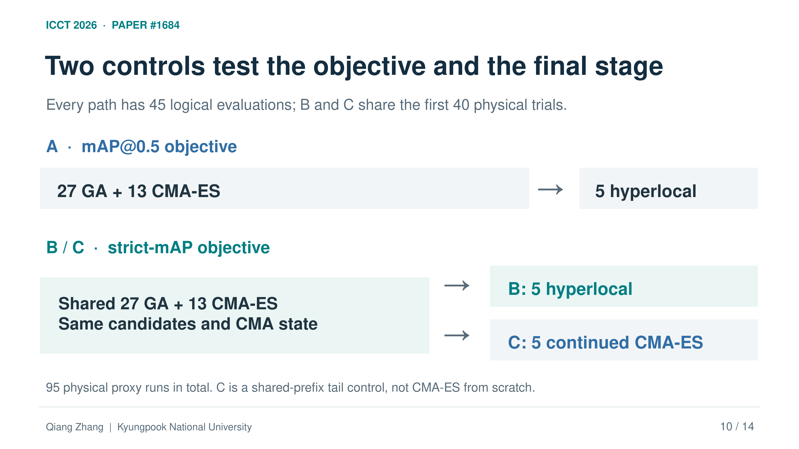
ICCT 2026 · PAPER #1684
Two controls test the objective and the final stage
Every path has 45 logical evaluations; B and C share the first 40 physical trials.
A · mAP@0.5 objective
→
27 GA + 13 CMA-ES
5 hyperlocal
B / C · strict-mAP objective
→
B: 5 hyperlocal
Shared 27 GA + 13 CMA-ES
Same candidates and CMA state
→
C: 5 continued CMA-ES
95 physical proxy runs in total. C is a shared-prefix tail control, not CMA-ES from scratch.
Qiang Zhang | Kyungpook National University
10 / 14
Notes:
Slide 10: New controls separate objective choice from final-stage allocation
Target time: 60 seconds
ENGLISH SCRIPT
We therefore define three new paths. A is Full optimizing permissive mAP. B is Full optimizing strict mAP. Both keep the twenty-seven, thirteen, and five allocation. C shares B's first forty physical evaluations and the same CMA-ES state, but spends its last five evaluations continuing CMA-ES. Comparing B with A addresses objective choice. Comparing B with C addresses the final allocation under an identical prefix. Each path still has forty-five logical evaluations. Because B and C share their prefix, the experiment requires ninety-five physical proxy runs. Each terminal winner is frozen before three-seed final training.
中文讲稿
因此，我们定义三条新路径。A 是优化宽松 mAP 的 Full，B 是优化严格 mAP 的 Full，两者都保留 27、13、5 的预算分配。C 与 B 共用前 40 次实际评估和相同的 CMA-ES 状态，但最后五次继续使用 CMA-ES。B 与 A 的比较考察目标选择，B 与 C 的比较则在相同前缀下考察最后阶段的预算分配。每条路径仍有 45 次逻辑评估。由于 B 和 C 共用前缀，整个实验只需要 95 次实际代理训练。每条路径的最终配置均在三个随机种子的最终训练前固定。
SOURCE / EVIDENCE
Section III.C; Section V.G; A/B change outer objective and selected peak epoch together

Slide 11
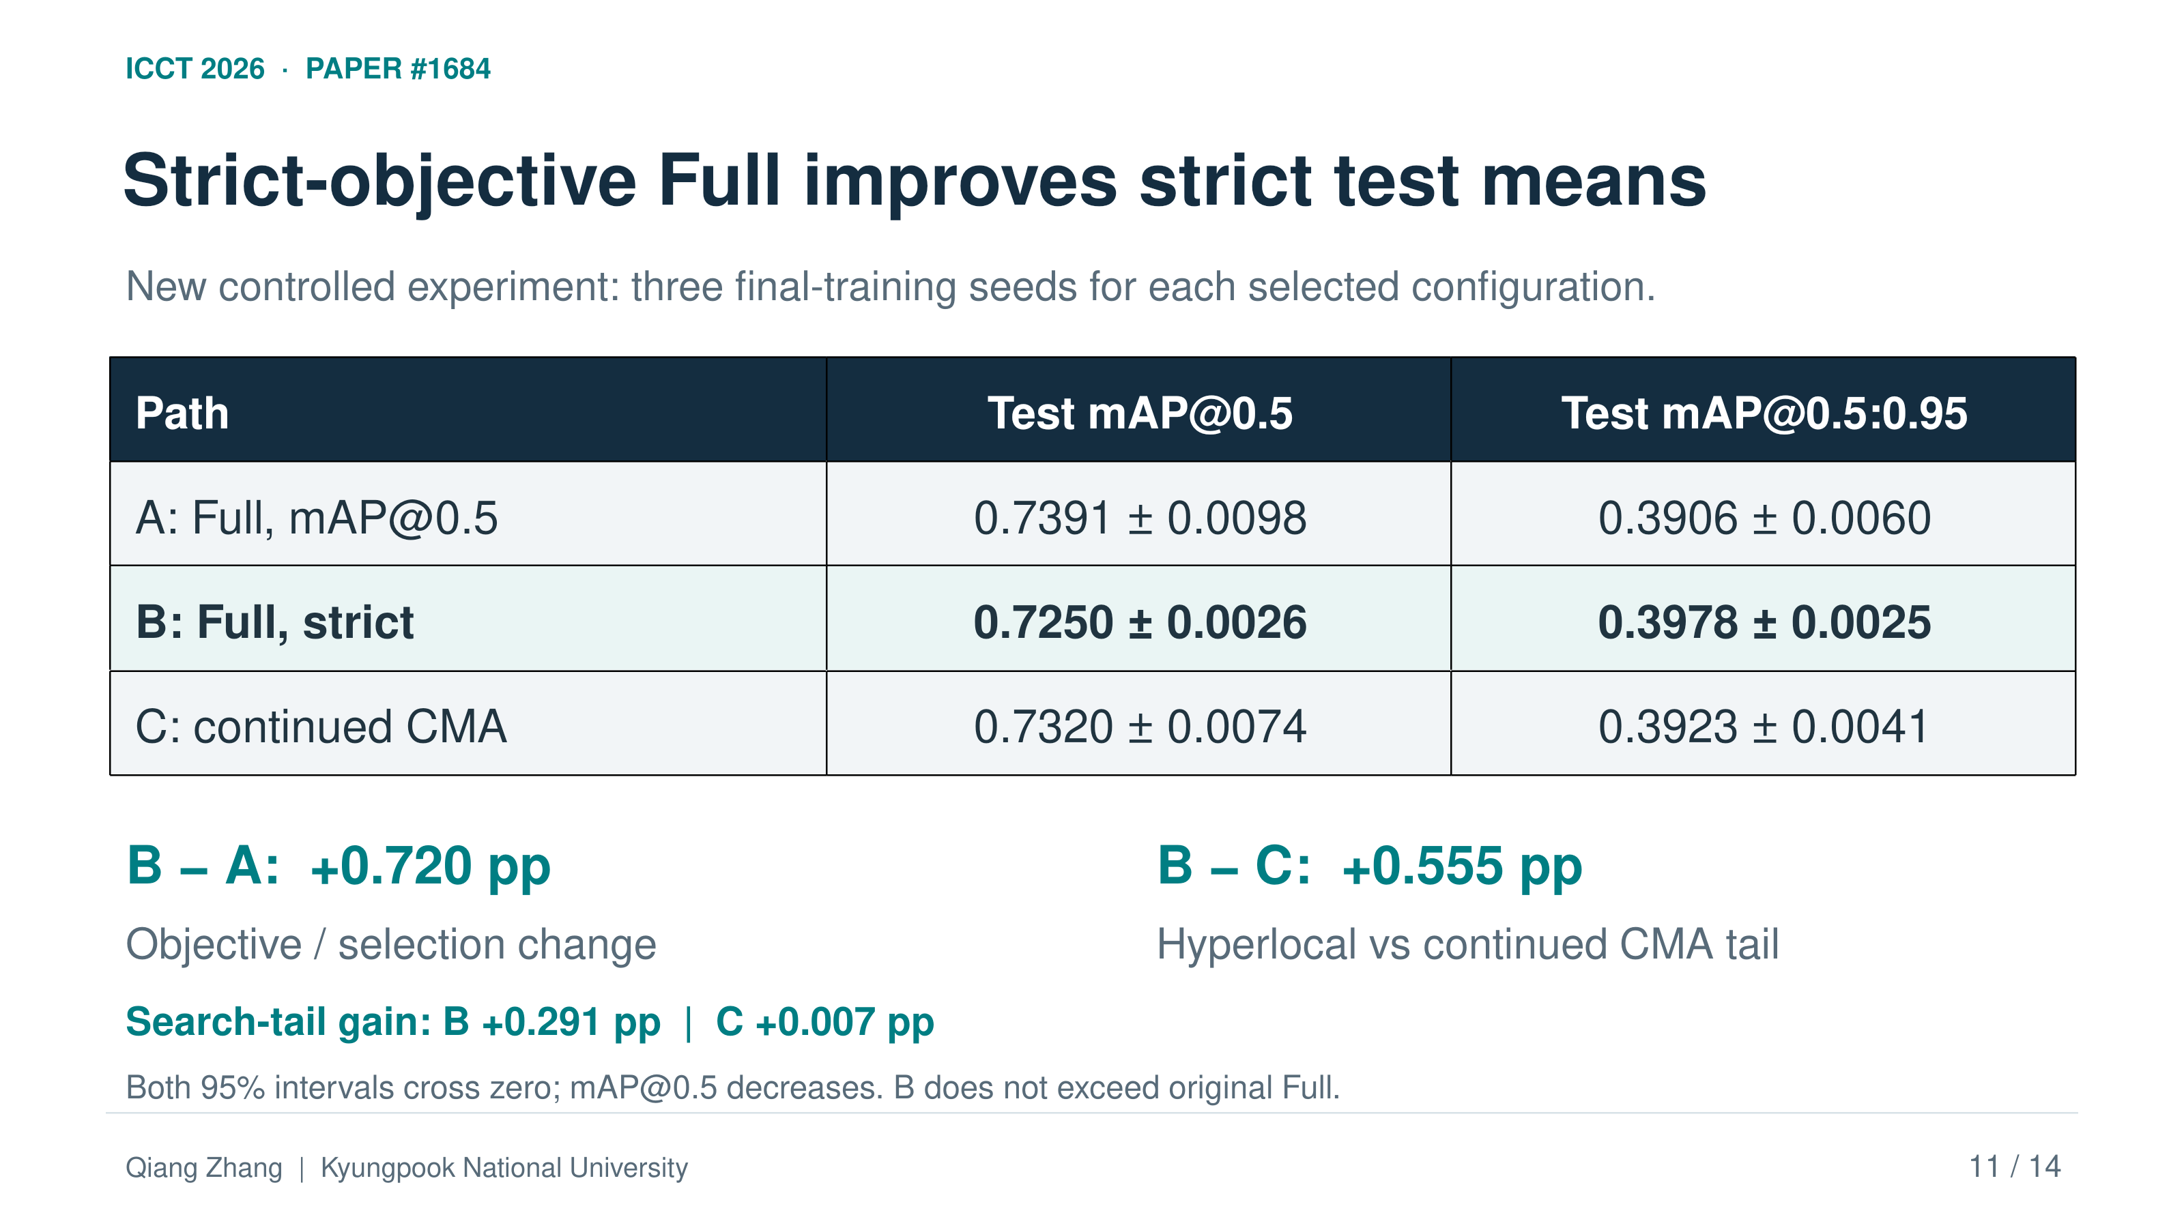
ICCT 2026 · PAPER #1684
Strict-objective Full improves strict test means
New controlled experiment: three final-training seeds for each selected configuration.
Path | Test mAP@0.5 | Test mAP@0.5:0.95
A: Full, mAP@0.5 | 0.7391 ± 0.0098 | 0.3906 ± 0.0060
B: Full, strict | 0.7250 ± 0.0026 | 0.3978 ± 0.0025
C: continued CMA | 0.7320 ± 0.0074 | 0.3923 ± 0.0041
B − A: +0.720 pp
B − C: +0.555 pp
Objective / selection change
Hyperlocal vs continued CMA tail
Search-tail gain: B +0.291 pp | C +0.007 pp
Both 95% intervals cross zero; mAP@0.5 decreases. B does not exceed original Full.
Qiang Zhang | Kyungpook National University
11 / 14
Notes:
Slide 11: The controlled experiment shows a localization tradeoff
Target time: 65 seconds
ENGLISH SCRIPT
In the strict-objective search, B's hyperlocal tail adds zero point two nine one percentage points, while C's continued CMA-ES adds zero point zero zero seven. On the test split, B improves strict mAP by zero point seven two zero points over A, and zero point five five five over C. Both differences are positive in all three matched pairs, but both confidence intervals include zero. B also has lower permissive mAP. These results support a conditional localization tradeoff. They do not establish a universal benefit. The new B winner remains below the original Full strict mean, so these are separate matched comparisons.
中文讲稿
在严格目标搜索中，B 的超局部阶段增加 0.291 个百分点，而 C 继续 CMA-ES 仅增加 0.007 个百分点。在测试集上，B 的严格 mAP 相对 A 提升 0.720 个百分点，相对 C 提升 0.555 个百分点。两种差值在三个匹配种子中都为正，但两者的置信区间都包含零。同时，B 的宽松 mAP 更低。这些结果支持有条件的定位权衡，不能证明普遍收益。新 B 的严格均值仍低于原始 Full，因此应将它们视为独立的匹配比较。
SOURCE / EVIDENCE
Sections V.F–G; Tables 7–8; B−A strict interval [−0.587,2.028] pp; B−C [−0.822,1.931] pp; both exact sign-flip p=0.25

Slide 12
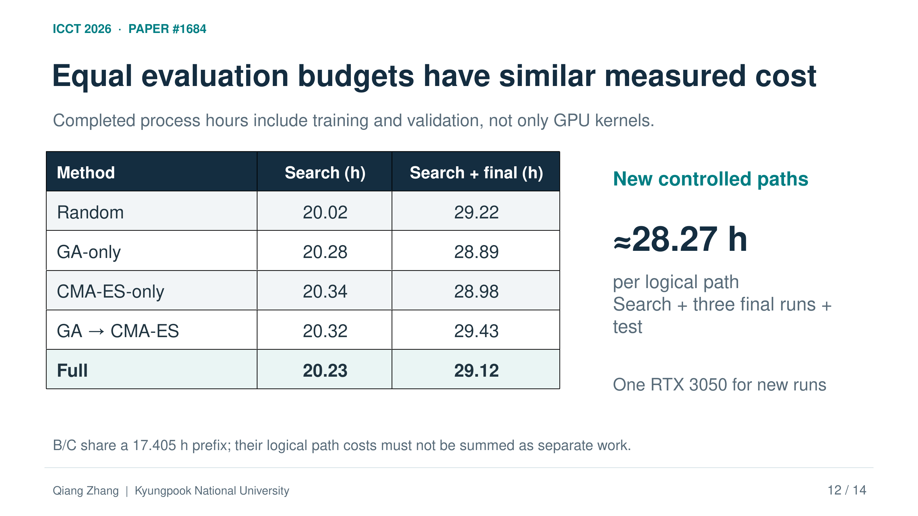
ICCT 2026 · PAPER #1684
Equal evaluation budgets have similar measured cost
Completed process hours include training and validation, not only GPU kernels.
Method | Search (h) | Search + final (h)
Random | 20.02 | 29.22
GA-only | 20.28 | 28.89
CMA-ES-only | 20.34 | 28.98
GA → CMA-ES | 20.32 | 29.43
Full | 20.23 | 29.12
New controlled paths
≈28.27 h
per logical path
Search + three final runs + test
One RTX 3050 for new runs
B/C share a 17.405 h prefix; their logical path costs must not be summed as separate work.
Qiang Zhang | Kyungpook National University
12 / 14
Notes:
Slide 12: Measured computation: nearly equal cost per completed path
Target time: 35 seconds
ENGLISH SCRIPT
Original Full takes twenty point two three hours for search, or twenty-nine point one two hours including three final-training runs. New completed paths each take about twenty-eight point two seven hours, including tests. These are training and evaluation process times, not GPU-kernel hours. B and C share their prefix, so their logical totals cannot be added as independent physical workloads.
中文讲稿
原始 Full 的搜索耗时为 20.23 小时，加上三次最终训练后为 29.12 小时。新实验的每条完整路径包含测试的总耗时都约为 28.27 小时。这些是训练和评估进程的实际经过时间，不是 GPU 内核计算时长。B 和 C 共用前缀，因此不能把两条逻辑路径的总时间相加并视作彼此独立的实际工作量。
SOURCE / EVIDENCE
Section V.H; Tables 9–10; new tests included, original separate testing excluded

Slide 13
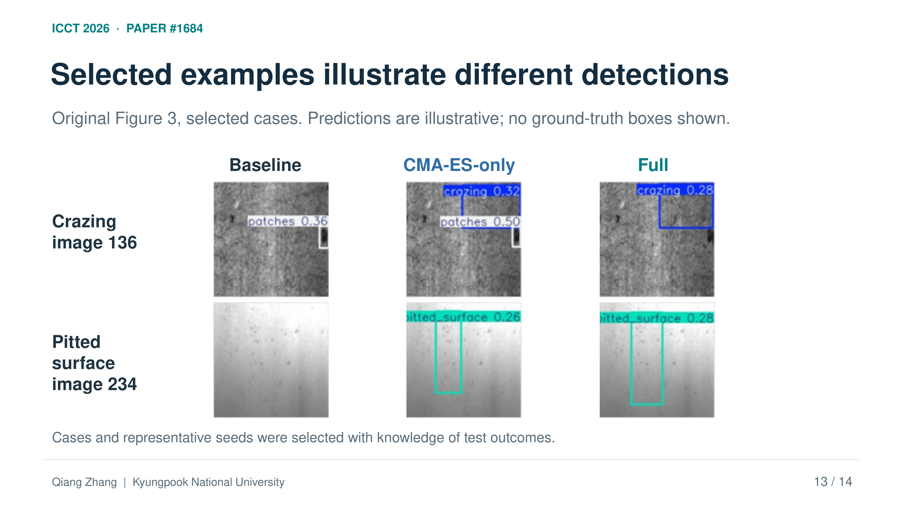
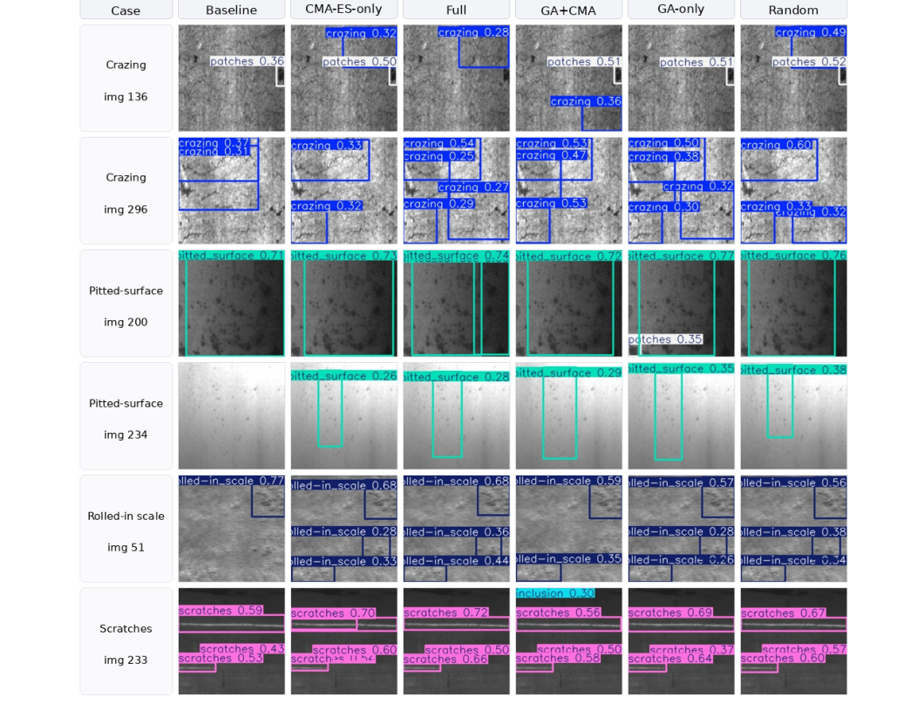
ICCT 2026 · PAPER #1684
Selected examples illustrate different detections
Original Figure 3, selected cases. Predictions are illustrative; no ground-truth boxes shown.
Baseline
CMA-ES-only
Full
Crazing
image 136
Pitted surface
image 234
Cases and representative seeds were selected with knowledge of test outcomes.
Qiang Zhang | Kyungpook National University
13 / 14
Notes:
Slide 13: Selected examples illustrate different prediction behavior
Target time: 40 seconds
ENGLISH SCRIPT
These selected examples compare Baseline, CMA-ES-only, and Full. In crazing image one hundred thirty-six, Full predicts crazing, while Baseline predicts patches. In pitted-surface image two hundred thirty-four, Baseline shows no box, while the HPO methods detect the defect. These cases were selected with knowledge of test outcomes, and ground-truth boxes are not drawn. They illustrate behavior, rather than providing an unbiased quantitative comparison.
中文讲稿
这些选出的示例比较 Baseline、仅 CMA-ES 和 Full。在 crazing 第 136 张图像中，Full 预测为 crazing，而 Baseline 预测为 patches。在 pitted_surface 第 234 张图像中，Baseline 没有显示检测框，而采用超参数优化的方法检测到了缺陷。这些示例是在已知测试结果的情况下选择的，且未绘制真实标注框。它们用于说明预测行为，而不是提供无偏的定量比较。
SOURCE / EVIDENCE
Section V.I; selected rows and columns from Figure 3

Slide 14
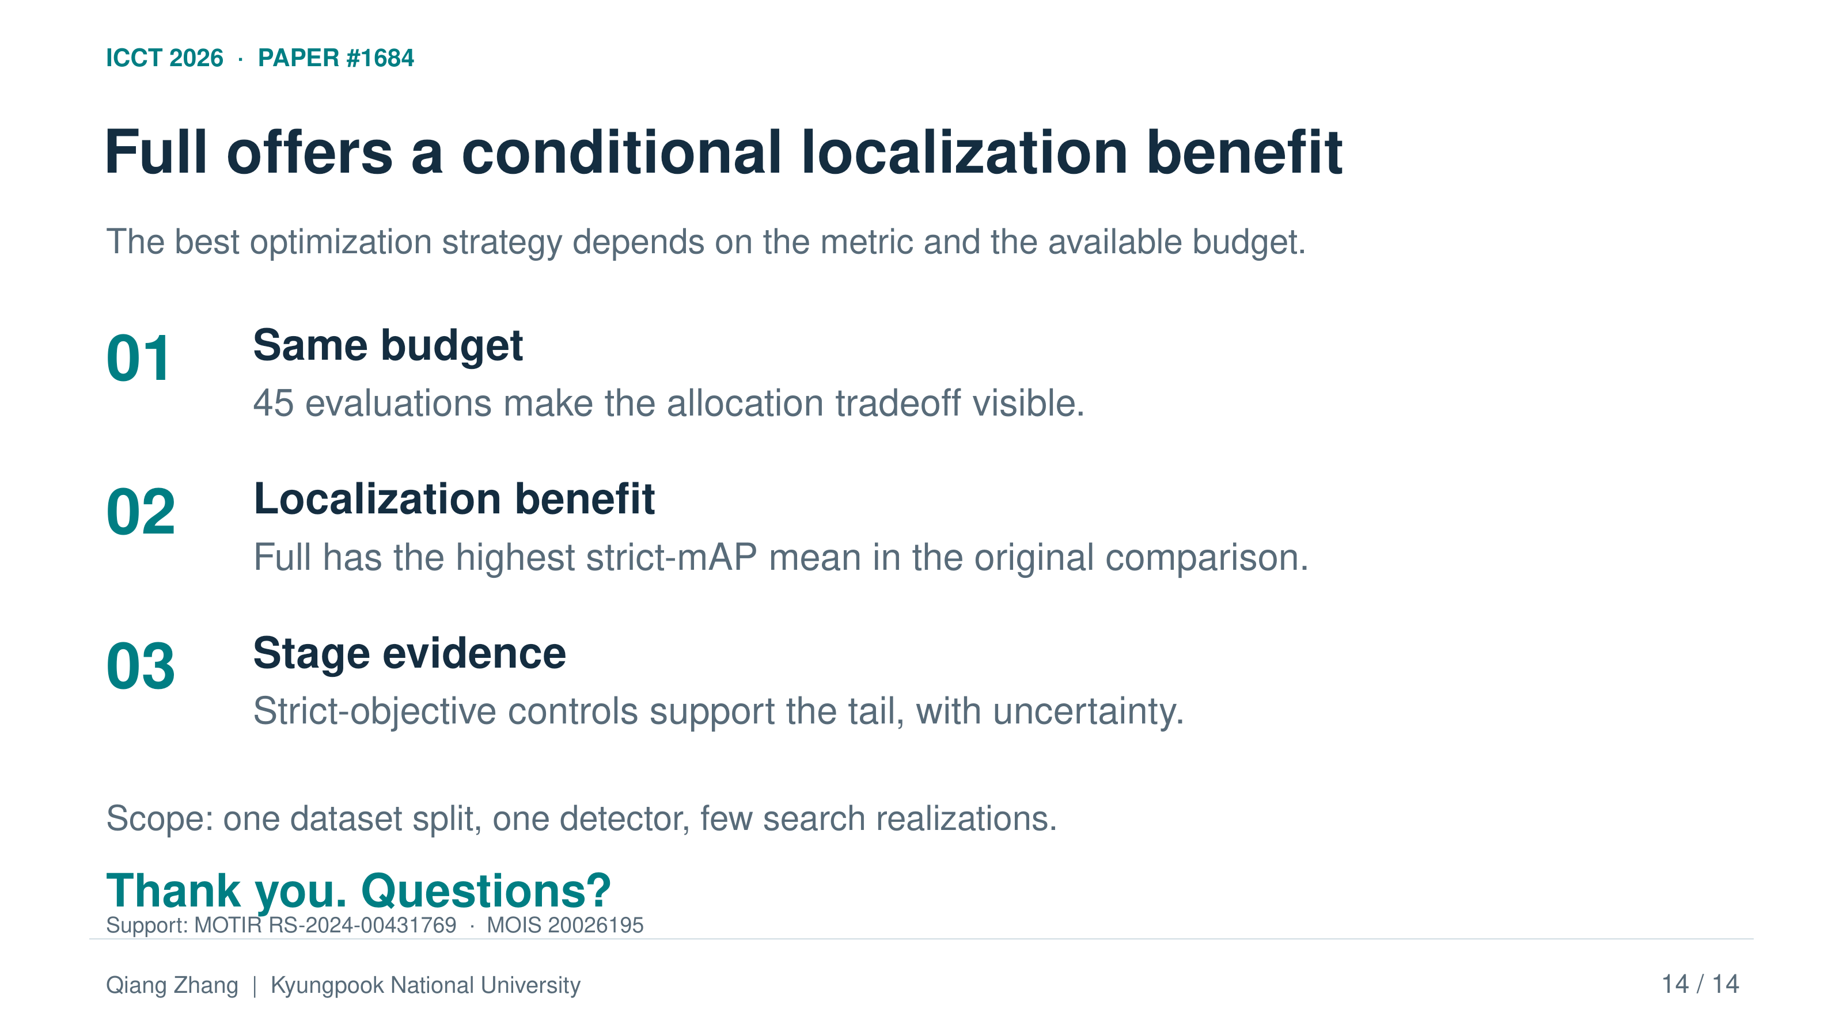
ICCT 2026 · PAPER #1684
Full offers a conditional localization benefit
The best optimization strategy depends on the metric and the available budget.
01
Same budget
45 evaluations make the allocation tradeoff visible.
02
Localization benefit
Full has the highest strict-mAP mean in the original comparison.
03
Stage evidence
Strict-objective controls support the tail, with uncertainty.
Scope: one dataset split, one detector, few search realizations.
Thank you. Questions?
Support: MOTIR RS-2024-00431769 · MOIS 20026195
Qiang Zhang | Kyungpook National University
14 / 14
Notes:
Slide 14: Conclusion: choose the method together with the metric
Target time: 50 seconds
ENGLISH SCRIPT
To conclude, equal budgets make the comparison interpretable. Full gives the highest original strict test mean and improves on Baseline in the five-seed extension. However, CMA-ES-only remains competitive, especially for permissive detection. The new controls show that objective choice and final-stage allocation can affect localization, with substantial uncertainty. Our evidence is limited to one dataset split and one detector, and training seeds do not replicate the search process. The practical message is to choose the optimization method together with the target metric. Thank you to our research funders, and thank you for listening.
中文讲稿
最后总结，相同预算使比较更容易解释。Full 获得原始实验中最高的严格测试均值，并在五种子扩展中优于 Baseline。不过，仅 CMA-ES 仍然很有竞争力，特别是在宽松检测指标上。新增对照表明，目标选择和最后阶段的预算分配能够影响定位表现，但仍存在较大的不确定性。我们的依据仅来自一个数据集划分和一种检测器，训练种子的重复也不等于搜索过程的重复。实际启示是：优化方法应与目标评价指标一起选择。感谢本研究的资助方，也感谢大家聆听。
SOURCE / EVIDENCE
Sections V.J and VI; Section VII, Acknowledgement
ACKNOWLEDGEMENT
This work was supported by the Ministry of Trade, Industry and Resources (MOTIR), Republic of Korea, under Grant No. RS-2024-00431769, and by the Ministry of the Interior and Safety (MOIS, Korea) under Development of Technology in Cooperation with the Ministry of Disaster and Safety Program (No. 20026195).

Slide 15
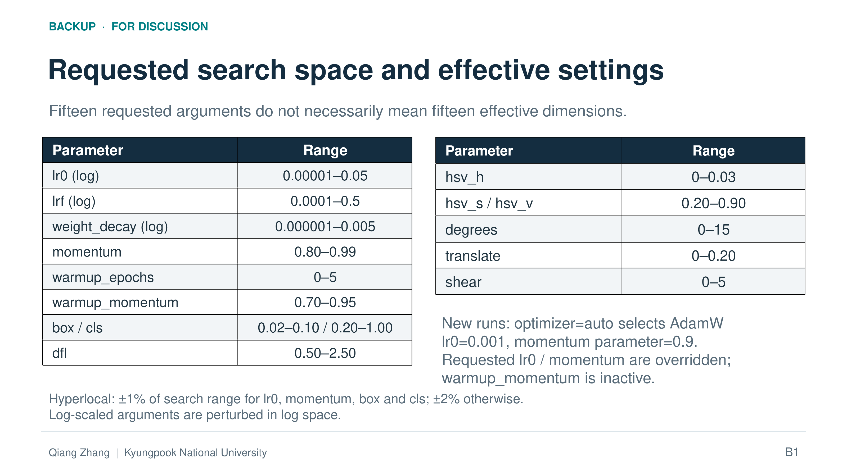
BACKUP · FOR DISCUSSION
Requested search space and effective settings
Fifteen requested arguments do not necessarily mean fifteen effective dimensions.
Parameter | Range
lr0 (log) | 0.00001–0.05
lrf (log) | 0.0001–0.5
weight_decay (log) | 0.000001–0.005
momentum | 0.80–0.99
warmup_epochs | 0–5
warmup_momentum | 0.70–0.95
box / cls | 0.02–0.10 / 0.20–1.00
dfl | 0.50–2.50
Parameter | Range
hsv_h | 0–0.03
hsv_s / hsv_v | 0.20–0.90
degrees | 0–15
translate | 0–0.20
shear | 0–5
New runs: optimizer=auto selects AdamW
lr0=0.001, momentum parameter=0.9.
Requested lr0 / momentum are overridden;
warmup_momentum is inactive.
Hyperlocal: ±1% of search range for lr0, momentum, box and cls; ±2% otherwise.
Log-scaled arguments are perturbed in log space.
Qiang Zhang | Kyungpook National University
B1
Notes:
Slide 15: Backup: requested search space and optimizer behavior
Backup slide: use during Q&A only
ENGLISH SCRIPT
The search space includes fifteen requested arguments for optimization, warmup, loss weights, and augmentation. The learning-rate parameters and weight decay use logarithmic scaling; the other variables use linear scaling. However, requested dimensions are not necessarily effective dimensions. With optimizer set to auto, the verified new runs select AdamW and override the requested initial learning rate and momentum. Warmup momentum is inactive on this optimizer path. All compared paths retain this same implementation. We therefore describe fifteen requested arguments, rather than claiming fifteen independently effective tuning dimensions.
中文讲稿
搜索空间包含 15 个请求参数，涉及优化、预热、损失权重和数据增强。学习率相关参数及权重衰减使用对数缩放，其他变量使用线性缩放。但请求维度不一定等于实际有效维度。在 optimizer 设置为 auto 的情况下，经核验的新实验选择 AdamW，并覆盖请求的初始学习率和 momentum；此优化器路径上的 warmup_momentum 不起作用。所有比较路径保留相同实现。因此，我们表述为 15 个请求参数，而不会声称它们是 15 个彼此独立有效的调优维度。
SOURCE / EVIDENCE
Section III.B, Shared Requested Search Space

Slide 16
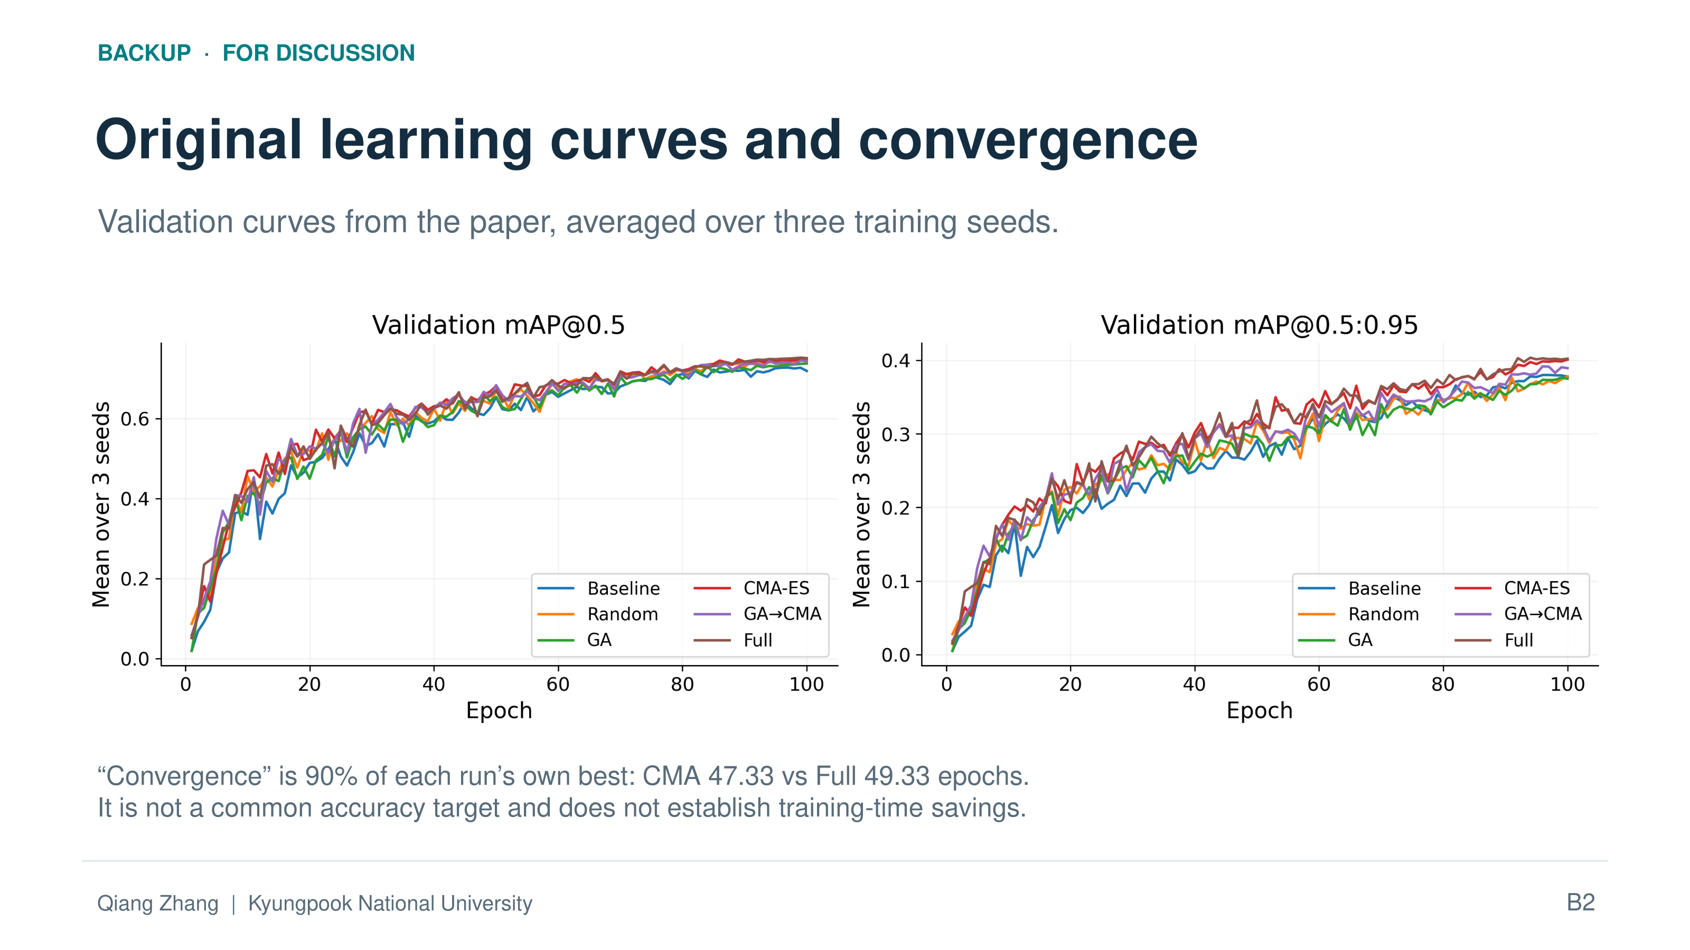
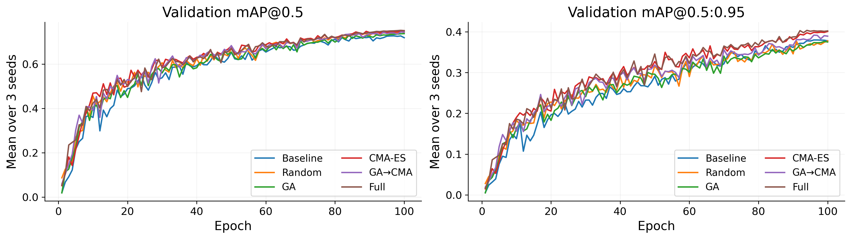
BACKUP · FOR DISCUSSION
Original learning curves and convergence
Validation curves from the paper, averaged over three training seeds.
“Convergence” is 90% of each run’s own best: CMA 47.33 vs Full 49.33 epochs.
It is not a common accuracy target and does not establish training-time savings.
Qiang Zhang | Kyungpook National University
B2
Notes:
Slide 16: Backup: learning curves and convergence definition
Backup slide: use during Q&A only
ENGLISH SCRIPT
The convergence indicator is the first epoch reaching ninety percent of each run's own best validation mAP at zero point five. Baseline reaches it at fifty-two point six seven epochs on average, CMA-ES-only at forty-seven point three three, and Full at forty-nine point three three. The threshold is relative to each individual run, so the absolute target differs. Earlier crossing describes the shape of the learning curve. It does not demonstrate fewer training epochs or measured compute savings, because every final run is trained for one hundred epochs.
中文讲稿
收敛指标定义为：首次达到该次训练自身最佳验证 mAP@0.5 的 90% 时的 epoch。Baseline 平均为 52.67，仅 CMA-ES 为 47.33，Full 为 49.33。阈值相对于各次训练自身的最佳结果，因此不同训练的绝对目标值并不相同。更早达到阈值描述的是学习曲线形状，不能证明训练 epoch 减少或实际计算开销降低，因为所有最终训练都进行 100 个 epoch。
SOURCE / EVIDENCE
Section V.D; Table 2; Figure 2

Slide 17
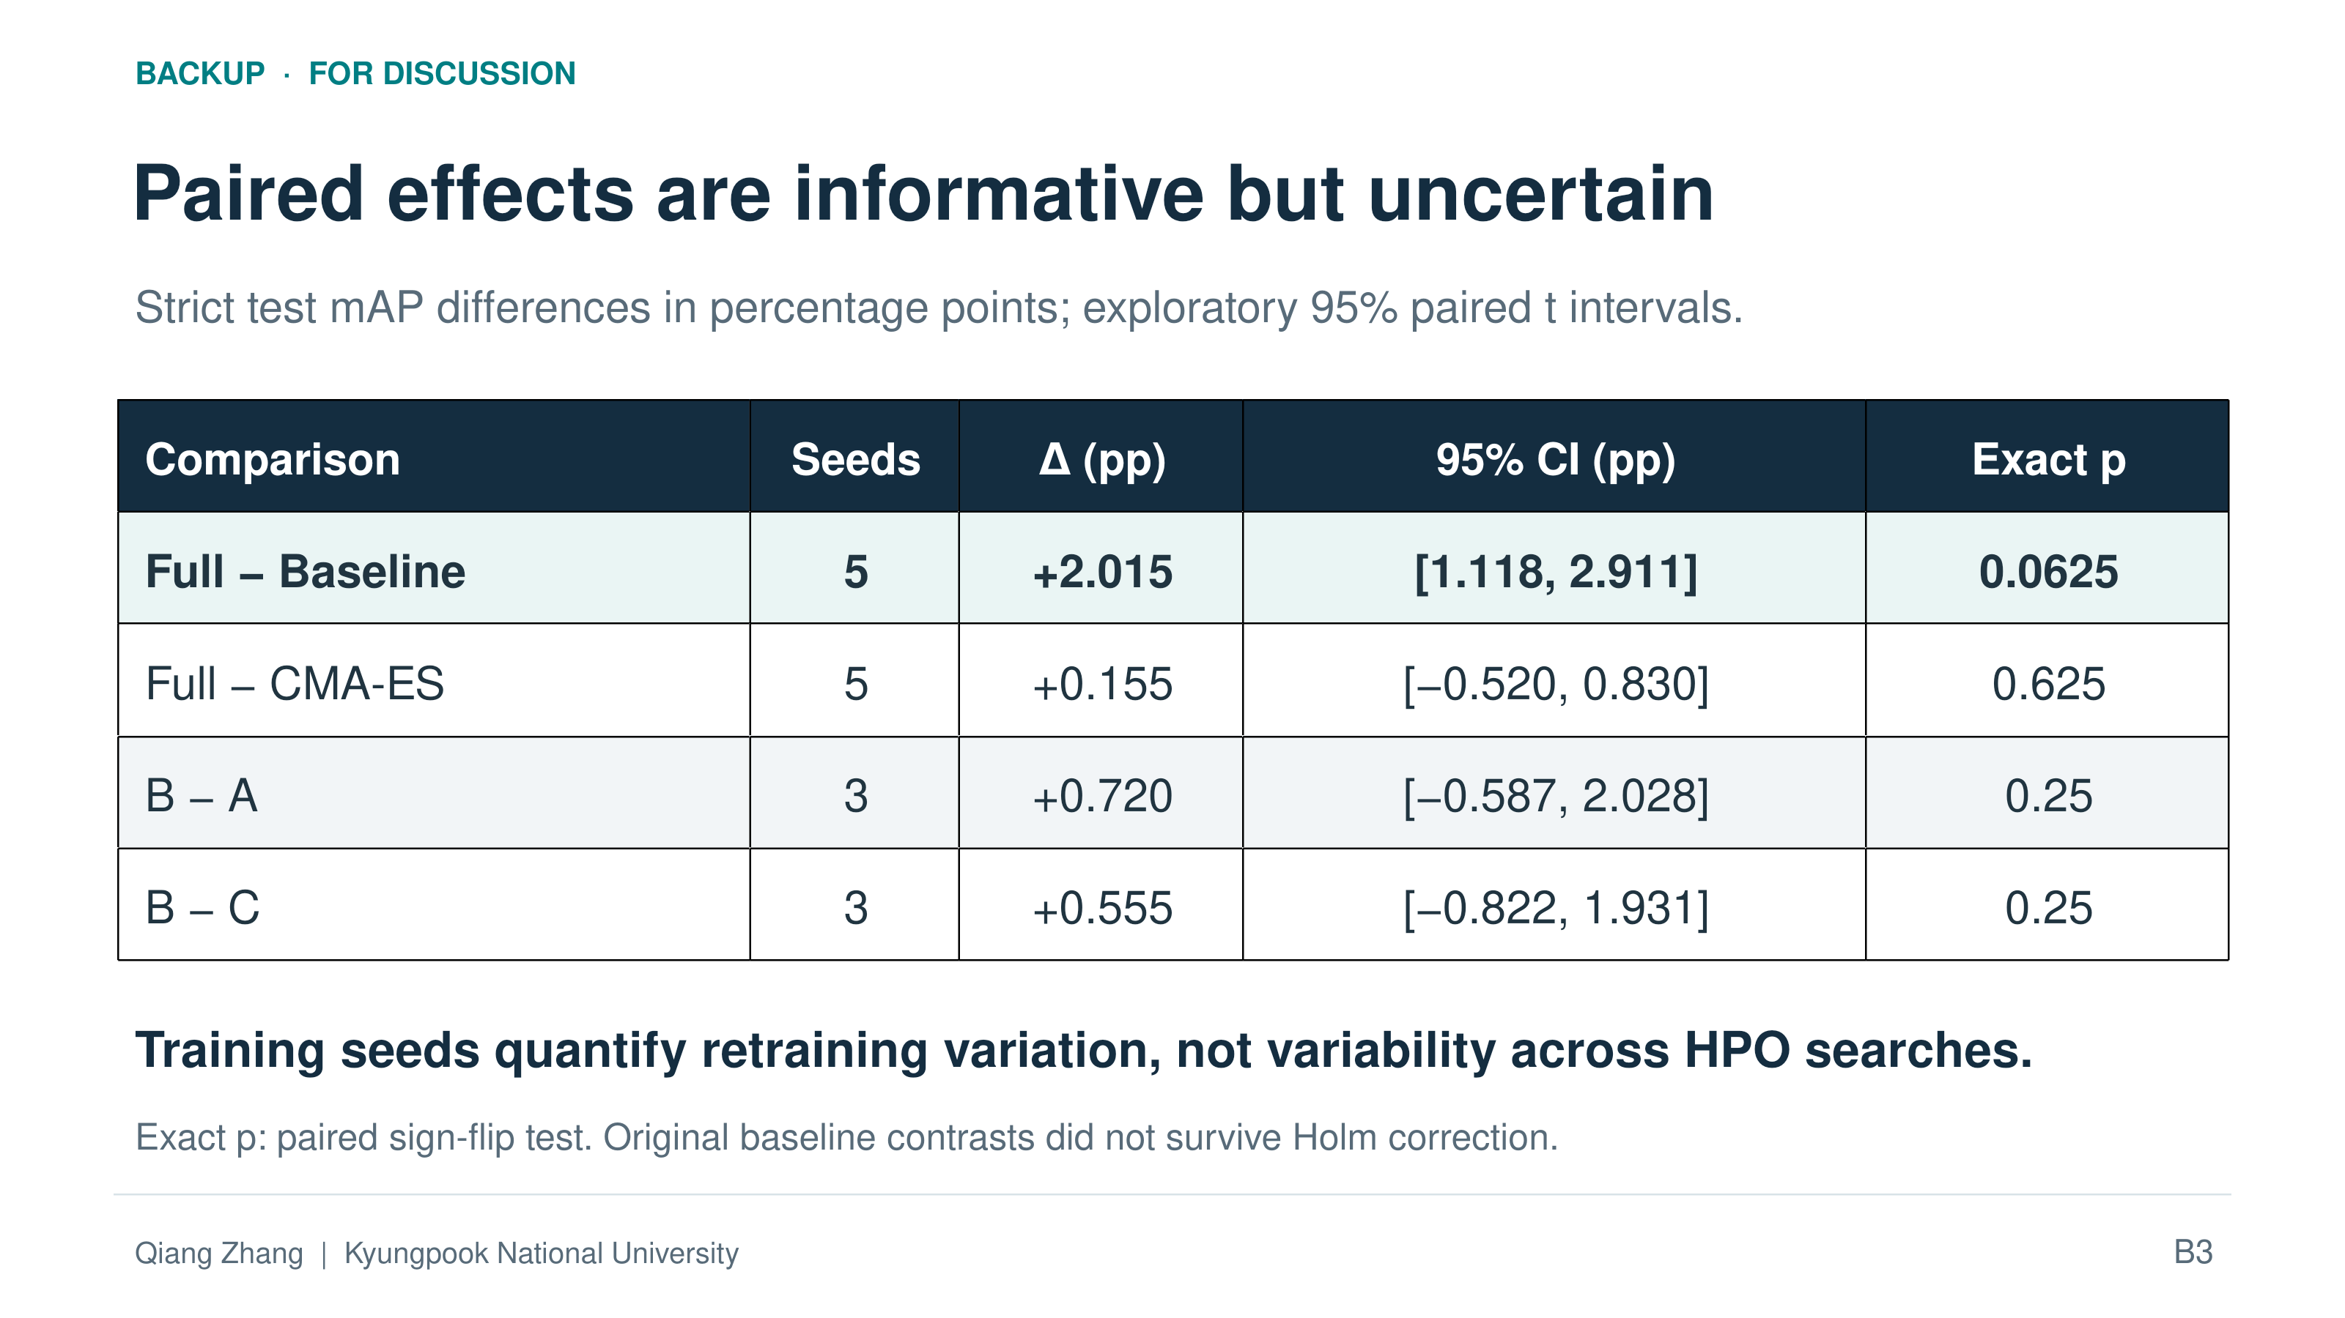
BACKUP · FOR DISCUSSION
Paired effects are informative but uncertain
Strict test mAP differences in percentage points; exploratory 95% paired t intervals.
Comparison | Seeds | Δ (pp) | 95% CI (pp) | Exact p
Full − Baseline | 5 | +2.015 | [1.118, 2.911] | 0.0625
Full − CMA-ES | 5 | +0.155 | [−0.520, 0.830] | 0.625
B − A | 3 | +0.720 | [−0.587, 2.028] | 0.25
B − C | 3 | +0.555 | [−0.822, 1.931] | 0.25
Training seeds quantify retraining variation, not variability across HPO searches.
Exact p: paired sign-flip test. Original baseline contrasts did not survive Holm correction.
Qiang Zhang | Kyungpook National University
B3
Notes:
Slide 17: Backup: paired uncertainty and small-sample checks
Backup slide: use during Q&A only
ENGLISH SCRIPT
This table shows paired differences, exploratory ninety-five percent t intervals, and exact two-sided sign-flip tests. In the five-seed extension, the Full minus Baseline interval is above zero, but the exact p-value is zero point zero six two five. The Full minus CMA-ES interval spans zero. For the new B minus A and B minus C comparisons, all three differences are positive, but both intervals span zero and both exact p-values are zero point two five. These checks explain why we describe observed improvements cautiously.
中文讲稿
此表报告成对差值、探索性的 95% t 区间，以及精确双侧符号翻转检验。五种子扩展中，Full 减 Baseline 的区间高于零，但精确 p 值为 0.0625。Full 减 CMA-ES 的区间包含零。新实验中，B 减 A 和 B 减 C 的三个种子差值都为正，但两者区间均包含零，且精确 p 值都为 0.25。这些检查说明了为什么我们需要谨慎表述观测到的改善。
SOURCE / EVIDENCE
Sections V.A–B and V.G; paired intervals and exact sign-flip p-values

Slide 18
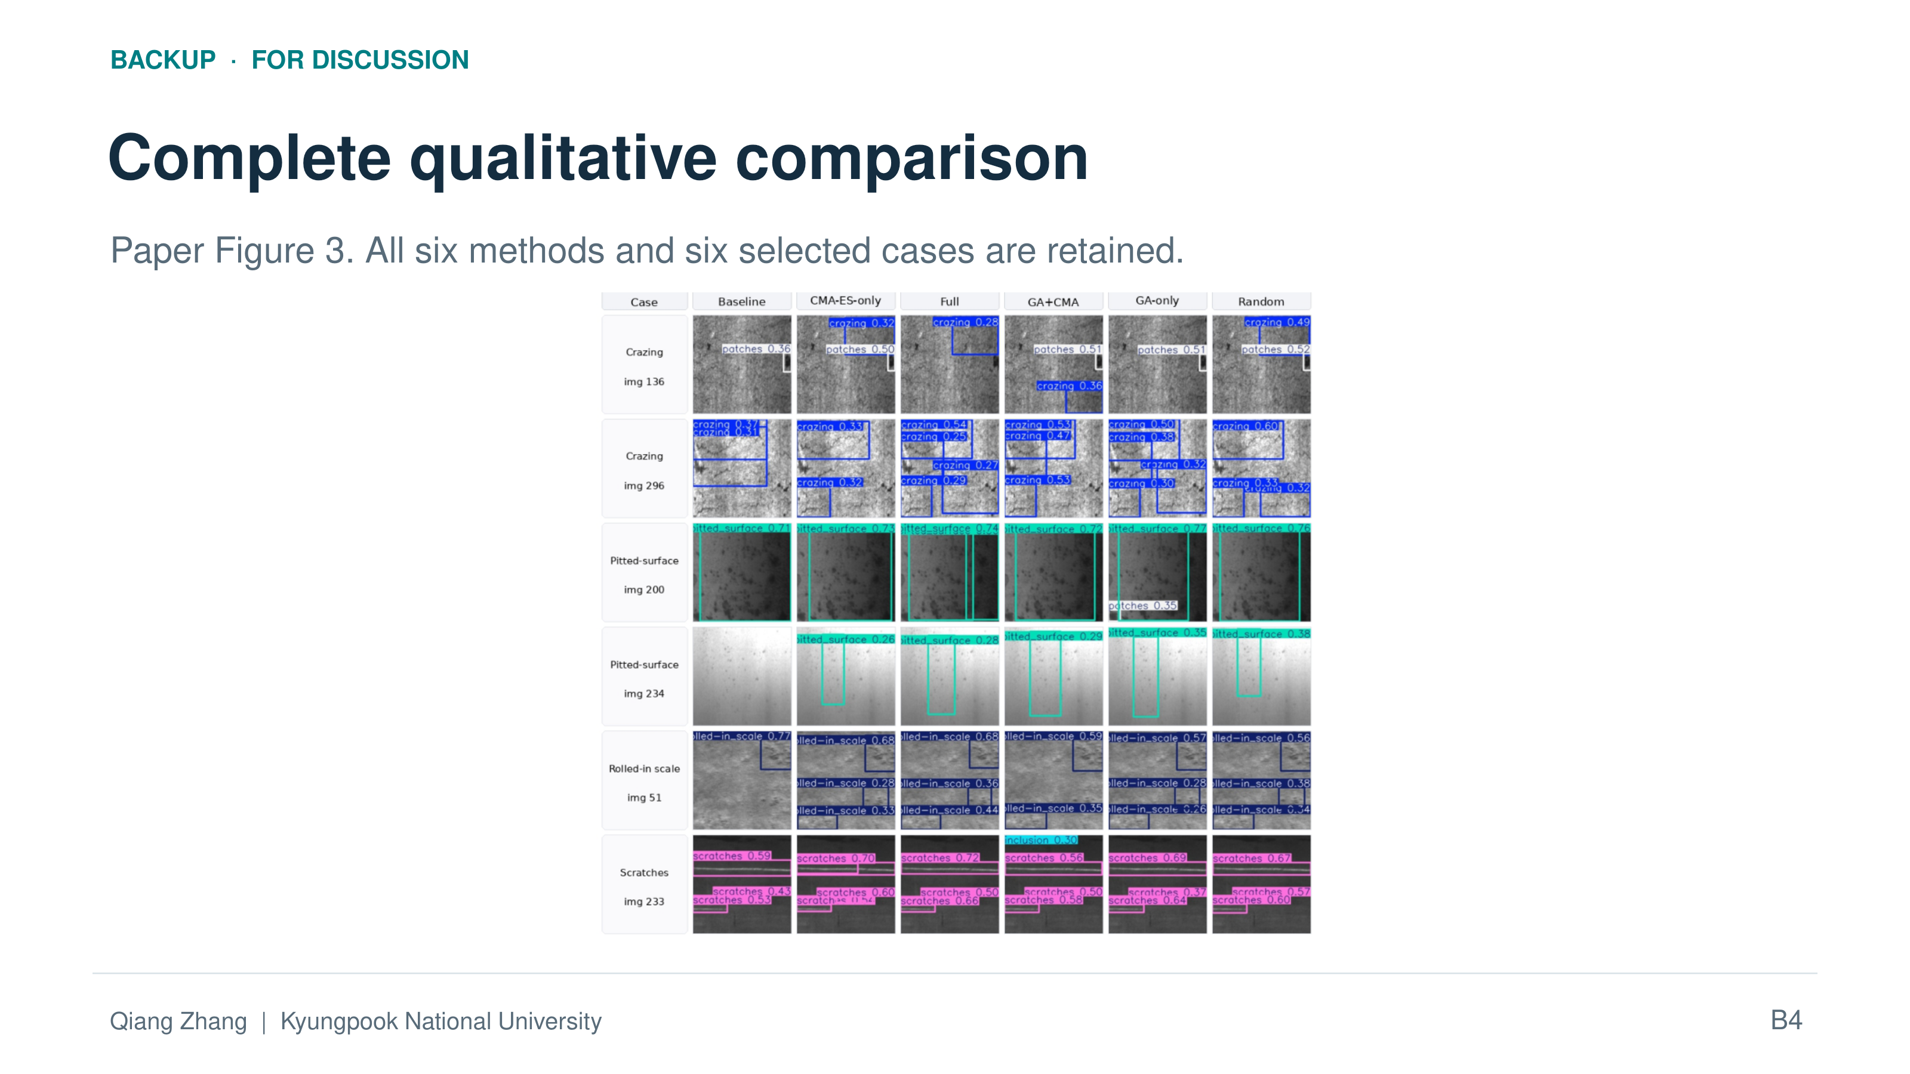
BACKUP · FOR DISCUSSION
Complete qualitative comparison
Paper Figure 3. All six methods and six selected cases are retained.
Qiang Zhang | Kyungpook National University
B4
Notes:
Slide 18: Backup: full qualitative comparison
Backup slide: use during Q&A only
ENGLISH SCRIPT
This is the complete original same-image comparison across Baseline and the five HPO strategies. It includes crazing, pitted-surface, and scratches examples. For scratches image two hundred thirty-three, all methods detect elongated regions, and GA followed by CMA-ES additionally predicts an inclusion. These images help discuss classification and detection differences. However, the examples and representative seeds were selected after examining test outcomes, and no ground-truth boxes are displayed. They cannot establish average localization error, false-positive rates, or reduced manual inspection cost.
中文讲稿
这里是 Baseline 与五种超参数优化策略的完整原始同图比较，包括 crazing、pitted_surface 和 scratches 示例。在 scratches 第 233 张图像中，所有方法都检测到细长区域，而 GA 后接 CMA-ES 还额外预测了 inclusion。这些图像有助于讨论分类与检测行为的差异。不过，示例和代表性种子是在查看测试结果后选择的，图中也没有显示真实标注框，因此不能据此确定平均定位误差、误报率或人工检查成本的减少。
SOURCE / EVIDENCE
Section V.I; Figure 3

Slide 19
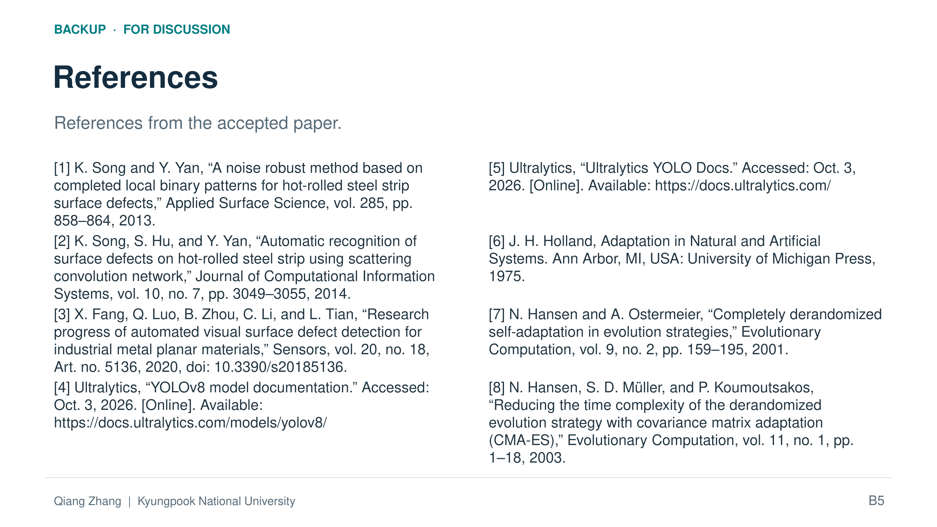
BACKUP · FOR DISCUSSION
References
References from the accepted paper.
[1] K. Song and Y. Yan, “A noise robust method based on completed local binary patterns for hot-rolled steel strip surface defects,” Applied Surface Science, vol. 285, pp. 858–864, 2013.
[5] Ultralytics, “Ultralytics YOLO Docs.” Accessed: Oct. 3, 2026. [Online]. Available: https://docs.ultralytics.com/
[2] K. Song, S. Hu, and Y. Yan, “Automatic recognition of surface defects on hot-rolled steel strip using scattering convolution network,” Journal of Computational Information Systems, vol. 10, no. 7, pp. 3049–3055, 2014.
[6] J. H. Holland, Adaptation in Natural and Artificial Systems. Ann Arbor, MI, USA: University of Michigan Press, 1975.
[3] X. Fang, Q. Luo, B. Zhou, C. Li, and L. Tian, “Research progress of automated visual surface defect detection for industrial metal planar materials,” Sensors, vol. 20, no. 18, Art. no. 5136, 2020, doi: 10.3390/s20185136.
[7] N. Hansen and A. Ostermeier, “Completely derandomized self-adaptation in evolution strategies,” Evolutionary Computation, vol. 9, no. 2, pp. 159–195, 2001.
[4] Ultralytics, “YOLOv8 model documentation.” Accessed: Oct. 3, 2026. [Online]. Available: https://docs.ultralytics.com/models/yolov8/
[8] N. Hansen, S. D. Müller, and P. Koumoutsakos, “Reducing the time complexity of the derandomized evolution strategy with covariance matrix adaptation (CMA-ES),” Evolutionary Computation, vol. 11, no. 1, pp. 1–18, 2003.
Qiang Zhang | Kyungpook National University
B5
Notes:
Slide 19: Backup: references
Backup slide: use during Q&A only
ENGLISH SCRIPT
These references provide the background for steel surface inspection, the detector implementation, and the optimization methods. The steel-defect studies and review motivate the inspection problem. The Ultralytics documentation identifies the YOLO implementation used for the controlled comparison. Holland provides the genetic-algorithm foundation, and the Hansen papers describe CMA-ES. Our contribution is the controlled comparison and the analysis of objectives and stages in this setting. We do not claim to have invented GA, CMA-ES, or a new detector architecture.
中文讲稿
这些参考文献提供了钢铁表面检测、检测器实现和优化方法的背景。钢铁缺陷研究及综述说明了检测问题的研究动机；Ultralytics 文档对应本研究受控比较所使用的 YOLO 实现；Holland 的著作提供遗传算法基础，Hansen 等人的论文介绍 CMA-ES。我们的贡献是在这一场景中的受控比较，以及对优化目标和各阶段作用的分析，并不声称发明了 GA、CMA-ES 或新的检测器架构。
SOURCE / EVIDENCE
Section II; References [1]–[8]

