Slide 1


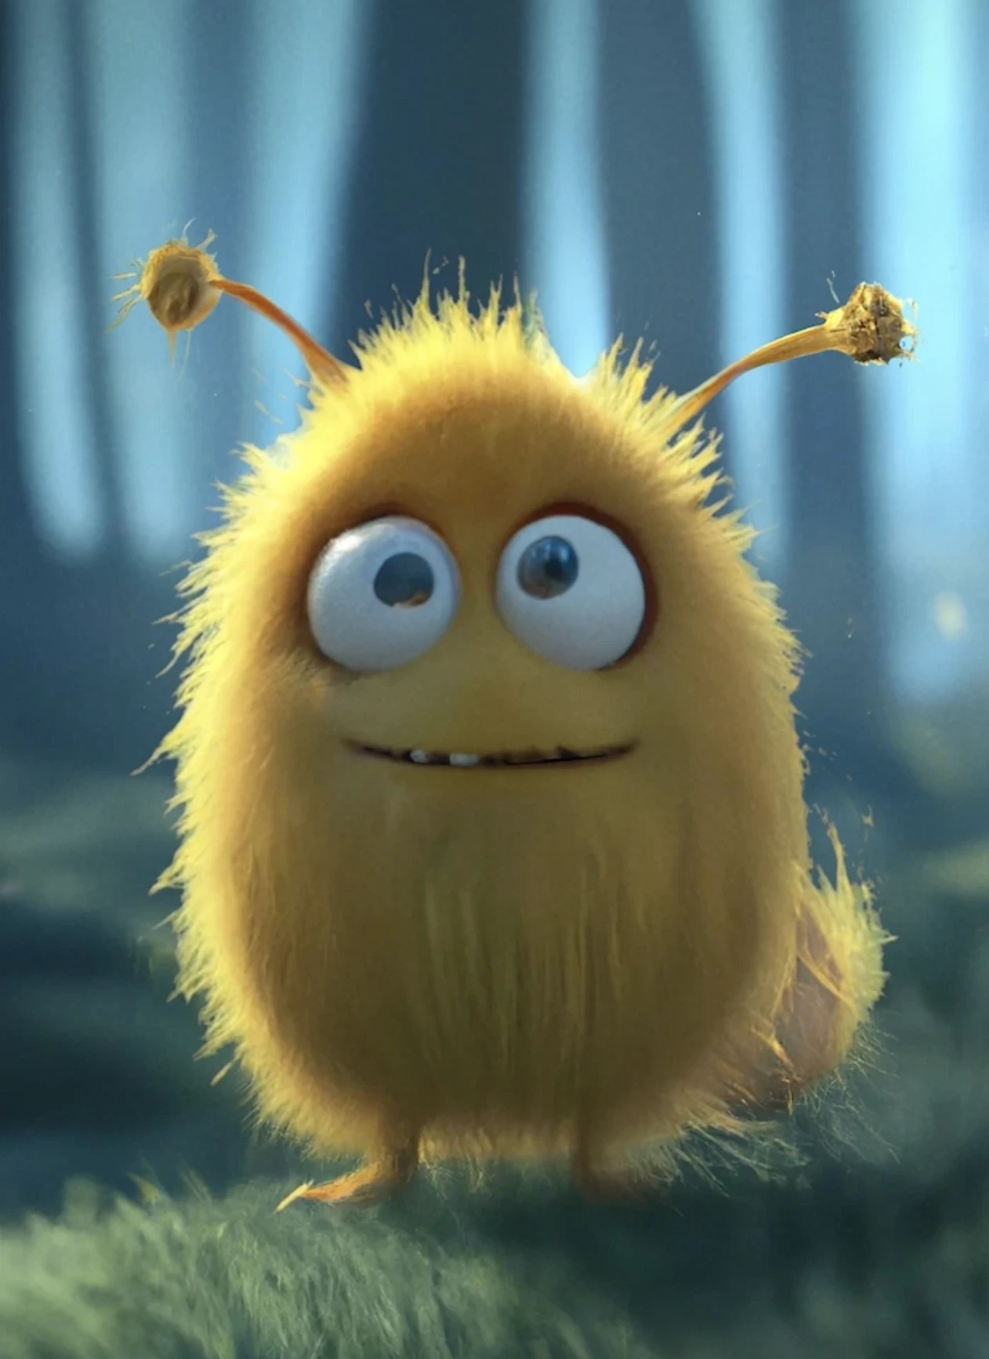
Reconfiguring Film
Production Workflows
amid Generative AI
Evolution
A Longitudinal Case Study
of Critterz
Jia Yu Yi and Jia Ni Zhou
Critterz character design
Film & VFX International College, Dongseo University
Busan, Republic of Korea
Image: Native Foreign
Yi and Zhou, Critterz manuscript
01
Notes:
ENGLISH SCRIPT
Good morning, everyone. My name is Jia Yu Yi. Together with my co-author, Jia Ni Zhou, I will present our longitudinal case study of Critterz. We examine how changing generative AI tools reshape the organisation of film production. I will introduce the research design, compare three production phases, and then discuss a possible direction for improving visual consistency across tools. The final section presents a proposal for future research, rather than an outcome already demonstrated by our case.
SOURCES
[M] Yi and Zhou. Uploaded Critterz manuscript, Sections I–VI and Table I.
User-supplied manuscript
The manuscript covers the project lineage from the 2023 short through May 2026 reporting. Supplementary July 2026 evidence is identified separately.
IMAGE CREDIT
Native Foreign, Critterz project page
https://framerusercontent.com/images/EvRALTuu56VROIsXloir1bjURA.webp?height=1734&width=1262

Slide 2
01 BACKGROUND
Background and research gap
What happens when a film outlives its AI tool?
Iterative workflows
Generation, review and revision reshape production.
Human creative control
People decide where AI enters the process.
Visual consistency
Appearance, motion and style require coordination.
Gap: limited attention to tool changes within a continuing film project.
Research context: [3], [9], [12], [13]
02
Notes:
ENGLISH SCRIPT
Film production takes time, while generative AI tools can change during a project. A team may retain its script and approved designs but need a different way to produce the remaining images. Previous research explains iterative workflows, human creative choices, and the challenge of visual consistency. Less attention has focused on tool changes within a continuing production. Our study addresses that gap by following Critterz across several technological configurations. The practical concern is how creators maintain continuity when the technical environment changes.
SOURCES
[M] Yi and Zhou. Uploaded Critterz manuscript, Sections I–VI and Table I.
User-supplied manuscript
[3] Kim, Lee and Hyun (2025). Exploratory Study on the Structural Transformation of Video Production Using Generative AI. Korean Journal of Arts Education, 23(4), 429–450.
https://doi.org/10.23317/kaae.2025.23.4.023
Abstract and bibliographic record checked through KCI
[9] Simón, Revilla and Sáenz (2024). Integrating AI in organizations for value creation through Human-AI teaming: A dynamic-capabilities approach. Journal of Business Research, 182, 114783.
https://doi.org/10.1016/j.jbusres.2024.114783
Authors’ MIT institutional abstract checked. Banking case, used as a conceptual lens.
[12] Halperin, Flores Ruíz and Rosner (2025). Underground AI? Critical Approaches to Generative Cinema through Amateur Filmmaking. CHI ’25, Article 1141.
https://doi.org/10.1145/3706598.3713342
Publisher-indexed abstract and bibliographic record checked on 22 October 2026. Full text was not accessible.
[13] Yin et al. A Survey: Spatiotemporal Consistency in Video Generation. arXiv:2502.17863v2 (18 February 2026). Published version DOI: 10.1145/3802588.
https://arxiv.org/abs/2502.17863
Authors’ arXiv abstract and revision history checked
The manuscript covers the project lineage from the 2023 short through May 2026 reporting. Supplementary July 2026 evidence is identified separately.

Slide 3
02 RESEARCH DESIGN
Research design: question and case
How do changing AI tools reconfigure
a continuing film project’s workflow?
2023
2025
2026
DALL-E short
Sora remaster
Feature production
Generated visual material
Conventional animation
Moving imagery
Same script and performances
Changing model environment
Workflow reconfiguration
One project lineage; short-to-feature scale changes remain an alternative explanation.
Qualitative longitudinal case study. Sources [5], [6], [7], [15].
03
Notes:
ENGLISH SCRIPT
Our question asks how evolving or discontinued AI tools reconfigure a continuing film project's workflow. We use a qualitative longitudinal case study. The original 2023 short combined DALL-E images with conventional animation. The February 2025 Sora remaster retained the script and performances while changing the production of moving images. The later feature explored alternative models within a broader production environment. These are related stages of one project lineage. However, the expansion from a short to a feature also changes scale and requirements, so technology is not the only possible explanation.
SOURCES
[M] Yi and Zhou. Uploaded Critterz manuscript, Sections I–VI and Table I.
User-supplied manuscript
[5] Hofferman and Sarto (14 July 2023). Chad Nelson Talks ‘Critterz’ and the Future Role of AI. Animation World Network.
https://www.awn.com/animationworld/chad-nelson-talks-critterz-and-future-role-ai
Creator interview checked
[6] Fink (13 February 2025). Native Foreign Uses OpenAI’s Sora To Remake 2023 AI Film ‘Critterz’. Forbes.
https://www.forbes.com/sites/charliefink/2025/02/13/native-foreign-uses-openais-sora-to-remake-2023-ai-film-critterz/
Creator statement and publication date checked in indexed Forbes text on 22 October 2026. Full article access was unavailable in this revision.
[7] OpenAI (2026). What to know about the Sora discontinuation. OpenAI Help Center.
https://help.openai.com/en/articles/20001152-what-to-know-about-the-sora-discontinuation
Official notice checked on 22 October 2026. Web/app end: 26 April 2026. Listed API end date: 24 September 2026. The notice still uses future wording for the API date.
[15] Kerr (26 May 2026, updated 30 May). Why ‘Critterz’ Is The Real Test Of AI Filmmaking. Forbes.
https://www.forbes.com/sites/maureenkerr/2026/05/26/why-critterz-is-the-real-test-of-ai-filmmaking/
Direct filmmaker interview reporting checked. Migration metrics are not supplied.
[S1] Native Foreign. Critterz. Official studio project page.
https://nativeforeign.co/work/critterz
Supplementary primary source checked on 22 October 2026
The manuscript covers the project lineage from the 2023 short through May 2026 reporting. Supplementary July 2026 evidence is identified separately.
[M] Yi and Zhou. Uploaded Critterz manuscript, Sections I–VI and Table I.
User-supplied manuscript
The manuscript covers the project lineage from the 2023 short through May 2026 reporting. Supplementary July 2026 evidence is identified separately.

Slide 4
02 RESEARCH DESIGN
Research design: evidence and comparison
Public documentary evidence
Four analytical dimensions
Creator interviews
Dimension | Question
AI function | Where does AI enter?
Human coordination | Who selects and approves?
Dependency | What relies on the model?
Adaptation risk | What work may follow change?
Reported tools and human tasks
Production reporting
Remaster and feature decisions
Official / producer material
Service changes and production systems
Chronological qualitative comparison; no internal cost or labour-hour dataset.
Sources [5], [6], [7], [15], [S2]. Four dimensions applied to every phase.
04
Notes:
ENGLISH SCRIPT
This slide brings the evidence and analytical framework together. We use published creator interviews, production reporting, official service announcements, and producer material. We organise these accounts chronologically and compare four dimensions. AI function concerns the tasks the model performs. Human coordination concerns selection, revision, integration, and approval. Technological dependency concerns reliance on model capabilities and support. Adaptation risk concerns the extra work that a change may require. We did not conduct the published interviews ourselves, and we do not have internal cost or labour records. This is therefore a qualitative comparison, not a model benchmark.
SOURCES
[M] Yi and Zhou. Uploaded Critterz manuscript, Sections I–VI and Table I.
User-supplied manuscript
[5] Hofferman and Sarto (14 July 2023). Chad Nelson Talks ‘Critterz’ and the Future Role of AI. Animation World Network.
https://www.awn.com/animationworld/chad-nelson-talks-critterz-and-future-role-ai
Creator interview checked
[6] Fink (13 February 2025). Native Foreign Uses OpenAI’s Sora To Remake 2023 AI Film ‘Critterz’. Forbes.
https://www.forbes.com/sites/charliefink/2025/02/13/native-foreign-uses-openais-sora-to-remake-2023-ai-film-critterz/
Creator statement and publication date checked in indexed Forbes text on 22 October 2026. Full article access was unavailable in this revision.
[7] OpenAI (2026). What to know about the Sora discontinuation. OpenAI Help Center.
https://help.openai.com/en/articles/20001152-what-to-know-about-the-sora-discontinuation
Official notice checked on 22 October 2026. Web/app end: 26 April 2026. Listed API end date: 24 September 2026. The notice still uses future wording for the API date.
[8] Kahn (12 May 2026). Vertigo and Federation launch AI ents company. Broadcast.
Listed in the manuscript. Not independently accessed. Woven context corroborated with producer source S2.
[15] Kerr (26 May 2026, updated 30 May). Why ‘Critterz’ Is The Real Test Of AI Filmmaking. Forbes.
https://www.forbes.com/sites/maureenkerr/2026/05/26/why-critterz-is-the-real-test-of-ai-filmmaking/
Direct filmmaker interview reporting checked. Migration metrics are not supplied.
[S1] Native Foreign. Critterz. Official studio project page.
https://nativeforeign.co/work/critterz
Supplementary primary source checked on 22 October 2026
[S2] Vertigo Films (14 May 2026). VERTIGO and FEDERATION form new Ai company AMERSIA. Producer announcement.
https://vertigofilms.com/uncategorized/vertigo-and-federation-form-new-ai-company-amersia-2/
Supplementary producer source checked on 22 October 2026
The manuscript covers the project lineage from the 2023 short through May 2026 reporting. Supplementary July 2026 evidence is identified separately.
[M] Yi and Zhou. Uploaded Critterz manuscript, Sections I–VI and Table I.
User-supplied manuscript
The manuscript covers the project lineage from the 2023 short through May 2026 reporting. Supplementary July 2026 evidence is identified separately.

Slide 5
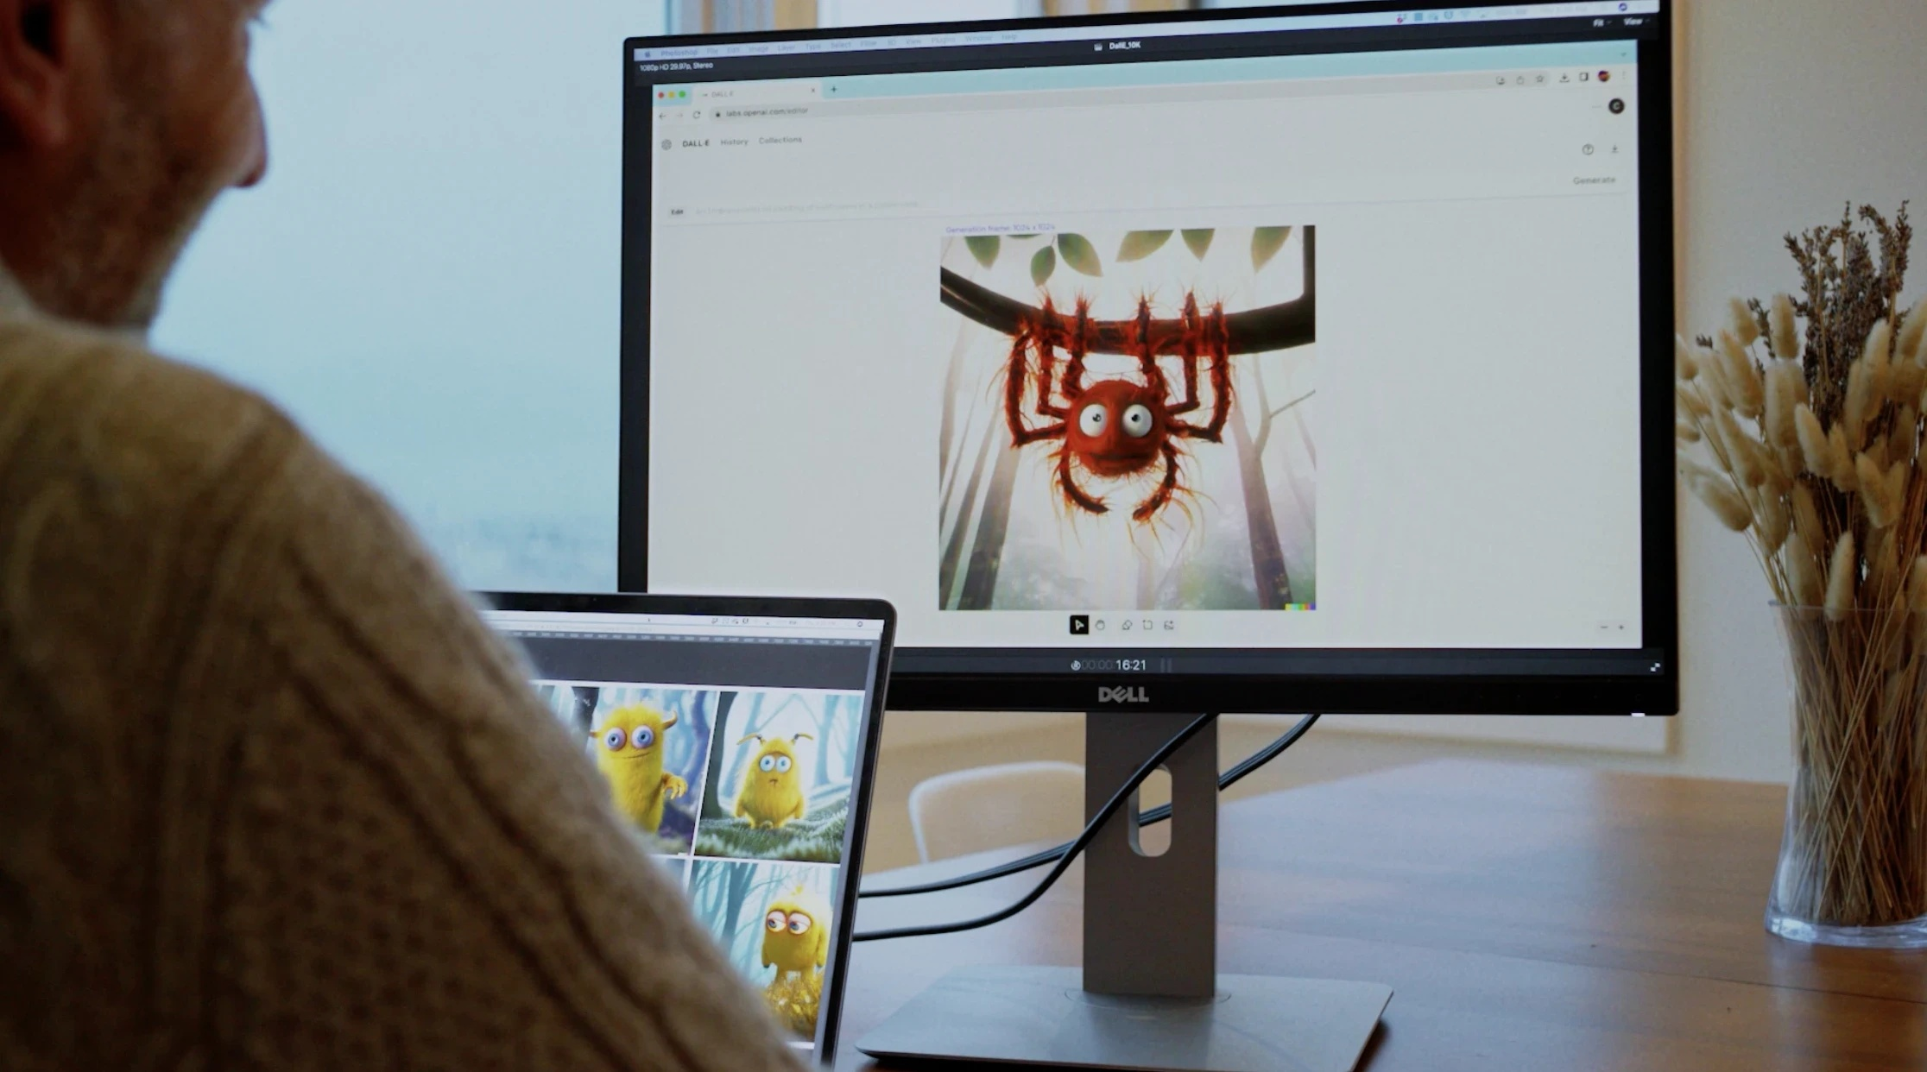
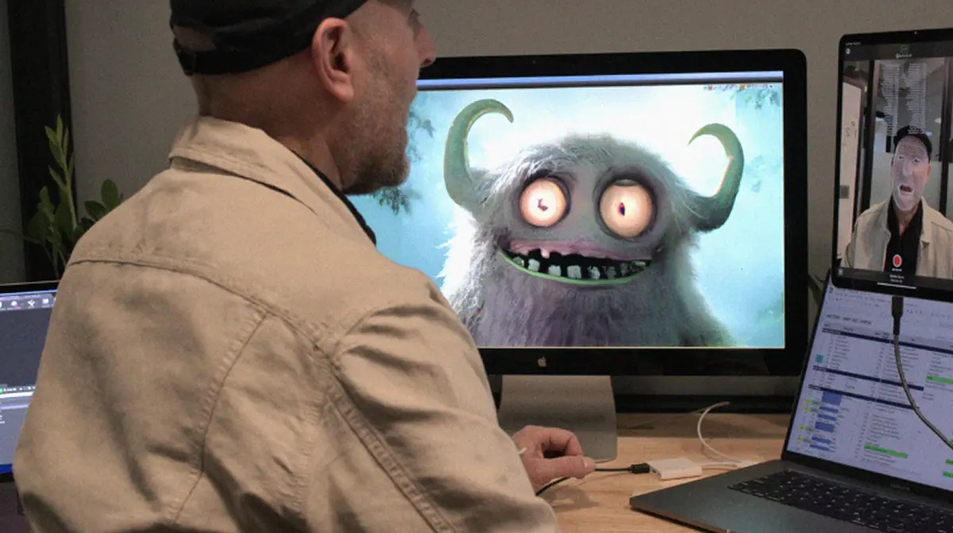
03 RESULTS
DALL-E supports visual development
2023 SHORT
Visual generation and selection
Performance and conventional animation
DALL-E visuals
Human refinement
Animation and editing
Sources [5], [S1]
05
Notes:
ENGLISH SCRIPT
In the first phase, DALL-E mainly supports visual development. Generated characters and environments still need human selection and refinement. The production images show the surrounding work that turns visual material into a film, including performance and conventional animation. Published accounts describe tools such as After Effects and Unreal Engine. We interpret the workflow as hybrid, with dependency on DALL-E concentrated in visual-material generation. Human decisions connect the generated designs with the intended performance, story, and visual identity.
SOURCES
[M] Yi and Zhou. Uploaded Critterz manuscript, Sections I–VI and Table I.
User-supplied manuscript
[5] Hofferman and Sarto (14 July 2023). Chad Nelson Talks ‘Critterz’ and the Future Role of AI. Animation World Network.
https://www.awn.com/animationworld/chad-nelson-talks-critterz-and-future-role-ai
Creator interview checked
[S1] Native Foreign. Critterz. Official studio project page.
https://nativeforeign.co/work/critterz
Supplementary primary source checked on 22 October 2026
The manuscript covers the project lineage from the 2023 short through May 2026 reporting. Supplementary July 2026 evidence is identified separately.
IMAGE CREDIT
Native Foreign, Critterz project page
https://framerusercontent.com/images/PTBH707igSiyDGNv0nxEhXSnST0.webp?height=1242&width=2232
IMAGE CREDIT
Native Foreign, Critterz project page
https://framerusercontent.com/images/prkMXZqkrOVTDGNizA0ZkhEhVUo.webp?height=820&width=1200
Documented tools: After Effects for background animation, Unreal Engine for facial performance capture, and Premiere for editing [5]. Images: Native Foreign [S1].

Slide 6
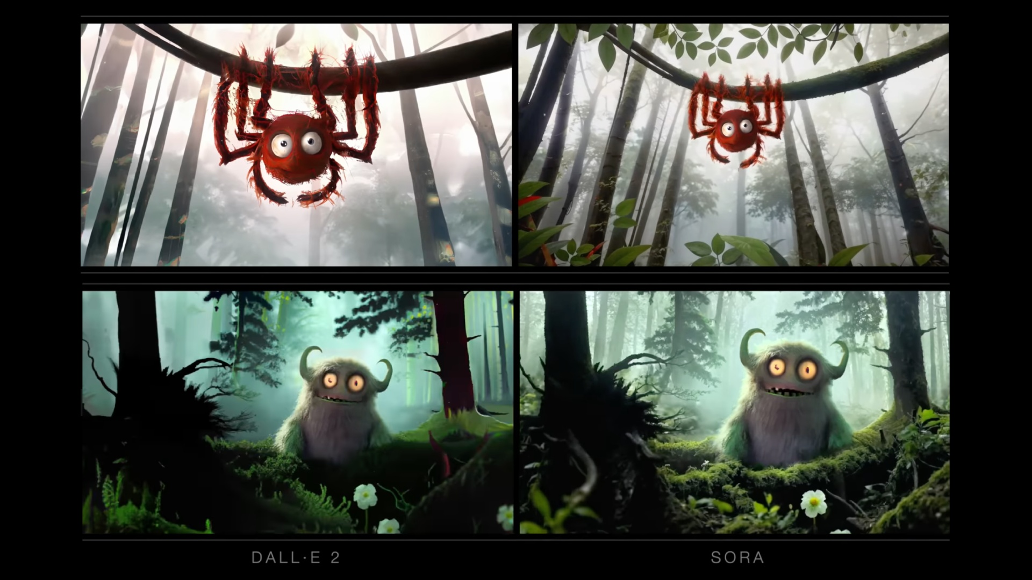
03 RESULTS
Sora enters moving-image production
FEBRUARY 2025
What changes
The model generates
moving imagery.
What continues
The script and
performances [6]
Original (left) and remaster (right). Still images do not measure motion quality.
Sources [6], [S1]
06
Notes:
ENGLISH SCRIPT
The Sora remaster changes the functional position of AI. DALL-E provided still images that required animation. Sora participates directly in generating moving imagery. The stills show the original and remastered versions, but they cannot establish motion quality. The retained script and performances provide a useful point of continuity. Human creative control remains important, while more of the moving-image work depends on the model's capabilities and limitations. We interpret this as deeper integration into the production process.
SOURCES
[M] Yi and Zhou. Uploaded Critterz manuscript, Sections I–VI and Table I.
User-supplied manuscript
[6] Fink (13 February 2025). Native Foreign Uses OpenAI’s Sora To Remake 2023 AI Film ‘Critterz’. Forbes.
https://www.forbes.com/sites/charliefink/2025/02/13/native-foreign-uses-openais-sora-to-remake-2023-ai-film-critterz/
Creator statement and publication date checked in indexed Forbes text on 22 October 2026. Full article access was unavailable in this revision.
[S1] Native Foreign. Critterz. Official studio project page.
https://nativeforeign.co/work/critterz
Supplementary primary source checked on 22 October 2026
The manuscript covers the project lineage from the 2023 short through May 2026 reporting. Supplementary July 2026 evidence is identified separately.
IMAGE CREDIT
Native Foreign. Comparative stills reproduced by EarlyGame. https://earlygame.com/news/entertainment/openai-chatgpt-plans-to-release-its-own-animated-movie-in-2026
https://prod.assets.earlygamecdn.com/images/Critterz-Short-Film-Screenshot.png?transform=Article+Webp

Slide 7
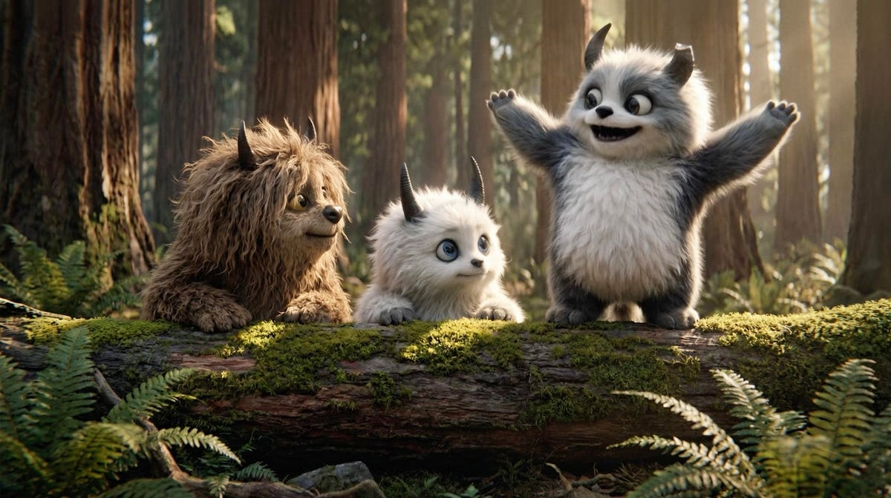
03 RESULTS
Production under tool discontinuity
26 APR 2026
Reported production response
Sora web and app end [7]
Listed API end date: 24 Sep 2026
Human creative decisions
Woven production environment
Collaboration and version management
Alternative generative models
The director retained API access during transition.
Switching also reflected future support. [S3]
Feature publicity image: Critterz Film Ltd. / Forbes
Sources [7], [15], [S2], [S3]
07
Notes:
ENGLISH SCRIPT
The feature phase makes service continuity a production concern. The official notice records the end of Sora's web and app experiences in April 2026 and lists the API end date in September. Reporting describes Woven as a surrounding environment for collaboration and alternative models. However, the director later explained that API access continued during the transition and that the team considered future support when testing alternatives. The change therefore involved both service discontinuation and a production decision. The evidence supports re-evaluation of the workflow, rather than a simple claim that all access disappeared immediately.
SOURCES
[M] Yi and Zhou. Uploaded Critterz manuscript, Sections I–VI and Table I.
User-supplied manuscript
[7] OpenAI (2026). What to know about the Sora discontinuation. OpenAI Help Center.
https://help.openai.com/en/articles/20001152-what-to-know-about-the-sora-discontinuation
Official notice checked on 22 October 2026. Web/app end: 26 April 2026. Listed API end date: 24 September 2026. The notice still uses future wording for the API date.
[15] Kerr (26 May 2026, updated 30 May). Why ‘Critterz’ Is The Real Test Of AI Filmmaking. Forbes.
https://www.forbes.com/sites/maureenkerr/2026/05/26/why-critterz-is-the-real-test-of-ai-filmmaking/
Direct filmmaker interview reporting checked. Migration metrics are not supplied.
[S2] Vertigo Films (14 May 2026). VERTIGO and FEDERATION form new Ai company AMERSIA. Producer announcement.
https://vertigofilms.com/uncategorized/vertigo-and-federation-form-new-ai-company-amersia-2/
Supplementary producer source checked on 22 October 2026
[S3] Rapid Response / Masters of Scale (17 July 2026). OpenAI’s Critterz blowback: Year zero for Hollywood. Interview with director Nik Kleverov.
https://mastersofscale.com/openais-critterz-blowback-year-zero-for-hollywood/
Supplementary follow-up beyond the manuscript’s original source period. Official episode page and automatically generated transcript checked on 22 October 2026. API access and the choice to switch qualify a simple access-loss narrative. No quantified migration dataset.
The manuscript covers the project lineage from the 2023 short through May 2026 reporting. Supplementary July 2026 evidence is identified separately.
IMAGE CREDIT
Critterz Film Ltd., via Maureen Kerr, Forbes, 26 May 2026.
https://imageio.forbes.com/specials-images/imageserve/6a101a81123bbf691e5fa23f/CRITTERZ-promotion-at-Cannes-Film-Festival-2026/0x0.jpg?width=1200

Slide 8
03 RESULTS
What changes across the three phases
Dimension | DALL-E | Sora | Reconfiguration
AI function | Visual material | Moving imagery | Changing models
Human work | Selection and refinement | Creative control and integration | Evaluation and coordination
Dependency | Visual development | Generative-video production | Dependency reconfigured
Adaptation risk* | Limited model exposure | Increasing model exposure | Testing, migration and consistency
*Analytical interpretation. The study does not measure the size of adaptation costs.
08
Notes:
ENGLISH SCRIPT
The comparison shows how AI function, human work, dependency, and adaptation risk change together. Visual-material generation gives way to moving-image generation, followed by a production setting with changing models. Human work expands toward model evaluation and coordination. Dependency also changes its location, becoming more closely connected with the moving-image process. The final row identifies possible testing, migration, and consistency risks. These are analytical interpretations. We have not measured whether adaptation costs increased, or by how much.
SOURCES
[M] Yi and Zhou. Uploaded Critterz manuscript, Sections I–VI and Table I.
User-supplied manuscript
The manuscript covers the project lineage from the 2023 short through May 2026 reporting. Supplementary July 2026 evidence is identified separately.

Slide 9
03 RESULTS
Core findings
01
AI changes its functional position
Visual development expands into moving-image generation.
02
Integration changes dependency
More production work depends on model capability and support.
03
Discontinuity prompts reevaluation
The surrounding production configuration changes.
The event sequence is documented. Dependency is the study’s interpretation.
09
Notes:
ENGLISH SCRIPT
Three findings emerge. First, AI changes its functional position within production. Second, deeper integration changes how the project depends on model capability and continued support. Third, discontinuity prompts re-evaluation of the surrounding workflow. The public record documents events and production decisions. Dependency is our interpretation of their relationship. Together, the findings raise a practical question for future work: if a production uses several models, can a shared visual baseline help preserve a consistent look while tools change?
SOURCES
[M] Yi and Zhou. Uploaded Critterz manuscript, Sections I–VI and Table I.
User-supplied manuscript
The manuscript covers the project lineage from the 2023 short through May 2026 reporting. Supplementary July 2026 evidence is identified separately.

Slide 10
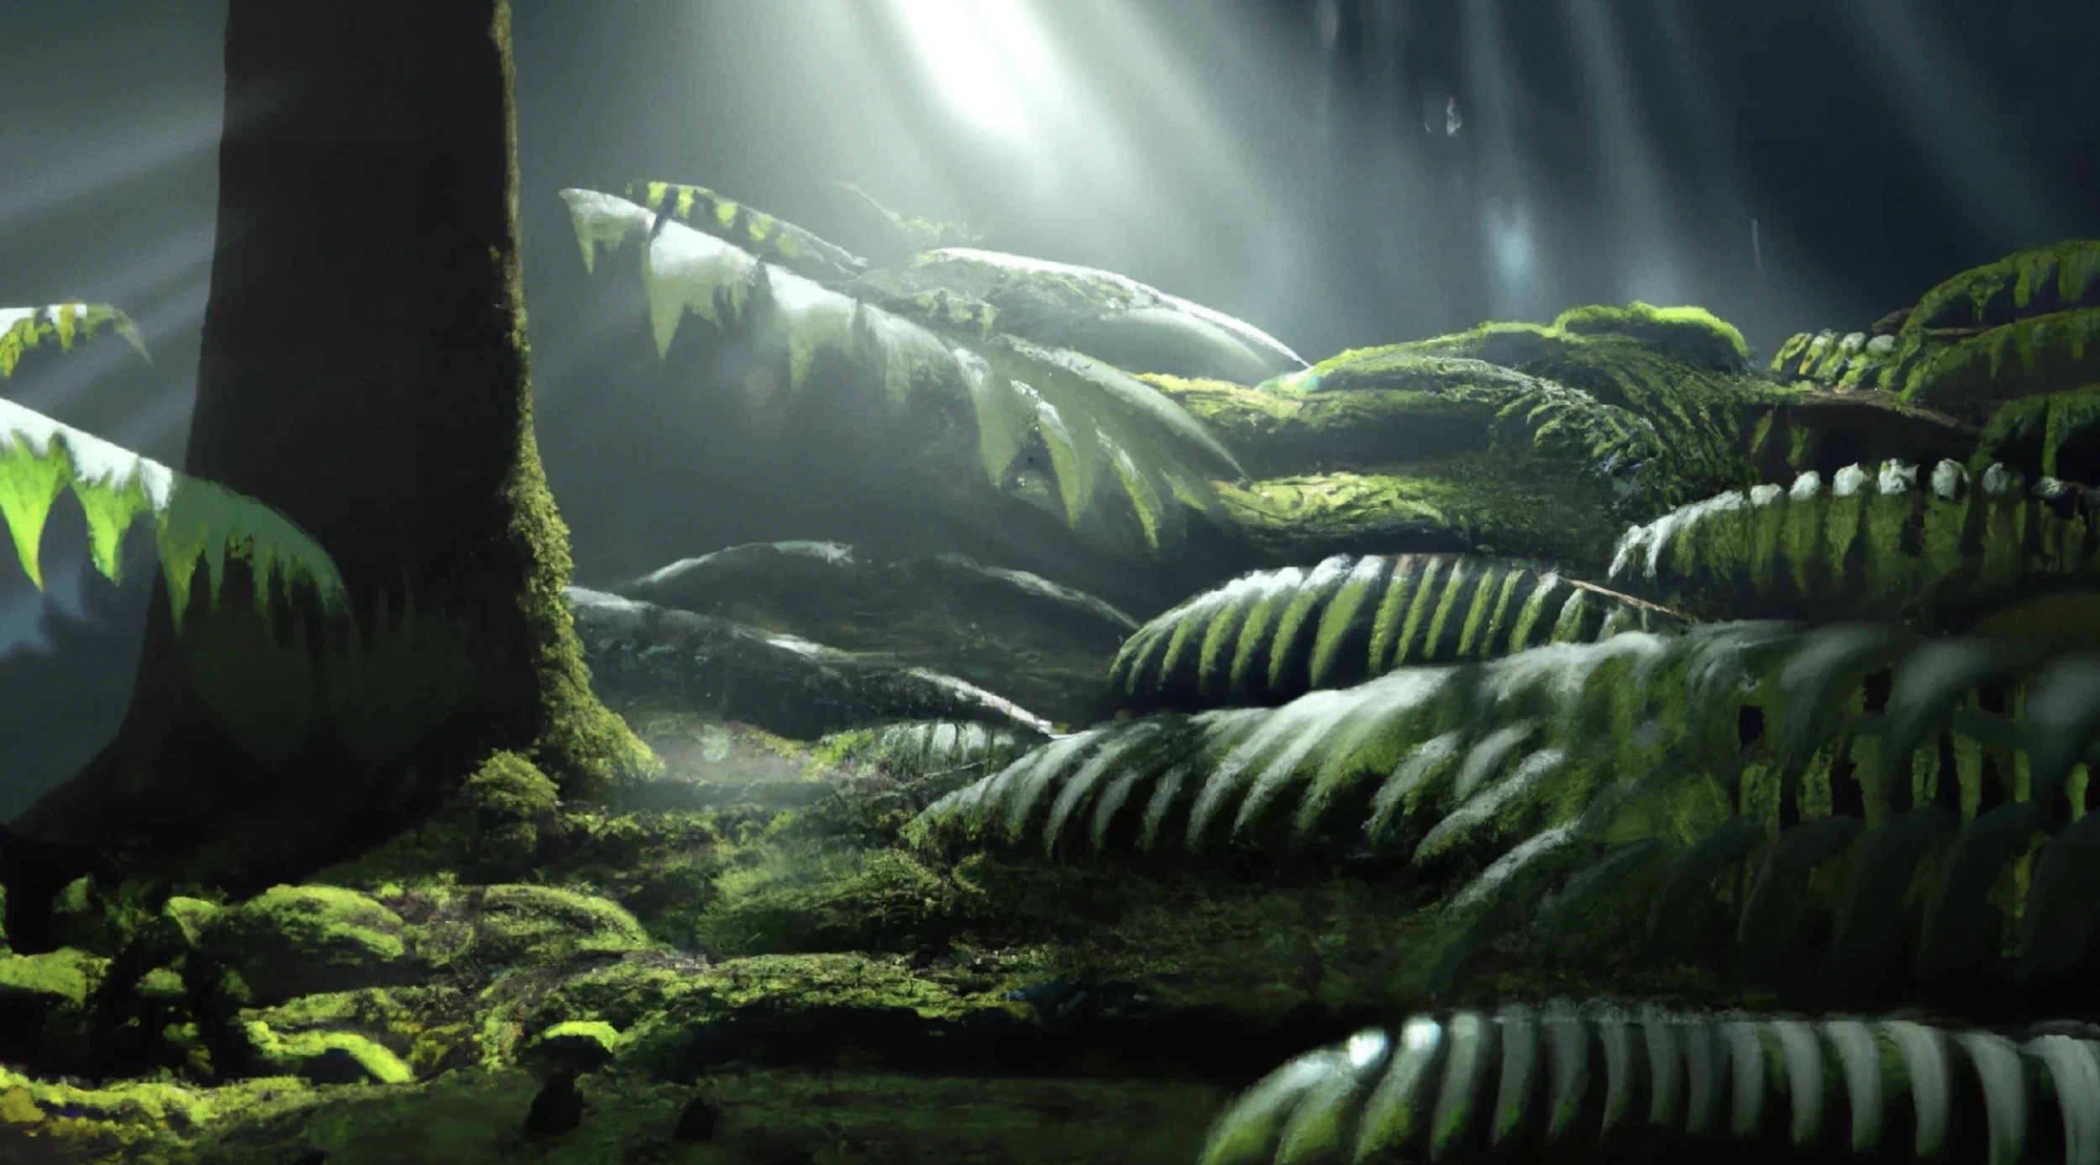
04 FUTURE OUTLOOK
Future outlook: a shared visual baseline
Midjourney’s existing seed control
vibrant California poppies
--seed 399674
Example from Midjourney’s official Seeds guide [F2]
A fixed seed helps compare prompt changes.
It controls initial noise, not colour or style.
Reference image: Native Foreign
Colour and tone: Style Reference
Illustrative colour and tone targets
--sref [image URL] --sw 100
Replace [image URL] with an approved reference. [F1]
Forest
Sage
Warm light
Gold
Muted greens; warm highlights; soft contrast
Future test: compare tools and record correction time.
Proposed future work, not a validated case result. Midjourney examples: [F1], [F2].
10
Notes:
ENGLISH SCRIPT
Our proposed next step starts with approved reference frames and a shared colour and tone baseline. Midjourney already provides a concrete seed example in its official guide: vibrant California poppies, followed by dash dash seed, three nine nine six seven four. The seed selects the initial random noise. Keeping it fixed helps compare prompt changes within the same model and settings. However, it does not store a visual style or guarantee consistency across AI tools. For colour and lighting, Midjourney provides Style Reference. We can attach an approved image with the sref parameter and adjust its influence with style weight, or sw. The default weight is one hundred. Our future study would combine these existing controls with shared visual targets, compare outputs under the same viewing conditions, and record correction time. The palette is illustrative, and this proposed workflow still needs testing.
SOURCES
[M] Yi and Zhou. Uploaded Critterz manuscript, Sections I–VI and Table I.
User-supplied manuscript
[3] Kim, Lee and Hyun (2025). Exploratory Study on the Structural Transformation of Video Production Using Generative AI. Korean Journal of Arts Education, 23(4), 429–450.
https://doi.org/10.23317/kaae.2025.23.4.023
Abstract and bibliographic record checked through KCI
The manuscript covers the project lineage from the 2023 short through May 2026 reporting. Supplementary July 2026 evidence is identified separately.
IMAGE CREDIT
Native Foreign, Critterz project page
https://framerusercontent.com/images/tx0e3tnP5bKm4VX58ZKfGlKWM.webp?height=1387&width=2500
[F1] Midjourney. Style Reference. https://docs.midjourney.com/hc/en-us/articles/32180011136653-Style-Reference
[F2] Midjourney. Seeds. https://docs.midjourney.com/hc/en-us/articles/32604356340877-Seeds
[F3] Runway. Creating with Gen-4 Image References. https://help.runwayml.com/hc/en-us/articles/40042718905875-Creating-with-Gen-4-Image-References
Official documentation checked 28 October 2026. The proposed shared colour/tone baseline and evaluation design are a future research proposal, not reported Critterz practice or validated findings. Tool parameters are model- and version-dependent. The sample palette is illustrative and was not measured from production data.
Midjourney official prompt example transcribed from its Seeds guide: vibrant California poppies --seed 399674. Official illustration: https://docs.midjourney.com/hc/article_attachments/32627343332749 . This is a documented interface example, not a generated test performed for this presentation. The style-reference syntax uses an image-URL placeholder that must be replaced with an actual approved reference URL. Keep model version and other settings fixed for prompt comparisons. Seed does not encode a transferable colour or style.

Slide 11
05 DISCUSSION
Contributions and the proposed trade-off
01
02
03
Temporal perspective
Comparative framework
Testable proposition
One project lineage across tool changes
AI function, human work and dependency
Flexibility may require additional work
Dependency–adaptation trade-off
Less reliance on one model may require more evaluation,
coordination and consistency work. The balance remains unmeasured.
Exploratory explanation and proposition building; [9] informs the adaptive-workflow lens.
11
Notes:
ENGLISH SCRIPT
The study contributes a temporal perspective, a comparative framework, and a testable proposition. The dependency-adaptation trade-off suggests that flexibility may reduce exposure to one model while requiring more evaluation and coordination. The proposed visual baseline makes this question more concrete. It could help teams communicate the look they want across different tools, but building and maintaining that baseline also takes work. Future research should test whether the resulting continuity benefits justify the additional effort. Our case offers a way to investigate this relationship, rather than a validated production method.
SOURCES
[M] Yi and Zhou. Uploaded Critterz manuscript, Sections I–VI and Table I.
User-supplied manuscript
The manuscript covers the project lineage from the 2023 short through May 2026 reporting. Supplementary July 2026 evidence is identified separately.

Slide 12
05 DISCUSSION
Implications and research limits
Implications for the next study
Limits of the current evidence
Preserve approved references and versions.
One project lineage and selective public accounts.
Compare outputs under the same viewing conditions.
Production scale changes from short to feature.
Record consistency judgments and correction time.
No internal migration or cost dataset.
Question: can a shared visual baseline improve continuity at an acceptable effort?
The visual-baseline approach is a proposal for testing, not an established production method.
12
Notes:
ENGLISH SCRIPT
For production teams, the implication is to preserve approved assets and version records, and to treat model dependency as part of planning. The proposed colour and tone baseline could become one part of that record. For researchers, the next step is to compare similar production conditions and measure testing and correction work. Our current evidence comes from one project lineage and selective public accounts. The short-to-feature transition also changes production scale. These limitations mean that our proposed approach needs controlled comparisons and further cases before we can assess its effectiveness.
SOURCES
[M] Yi and Zhou. Uploaded Critterz manuscript, Sections I–VI and Table I.
User-supplied manuscript
The manuscript covers the project lineage from the 2023 short through May 2026 reporting. Supplementary July 2026 evidence is identified separately.

Slide 13
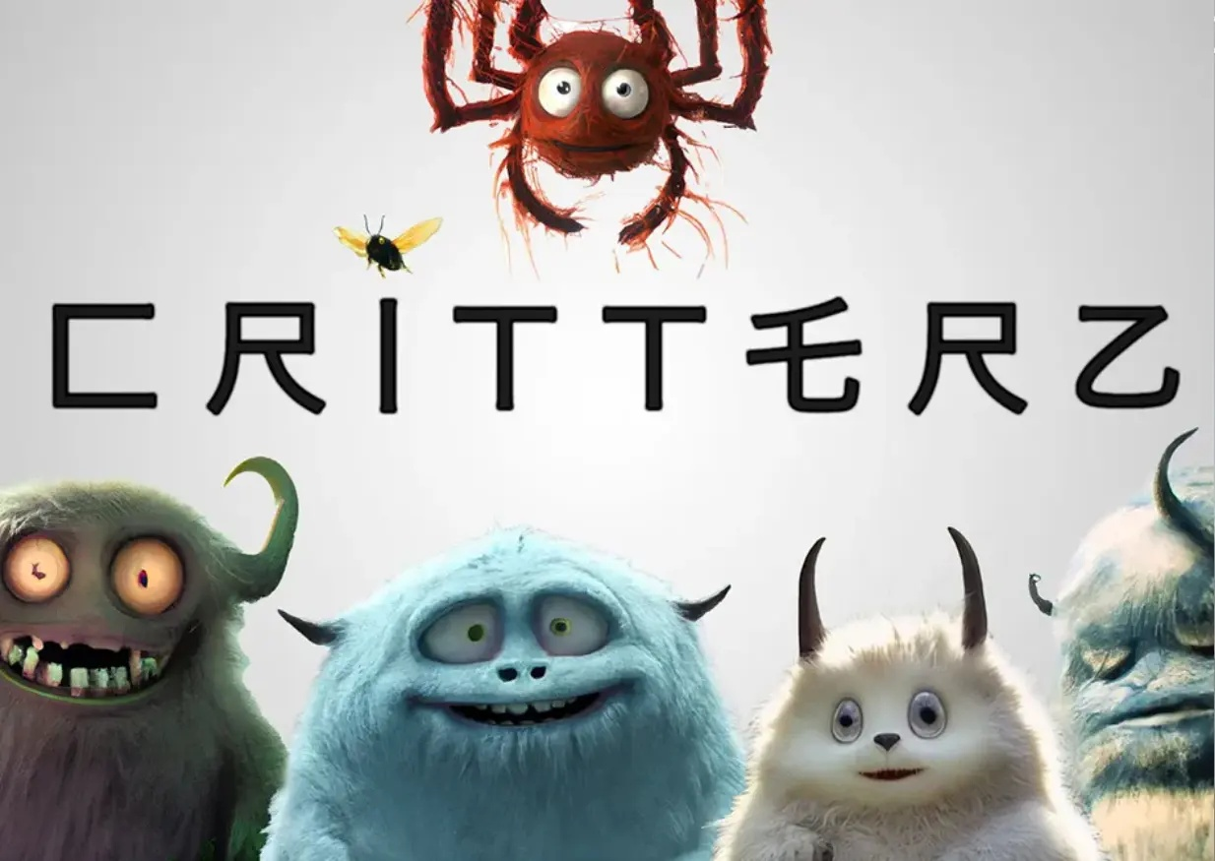
Production
continuity matters
AI’s changing role reorganizes
production work and dependency.
Image: Native Foreign
A shared visual baseline is a
practical direction for future testing.
Thank you
Thank you for your attention
13
Notes:
ENGLISH SCRIPT
To conclude, Critterz suggests that changes in generative AI tools also change the organisation of production and dependency. Maintaining creative continuity may require flexibility, while that flexibility can involve additional work. A shared colour and tone baseline offers a practical direction for the next study. Its effectiveness remains to be tested. Thank you for your attention. I look forward to your questions and suggestions.
SOURCES
[M] Yi and Zhou. Uploaded Critterz manuscript, Sections I–VI and Table I.
User-supplied manuscript
The manuscript covers the project lineage from the 2023 short through May 2026 reporting. Supplementary July 2026 evidence is identified separately.
IMAGE CREDIT
Native Foreign, Critterz project page
https://framerusercontent.com/images/ZqmueYjyNgToZ036fK5HKKRU3VI.webp?height=875&width=1234

Slide 14
REFERENCES
Selected references
[5] Hofferman & Sarto, 2023
[3] Kim, Lee & Hyun, 2025
AWN creator interview: original Critterz workflow
AI-assisted nonlinear video workflows
[6] Fink, 2025
[9] Simón, Revilla & Sáenz, 2024
Forbes: Sora remaster
Human–AI teaming and dynamic capabilities
[7] OpenAI, 2026
[12 / 13] Halperin et al. / Yin et al.
Official Sora discontinuation notice
Human creative agency / video consistency
[15] Kerr, 2026
[F1] Midjourney
Forbes: feature production and Woven
Style Reference: images, codes and weights
[S1 / S2] Native Foreign / Vertigo Films
[F2] Midjourney
Studio images and producer material
Seeds: testing and limitations
[S3] Rapid Response, July 2026
[F3] Runway
Director interview: API access and switching
Gen-4 Image References
Full source URLs and individual image credits appear in the relevant slide notes.
14
Notes:
ENGLISH SCRIPT
This slide lists the principal case sources, analytical references, and official documentation supporting the future-work proposal. Full links and image credits appear in the notes for the relevant slides. The documentation describes available tool functions. It does not validate our proposed workflow or measure its effects on Critterz.
SOURCES
[M] Yi and Zhou. Uploaded Critterz manuscript, Sections I–VI and Table I.
User-supplied manuscript
[5] Hofferman and Sarto (14 July 2023). Chad Nelson Talks ‘Critterz’ and the Future Role of AI. Animation World Network.
https://www.awn.com/animationworld/chad-nelson-talks-critterz-and-future-role-ai
Creator interview checked
[6] Fink (13 February 2025). Native Foreign Uses OpenAI’s Sora To Remake 2023 AI Film ‘Critterz’. Forbes.
https://www.forbes.com/sites/charliefink/2025/02/13/native-foreign-uses-openais-sora-to-remake-2023-ai-film-critterz/
Creator statement and publication date checked in indexed Forbes text on 22 October 2026. Full article access was unavailable in this revision.
[7] OpenAI (2026). What to know about the Sora discontinuation. OpenAI Help Center.
https://help.openai.com/en/articles/20001152-what-to-know-about-the-sora-discontinuation
Official notice checked on 22 October 2026. Web/app end: 26 April 2026. Listed API end date: 24 September 2026. The notice still uses future wording for the API date.
[15] Kerr (26 May 2026, updated 30 May). Why ‘Critterz’ Is The Real Test Of AI Filmmaking. Forbes.
https://www.forbes.com/sites/maureenkerr/2026/05/26/why-critterz-is-the-real-test-of-ai-filmmaking/
Direct filmmaker interview reporting checked. Migration metrics are not supplied.
[S1] Native Foreign. Critterz. Official studio project page.
https://nativeforeign.co/work/critterz
Supplementary primary source checked on 22 October 2026
[S2] Vertigo Films (14 May 2026). VERTIGO and FEDERATION form new Ai company AMERSIA. Producer announcement.
https://vertigofilms.com/uncategorized/vertigo-and-federation-form-new-ai-company-amersia-2/
Supplementary producer source checked on 22 October 2026
[S3] Rapid Response / Masters of Scale (17 July 2026). OpenAI’s Critterz blowback: Year zero for Hollywood. Interview with director Nik Kleverov.
https://mastersofscale.com/openais-critterz-blowback-year-zero-for-hollywood/
Supplementary follow-up beyond the manuscript’s original source period. Official episode page and automatically generated transcript checked on 22 October 2026. API access and the choice to switch qualify a simple access-loss narrative. No quantified migration dataset.
The manuscript covers the project lineage from the 2023 short through May 2026 reporting. Supplementary July 2026 evidence is identified separately.
[M] Yi and Zhou. Uploaded Critterz manuscript, Sections I–VI and Table I.
User-supplied manuscript
[3] Kim, Lee and Hyun (2025). Exploratory Study on the Structural Transformation of Video Production Using Generative AI. Korean Journal of Arts Education, 23(4), 429–450.
https://doi.org/10.23317/kaae.2025.23.4.023
Abstract and bibliographic record checked through KCI
[9] Simón, Revilla and Sáenz (2024). Integrating AI in organizations for value creation through Human-AI teaming: A dynamic-capabilities approach. Journal of Business Research, 182, 114783.
https://doi.org/10.1016/j.jbusres.2024.114783
Authors’ MIT institutional abstract checked. Banking case, used as a conceptual lens.
[10] Eisenhardt (1989). Building theories from case study research. Academy of Management Review, 14(4), 532–550.
https://doi.org/10.5465/amr.1989.4308385
Foundational method reference retained from the manuscript
[12] Halperin, Flores Ruíz and Rosner (2025). Underground AI? Critical Approaches to Generative Cinema through Amateur Filmmaking. CHI ’25, Article 1141.
https://doi.org/10.1145/3706598.3713342
Publisher-indexed abstract and bibliographic record checked on 22 October 2026. Full text was not accessible.
[13] Yin et al. A Survey: Spatiotemporal Consistency in Video Generation. arXiv:2502.17863v2 (18 February 2026). Published version DOI: 10.1145/3802588.
https://arxiv.org/abs/2502.17863
Authors’ arXiv abstract and revision history checked
The manuscript covers the project lineage from the 2023 short through May 2026 reporting. Supplementary July 2026 evidence is identified separately.
[F1] Midjourney. Style Reference. https://docs.midjourney.com/hc/en-us/articles/32180011136653-Style-Reference
[F2] Midjourney. Seeds. https://docs.midjourney.com/hc/en-us/articles/32604356340877-Seeds
[F3] Runway. Creating with Gen-4 Image References. https://help.runwayml.com/hc/en-us/articles/40042718905875-Creating-with-Gen-4-Image-References
Official documentation checked 28 October 2026. The proposed shared colour/tone baseline and evaluation design are a future research proposal, not reported Critterz practice or validated findings. Tool parameters are model- and version-dependent. The user-supplied term pin value has not been identified with a specific tool or parameter; it is not treated as equivalent to seed or style code. The sample palette is illustrative and was not measured from production data.

