Slide 1

CONFERENCE PAPER PRESENTATION
Hiding the Eyes: Narrative Effects of Hidden-Eye Close-Ups in Anime
Christa Springs & Sunghoon Cho
Dongseo University, Busan, South Korea

Slide 2
TABLE OF CONTENTS
Introduction
Reason for Study
Defining the Hidden-Eye Close-up Shot
  What is a close-up Shot?
Framework of Omission
Coding of Eye Omission
Research Methodology
Case Study: Sound! Euphonium
Case Study: Re:Zero
Comparative Analysis
Conclusion

Slide 3


INTRODUCTION:
Eyes: The Window to the Soul
Traditional Expectation
Anime Subversion
"The eyes are the windows to the soul" (anonymous) – eyes provide a unique gateway into a character's internal world, offering clues to emotions and essence.
Japanese animation frequently reverses this by obscuring eyes, turning a revealing device into one of withholding and ambiguity.
Film theory traditionally uses close-ups of eyes to deepen empathy and social interaction between character and viewer.
This study investigates how eye omission heightens emotional uncertainty and encourages active audience completion.
[1] A. Brown, “Narrative technique: Point of view,” vol. 1, 2024. Unpublished.
[2] I. Ribó, Prose Fiction: An Introduction to the Semiotics of Narrative. Cambridge, UK: Open Book Publishers, 2019, pp. 2–3.
[3] J. E. Cutting, “Narrative theory and the dynamics of popular movies,” Psychon. Bull. Rev., vol. 23, p. 1713, 2016.

Slide 4
How are Hidden-Eye Close-Ups used as narrative devices in anime?

Slide 5
REASON FOR THE STUDY
To provide a research basis for the codification of hidden-eye close-ups to encourage wide-spread understanding and usage.

Slide 6
Hidden-Eye Close-Up
Definition: A close-up of a character’s face that intentionally and obviously omits the character’s eyes, leaving the final emotional state open to interpretation.

Slide 7
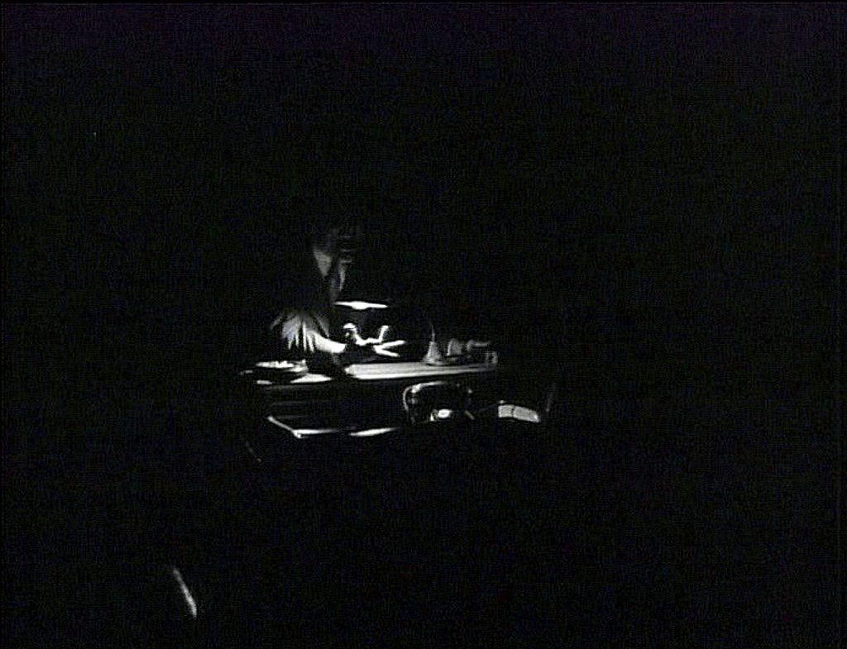
FRAMEWORK: OMISSION
Hanich: emotional engagement is often intensified by what is deliberately withheld.
Omission is a conscious artistic decision, not an oversight.
Omission: The act of leaving elements open to interpretation.
Suggestion: Visual cues that imply a specific mental state.
Completion: The viewer actively fills in the emotional gap.
Hannich
[6] J. Hanich, “Omission, suggestion, completion: Film and the imagination of the spectator,” Screening the Past, no. 43, 2018.

Slide 8
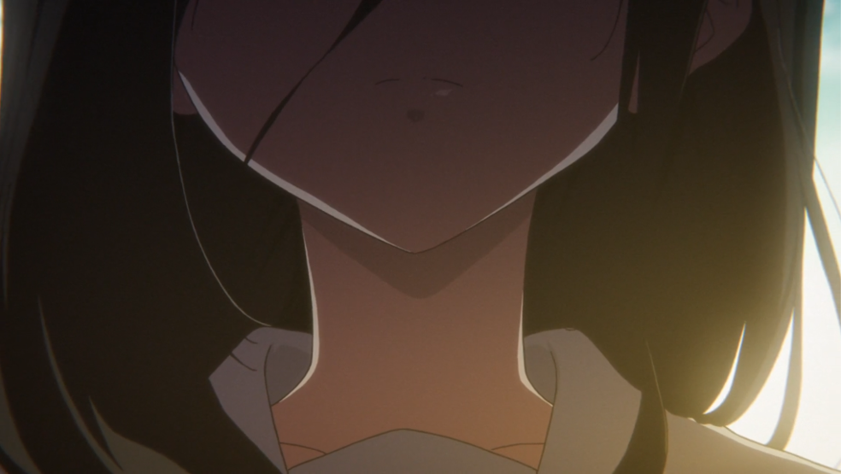
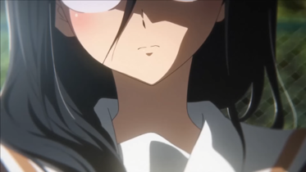
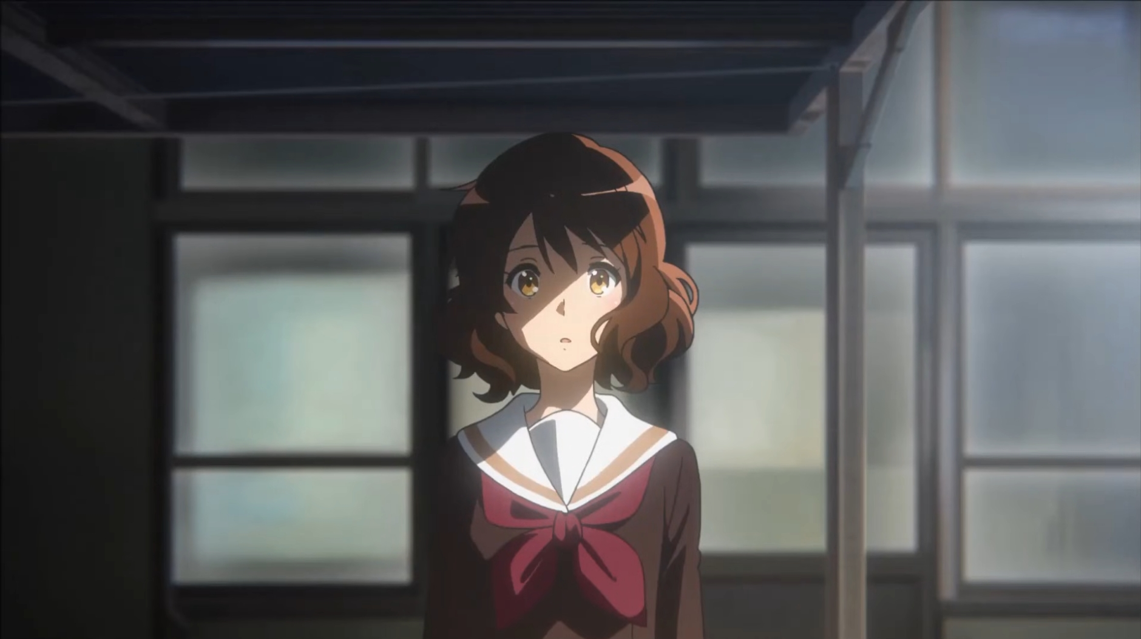
FRAMEWORK: OMISSION
Hanich: “What is left out is not a mere lack here – it results from the conscious artistic act of leaving things open”
Omission
Suggestion
Completion
Something is intentionally left out of the frame. This intentionality is communicated to the audience.
Visual or oral cues (lighting, music, posture, set-up, etc) encourage audience’s participation to complete the image.
Audience completes the process by filling in the film’s gaps through their own imaginative process.
[6] J. Hanich, “Omission, suggestion, completion: Film and the imagination of the spectator,” Screening the Past, no. 43, 2018.

Slide 9
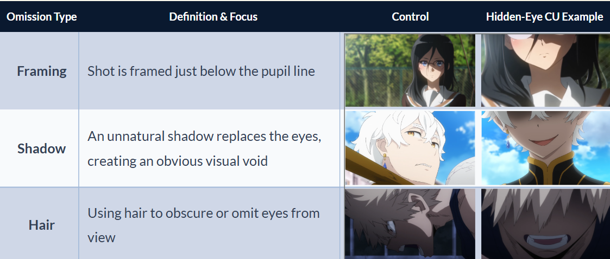
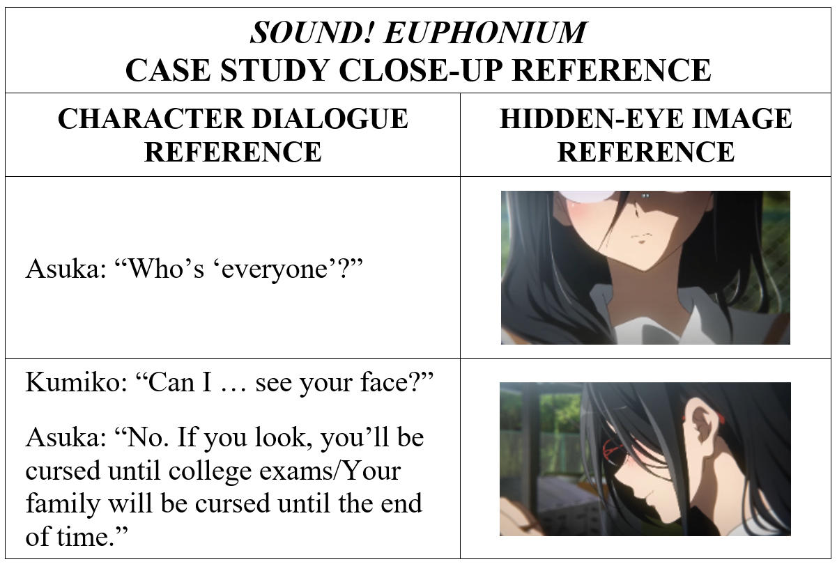
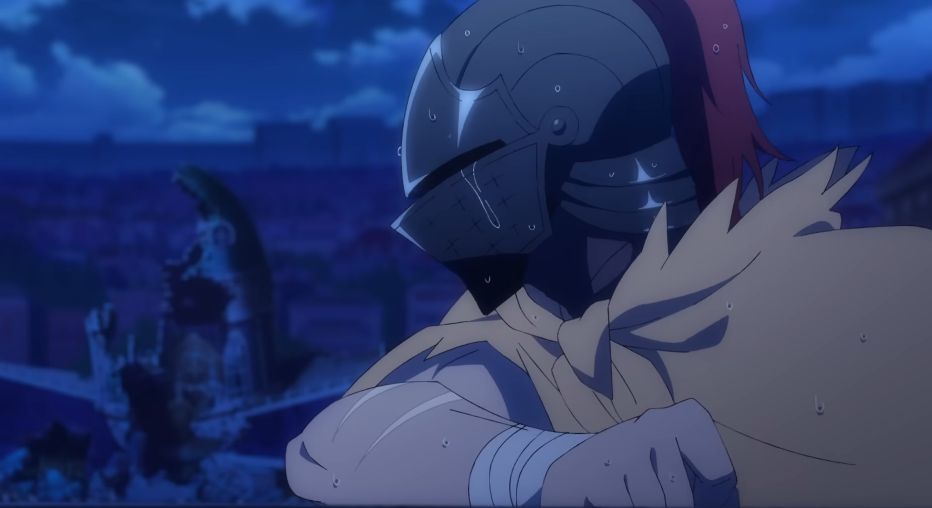
RESEARCH METHODOLOGY
Qualitative Research Method:
Narrative Context: Analyzing dialogue interaction
(cross-referenced via OpenAi Whisper/Whisper-4o), music, lighting, framing, and other scene elements
Deliberate Omission: Compared the Hidden-Eye Close-Up to other shots in the same scene where eyes ARE visible.
Visual Mechanism: Identifying how the eyes were omitted
(cropping, shadows, or hair obstruction)
Exclusion: Characters with masks or veils were as part of character design.

Slide 10
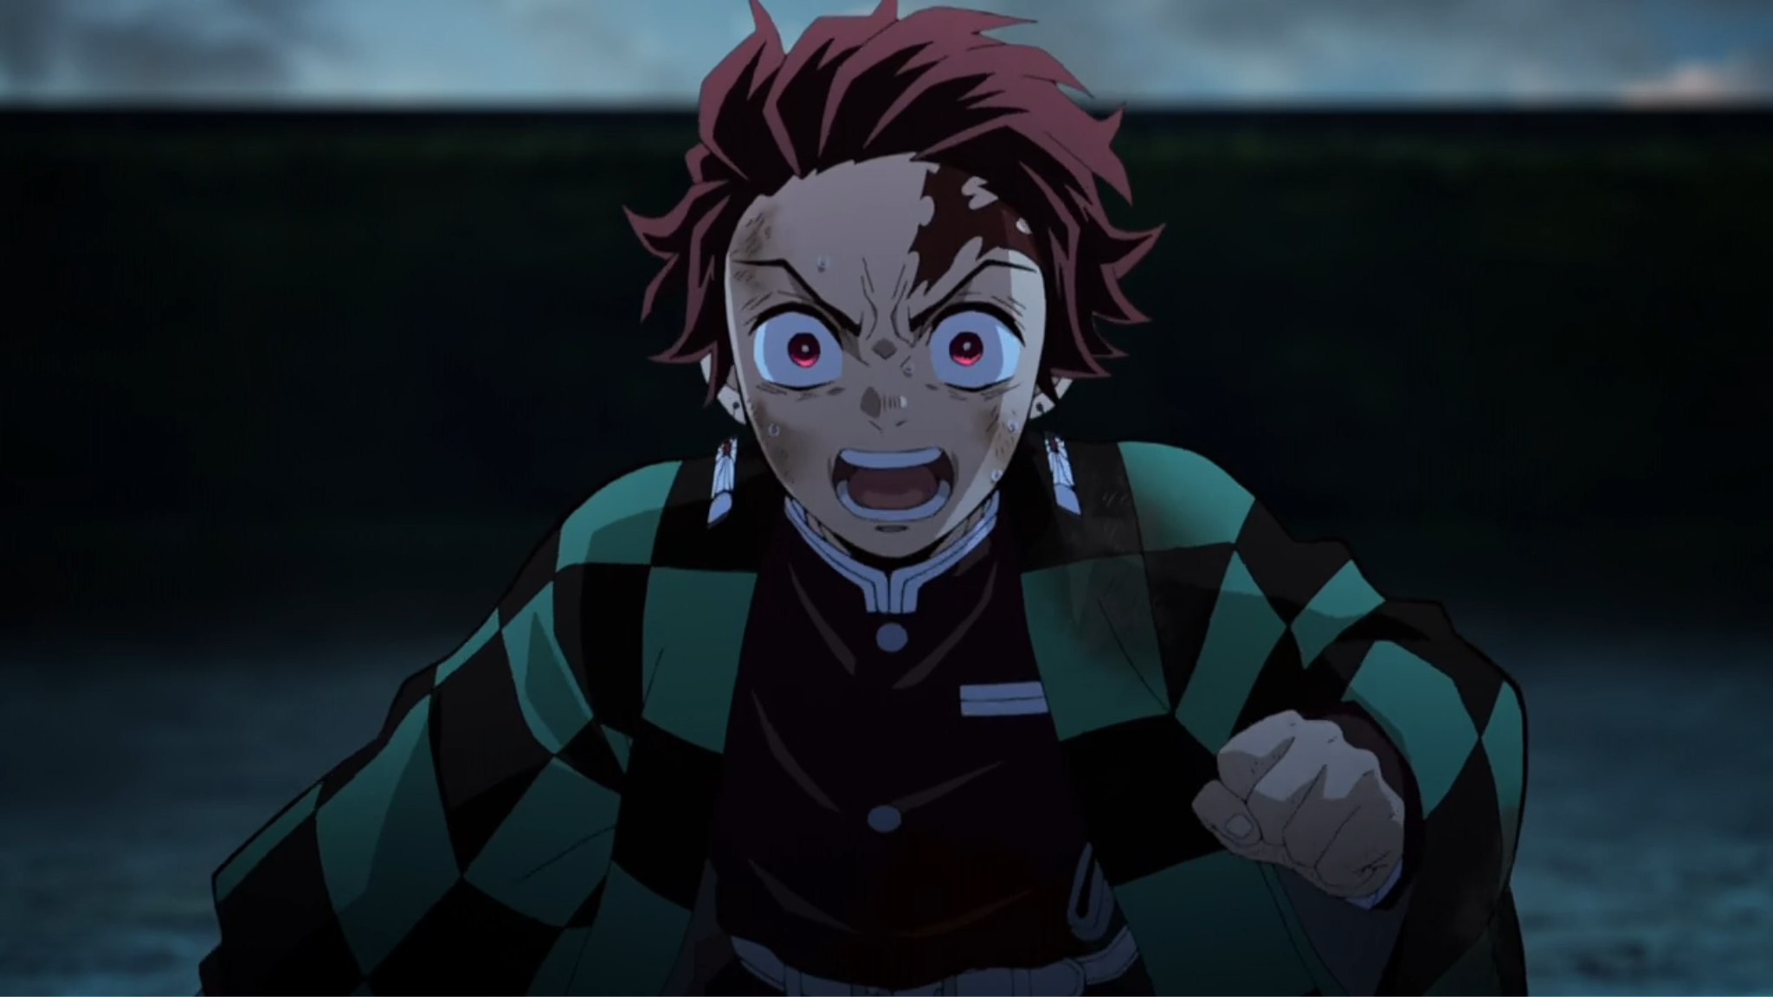


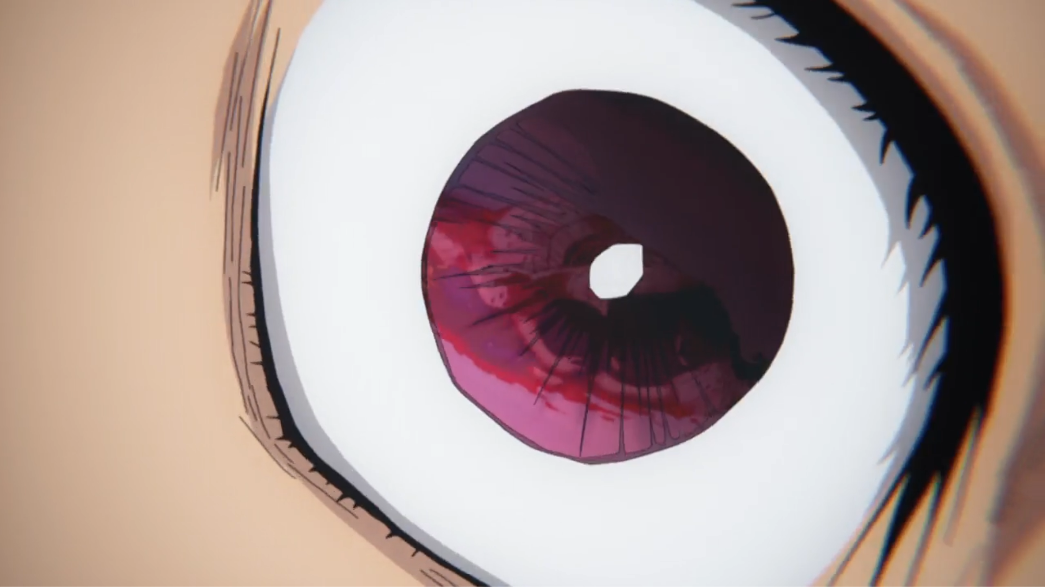
WHAT IS A CLOSE-UP SHOT?
Examples of a “Close-Up” Shot
Medium Close-Up: Shot from the chest or waist upward | Close-up (CU): Shot from upwards from the neck or shirt pockets | Choker: Shot from the top of the head to the chin | Extreme Close-up (ECU): Focuses on one element or detail about a character or object
Figures: Examples of types of close-up shots where the eyes are used to accentuate the character’s emotional state. Images from Sotozaki , Demon Slayer: Kimetsu no Yaiba – The Movie: Mugen Train, 2020
[4] F. E. Beaver, Dictionary of Film Terms: The Aesthetic Companion to Film Art, 2nd ed. New York, NY: Peter Lang Publishing, 2007, p. 45.
[5] A. Orsi, “The close-up,” in Early Film Theories in Italy 1896–1922: The Little Magic Machine, F. Casetti, S. Alovisio, and L. Mazzei, Eds. Amsterdam, Netherlands: Amsterdam University Press, 2021, p. 136.

Slide 11
TYPES OF Hidden-Eye Close-Up
Images: Sound! Euphonium, Season 2, Ep. 10, “After school obligato,” Directed by T. Ishihara. Japan: Kyoto Animation, Nov. 30, 2016. [TV series episode].
Re:Zero – Starting Life in Another World, Season 3, Ep. 1, “Theatrical malice,” Directed by M. Shinohara. Japan: White Fox, Oct. 2, 2024. [TV series episode].
My Hero Academia, Season 3, Ep. 22, “A talk about your quirk,” Directed by K. Nagasaki. Written by Y. Kuroda. Japan: Bones, Sep. 8, 2018. [TV series episode].

Slide 12
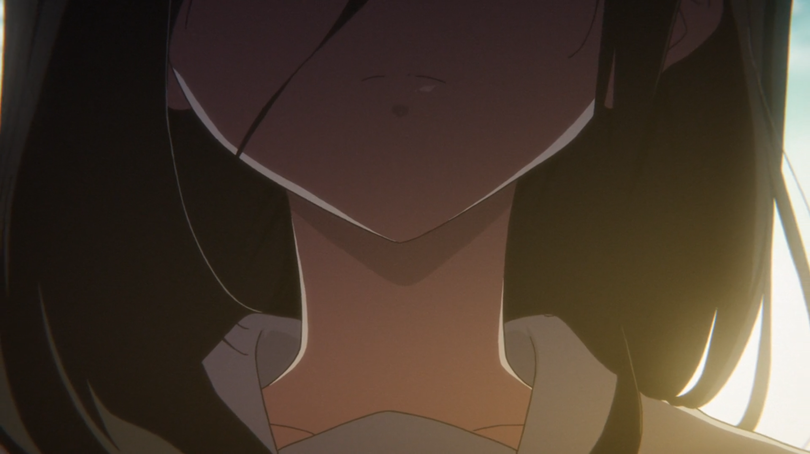
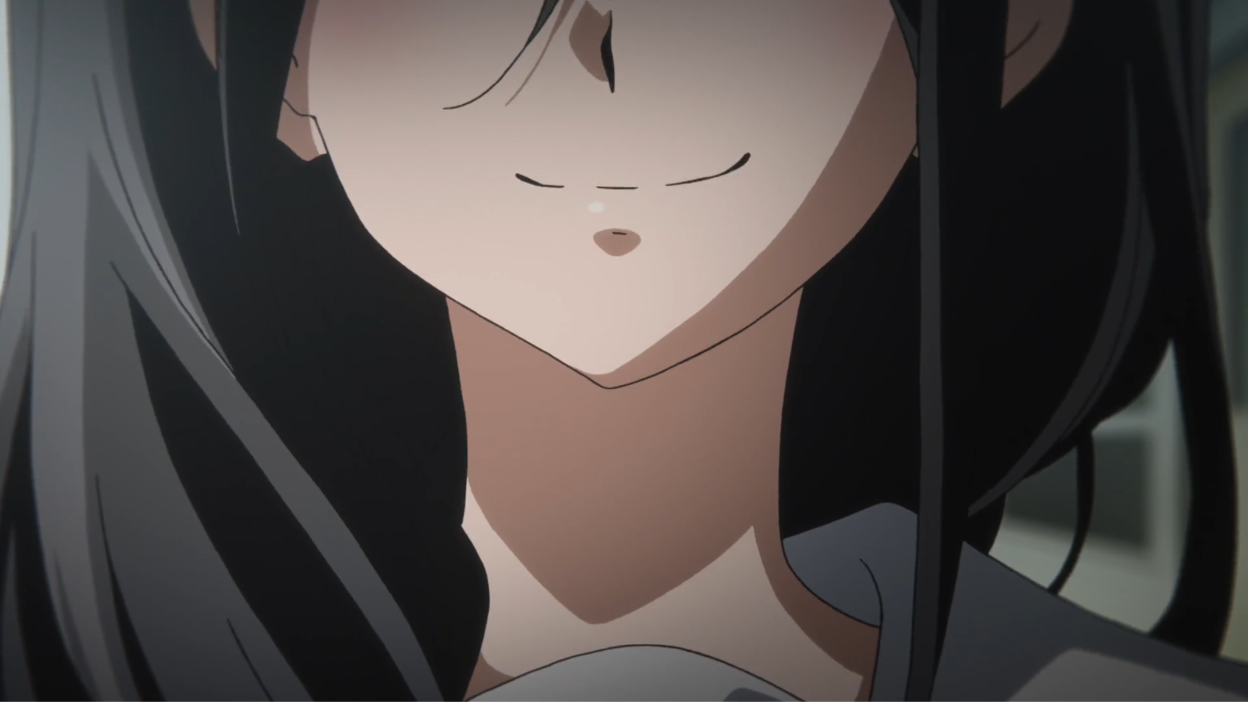
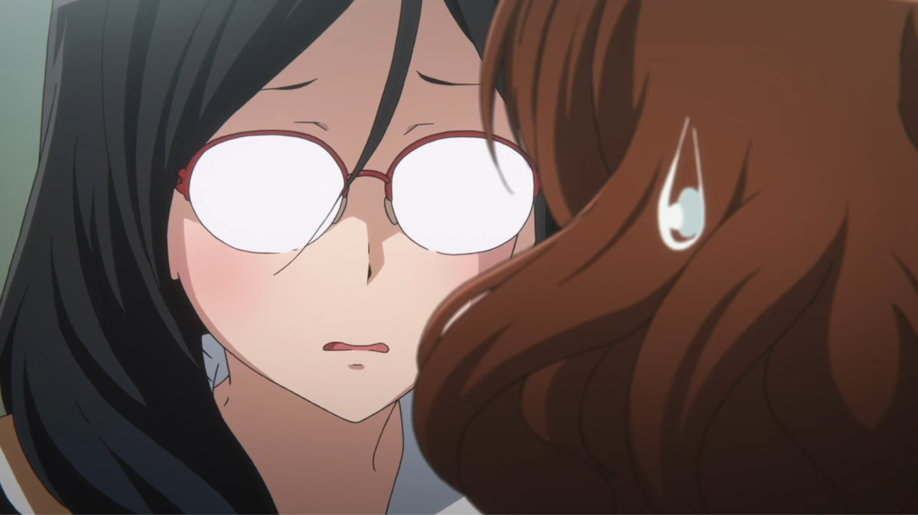
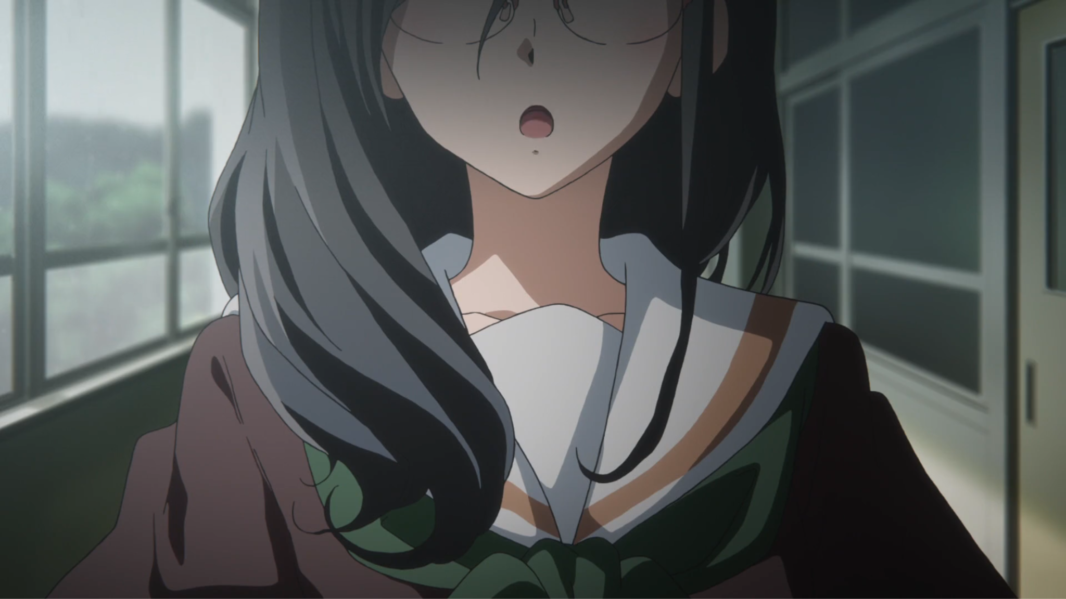
CASE STUDY: SOUND! EUPHONIUM
Fig 1. Additional occurrences of visual obstruction with Asuka during emotional moments
Tanaka Asuka
Additional Occurrences: Director Tatsuya Ishihara predominantly employs hidden-eye close-ups for Asuka's character throughout the series. These unexplained moments are emphasized by the reactions of the surrounding characters, specifically frustration from the mystery surrounding Asuka’s intentions.
Sound! Euphonium, Directed by T. Ishihara. Japan: Kyoto Animation, Nov. 30, 2016. [TV series episode].

Slide 13

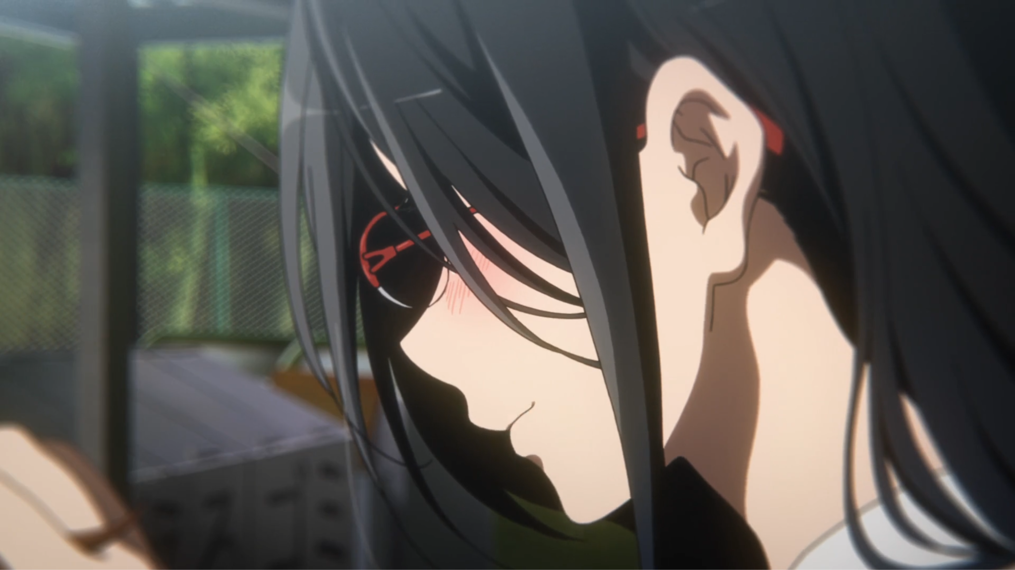
CASE STUDY: SOUND! EUPHONIUM
Tanaka Asuka
Hidden-eye close up shots reflect the character’s emotional elusivity
•
Narrative Context: A confrontation where protagonist Kumiko seeks to understand Asuka’s aloofness.
Visual Mechanism: Brief, 1.22s shots; eyes are cropped out or hidden by hair and opaque glasses.
Narrative Effect: The close-up withholds more than it reveals, turning intimacy into dissonance and mirroring Kumiko’s lack of access.
•
•
Sound! Euphonium, Season 2, Ep. 10, “After school obligato,” Directed by T. Ishihara. Japan: Kyoto Animation, Nov. 30, 2016. [TV series episode].

Slide 14




CASE STUDY: RE:ZERO
Fig 2. Control shots of Regulus in other scenes prove the character has eyes and his evil nature
Regulus Corneas: Visual Warning
Reintroducing a Character: Shinohara introduces Regulus for the 3rd time in the series, yet obscures his face. In episode 1 of the third season, Regulus’s face is concealed for the entire introduction. The question is why?
Re:Zero – Starting Life in Another World, Season 3, Directed by M. Shinohara. Japan: White Fox, Oct. 2, 2024. [TV series episodes].

Slide 15
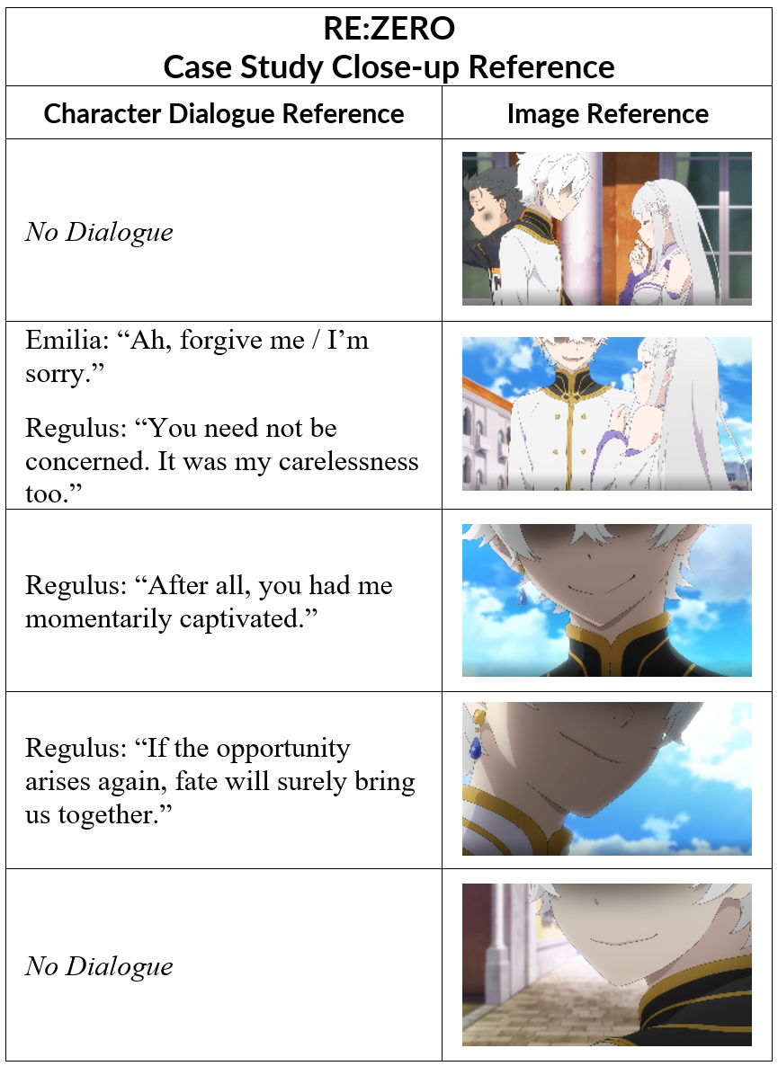
CASE STUDY: RE:ZERO
Regulus Corneas: Visual Warning
Hidden-eye shots, using shadow obstruction to signal instability.
•
Narrative Context: Character introduction
Visual Mechanism: Continuous, shadow obstruction independent of motivated lighting; elevated angles prevent eye contact, establishing superiority.
Narrative Effect: Polite pleasantries vs. constant visual concealment creates deep unease.
•
•
Re:Zero – Starting Life in Another World, Season 3, Ep. 10, “Theatrical malice,” Directed by M. Shinohara. Japan: White Fox, Oct. 2, 2024. [TV series episode].

Slide 16
COMPARATIVE ANALYSIS RESULTS
Metric | Sound! Euphonium (2.10) | Re:Zero (3.01)
Character | Tanaka Asuka | Regulus Corneas
Mechanism | Framing / Hair Obstruction | Shadow / Framing Omission
Frequency | Twice (Strategic) | Seven Times (Introductory)
Effect | Awkwardness & Empathy Block; Thematic | Threat, Instability & Unease

Slide 17
How are Hidden-Eye Close-Ups used as narrative devices in anime?

Slide 18
IMAGE SOURCES
Demon Slayer: Kimetsu no Yaiba – The Movie: Mugen Train, Directed by Haruo Sotozaki. Tokyo, Japan: Aniplex / Funimation, 2020. [Motion picture].
J. Hanich, “Omission, suggestion, completion: Film and the imagination of the spectator,” Screening the Past, no. 43, 2018.
Sound! Euphonium, Season 2, Ep. 10, “After school obligato,” Directed by T. Ishihara. Japan: Kyoto Animation, Nov. 30, 2016. [TV series episode].
Re:Zero – Starting Life in Another World, Season 3, Ep. 1, “Theatrical malice,” Directed by M. Shinohara. Japan: White Fox, Oct. 2, 2024. [TV series episode].
Re:Zero – Starting Life in Another World, Season 3, Ep. 15, “A Hideous Dinner Party,” Directed by M. Shinohara. Japan: White Fox, Mar. 19, 2025. [TV series episode].

Slide 19
REFERENCES
J. Hanich, “Omission, suggestion, completion: Film and the imagination of the spectator,” Screening the Past, no. 43, 2018.
Sound! Euphonium, Season 2, Ep. 10, “After school obligato,” Directed by T. Ishihara. Japan: Kyoto Animation, Nov. 30, 2016. [TV series episode].
Re:Zero – Starting Life in Another World, Season 3, Ep. 10, “Theatrical malice,” Directed by M. Shinohara. Japan: White Fox, Oct. 2, 2024. [TV series episode].
A. Brown, “Narrative technique: Point of view,” vol. 1, 2024. Unpublished.
I. Ribó, Prose Fiction: An Introduction to the Semiotics of Narrative. Cambridge, UK: Open Book Publishers, 2019, pp. 2–3.
J. E. Cutting, “Narrative theory and the dynamics of popular movies,” Psychon. Bull. Rev., vol. 23, p. 1713, 2016.
N. Kashaka and N. Nyiramukama, “Cinematic techniques: Shaping viewer perception and emotion,” Res. Invention J. Curr. Issues Arts Manag., vol. 4, pp. 28–29, 2025.
B. Brown, Cinematography: Theory and Practice – For Cinematographers and Directors, 4th ed. Abingdon, UK: Routledge, 2022, pp. 67, 71.
F. E. Beaver, Dictionary of Film Terms: The Aesthetic Companion to Film Art, 2nd ed. New York, NY: Peter Lang Publishing, 2007, p. 45.
W. H. Hall, Understanding Cinema. New York, NY: Greenwood Press, 1975, pp. 82–83.
Demon Slayer: Kimetsu no Yaiba – The Movie: Mugen Train, Directed by Haruo Sotozaki. Tokyo, Japan: Aniplex / Funimation, 2020. [Motion picture].
A. Orsi, “The close-up,” in Early Film Theories in Italy 1896–1922: The Little Magic Machine, F. Casetti, S. Alovisio, and L. Mazzei, Eds. Amsterdam, Netherlands: Amsterdam University Press, 2021, p. 136.
M. Franca, N. Bolognini, and M. Brysbaert, “Seeing emotions in the eyes: A validated test to study individual differences in the perception of basic emotions,” Cogn. Res. Princ. Implic., vol. 8, no. 1, pp. 1–14, 2023.
D. Matsumoto, “Cultural influences on the perception of emotion,” J. Cross-Cult. Psychol., vol. 20, no. 1, p. 92, 1989.
B. Rooney and K. E. Bálint, “Watching more closely: Shot scale affects film viewers’ theory of mind tendency but not ability,” Front. Psychol., vol. 8, pp. 5–8, 2017.
L. Jungbauer, “The effect of motion dynamics and POV shots on film viewers’ narrative engagement, empathy and arousal,” B.S. thesis, Dept. Commun. and Inf. Sci., Tilburg Univ., Tilburg, Netherlands, 2018, pp. 15-16.
H. K. Nguyen, “The culture of ambiguity: Ma in Japanese culture and design movement posters,” Design Issues, vol. 36, no. 4, pp. 73–74, Autumn 2020.
G. Nitschke, “MA: Place, Space, Void,” Kyoto Journal, May 16, 2018. [Online]. Available: https://kyotojournal.org/culture-arts/ma-place-space-void/. [Accessed: April 10, 2026].
S. Goda, “Cinematic experience: Examining the psychological effects of film,” Ph.D. dissertation, Northumbria Univ., Newcastle upon Tyne, UK, 2010, pp. 3-4. [Online]. Available: https://researchportal.northumbria.ac.uk/ws/portalfiles/portal/177404381/SachiyoGodaThesisUNN.
N. Cohn, A. Taylor-Weiner, and S. Grossman, “Framing attention in Japanese and American comics: Cross-cultural differences in attentional structure,” Front. Psychol., vol. 3, pp. 240–241, 2012.
Reddit user, “What does it mean, in general, when a character’s eyes are hidden?” Reddit.com, Mar. 1, 2021. [Online]. Available: https://www.reddit.com/r/anime/comments/lvc44c/what_does_it_mean_in_general_when_a_characters/. [Accessed: April 10, 2026].
“Eyes convey truth in Fullmetal Alchemist: Brotherhood,” Under The Scope,
7, 2016. [Online Video]. Available: https://www.youtube.com/watch?v=4H4dYeXt-uk. [Accessed: April 10, 2026].
My Hero Academia, Season 3, Ep. 22, “A talk about your quirk,” Directed by K. Nagasaki. Written by Y. Kuroda. Japan: Bones, Sep. 8, 2018. [TV series episode].
D. Bordwell, K. Thompson, and J. Smith, Film Art: An Introduction, 12th ed. New York, NY: McGraw-Hill Education, 2020, pp. 191-192.
F. E. Beaver, Dictionary of Film Terms: The Aesthetic Companion to Film Analysis. New York, NY: Twayne Publishers, 1994, p. 221.

Slide 20
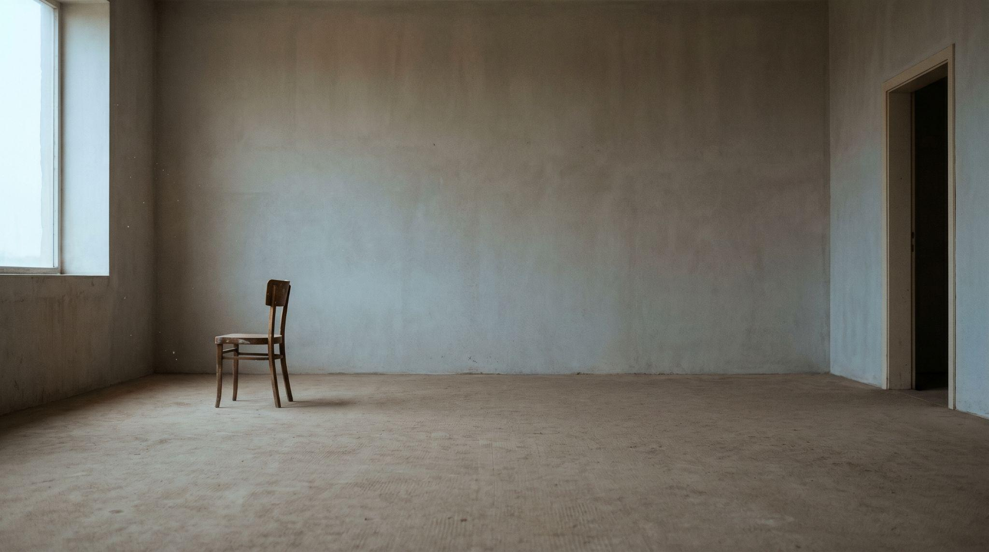
Questions?
Hiding the Eyes: Narrative Effects of Hidden-Eye Close-Ups in Anime
ChristaSprings@yahoo.com
Dongseo University, Busan

