Slide 1
Coefficient-Aware Global Assignment for
Robust Latent-DCT Watermarking in Stable Diffusion
Chakkratorn Kwakhong · Chien-Chang Chen · Cheng-Hsiu Li
Somchoke Ruengittinun · Worasait Suwannik
Kasetsart University, Thailand · Tamkang University, Taiwan
Notes:
Joint work between Kasetsart and Tamkang. 12 minutes.

Slide 2
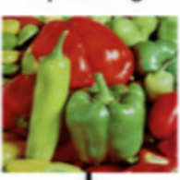
Problem and Research Goal
Generated Image
Metadata is stripped on re-encoding
Training-based watermarking is costly
Frozen-model latent methods ignore image content
↓
Redistributed/Edited
↓
Metadata removed
GOAL
↓
Enable reliable and computationally practical watermarking of existing diffusion-generated images without retraining the model
Difficult to verify ownership
Notes:
Open with: our goal is to let someone prove they own an image, when all they have is the image itself.

Slide 3
Literature Review
Related Work | Strength | Limitation
Conventional DCT-domain [2] | Works on existing images | Pixel level only
Tree-Rings [3], Gaussian Shading [4] | Training-free | Needs generator access
Frozen-model latent Watermarking [8], [9] | Post-generation watermarking | Uses image-independent mapping and a fixed refinement iterations
This research addresses two limitations of [8] and [9]
Notes:
Gap A is why we chose this pipeline — [8],[9] solved it, not us. Gap B is what this paper actually tests. Bridge line: the post-generation setting is already solved; what is not settled is how that pipeline should be configured per image.

Slide 4
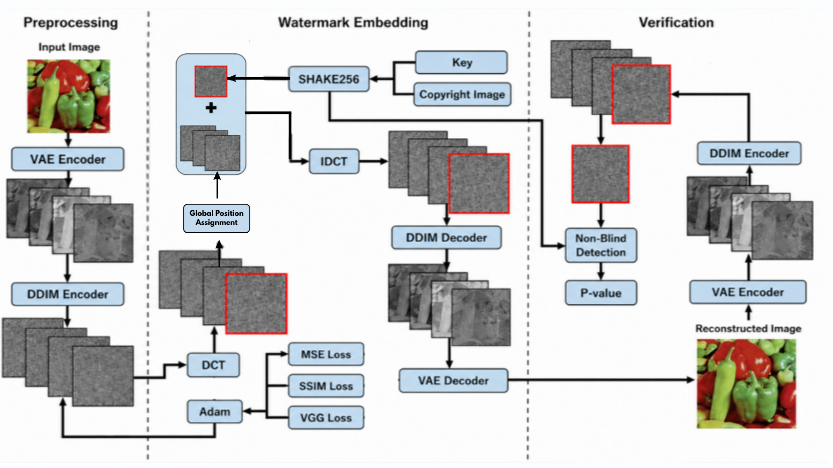
Architecture
Notes:
5 steps only, do not read every box. Step 3 is where both fixed decisions live. ~1:20.

Slide 5
Research questions and proposed solution
Q1
Q2
Does position selection or payload matching drive robustness?
Can refinement stop early without losing detection?
Robustness | Efficiency
Baseline: fixed template, direct payload order | Baseline: 60 iterations for every image
Ours: global position assignment + matching | Ours: stop when the loss converges
↓
↓
Notes:
These two questions drive everything that follows.

Slide 6
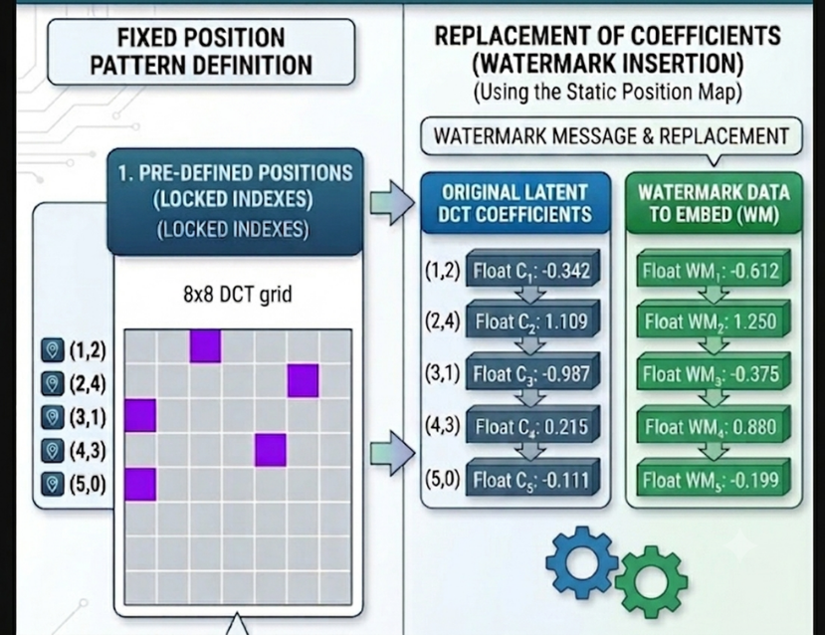
Baseline pipeline
Fixed position:
Global position assignment
DCT positions are chosen in advance and reused for every image
Pick 5 of 53 coordinates by solving a linear assignment problem
Hungarian and onker–Volgenant, both exact
decides WHERE to write
Direct Assignment:
Payload values are written in their generated order, so a value may land far from the coefficient already there
direct order
each bar = how far one payload value sits from the coefficient already there
Notes:
One decides where to write. The other decides what to write there.

Slide 7
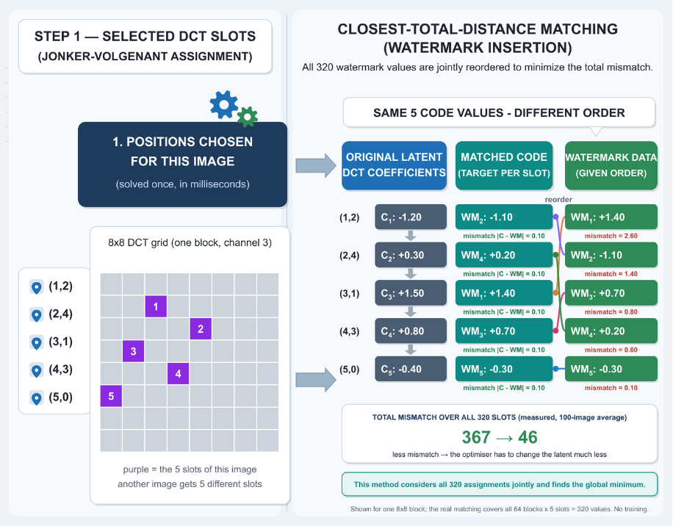
Global position and Coefficient-aware matching
Coefficient-aware matching
Global position
Global position assignment
Five positions are chosen per image, at the lowest total cost
Pick 5 of 53 coordinates by solving a linear assignment problem
Hungarian and onker–Volgenant, both exact
decides WHERE to write
8x8 DCT grid
Coefficient-aware matching Assignment:
direct order
The same 320 values are reordered so each lands on the nearest coefficient
each bar = how far one payload value sits from the coefficient already there
Notes:
One decides where to write. The other decides what to write there.

Slide 8
Experimental setup
Configuration compared
Variables, environments
Fixed-Direct
▦
Dataset
100 WikiArt images, 512 × 512
predetermined positions
◈
Model
Stable Diffusion 2.1-base, frozen
Hungarian-Direct
■
Hardware
NVIDIA RTX 4090, 24 GB
global positions
✕
Robustness
Detection rate of 12 attack conditions
JV Coefficient-Matched
✓
global positions + reordering
Threshold
watermark declared when p ≤ 0.1
◐
Quality
PSNR and SSIM, mixed SSIM at 0.92
Each configuration is run twice
◷
Efficiency
full-pipeline runtime per image
full 60 iterations · with early stopping
The twelve attack conditions are listed in the backup slides.
Notes:
Keep this short. Name the dataset, the model and the threshold, then move on. Do not read the twelve attacks — they are in the backup if anyone asks. The point to land: three position rules, each run at the full schedule and again with early stopping.

Slide 9
Results from payload matching and global positions
Configurations
Detection after 9 attack sequence with no rotation
False positives
Fixed positions
69%
11%
direct payload
Global positions
70%
6%
direct payload
Global positions
98%
6%
coefficient matching
+28 %
11 -> 6% FP
From reordering the payload on the same positions
Observed from choosing the best positions
Notes:
Read it as two separate effects. Position assignment changes where the payload goes: detection barely moves, 69 to 70, but the observed false-positive rate drops from 11 to 6. Coefficient-aware matching changes what is written at each selected location, and that is what drives robustness: 70 to 98, with false positives unchanged at 6. Pause after ninety-eight. Then note early stopping costs one point for an 11% time saving.

Slide 10
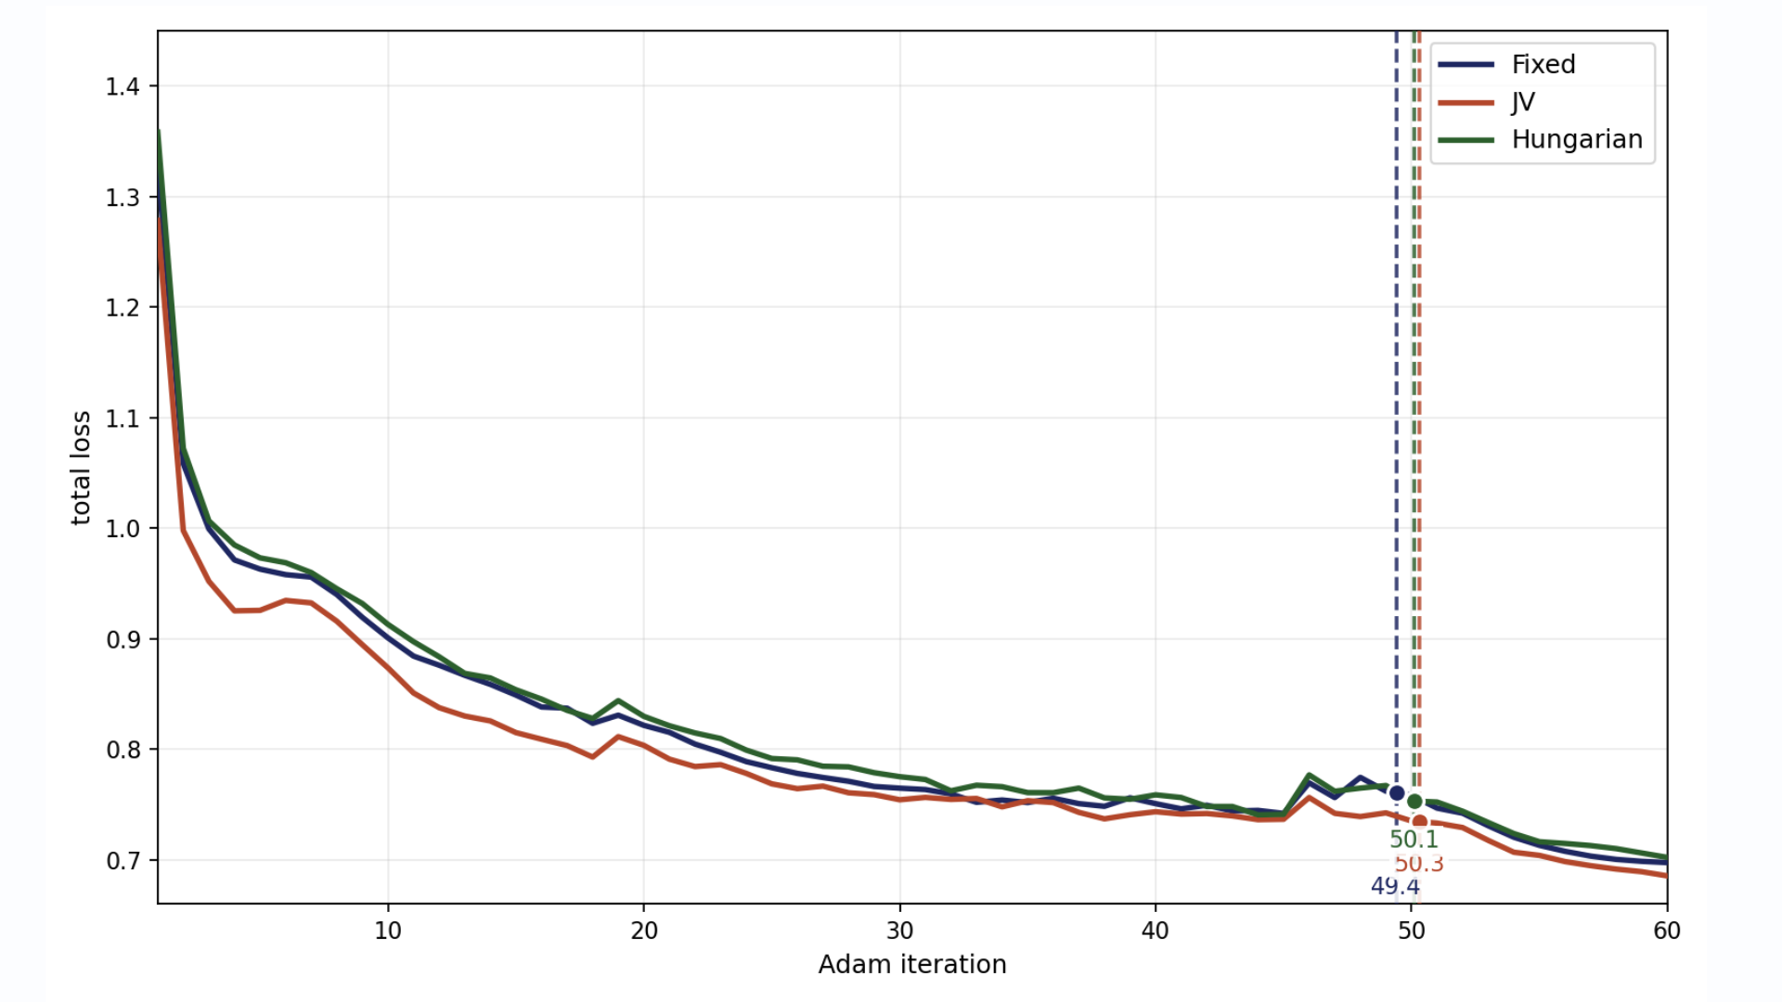
Refinement can stop at convergence
~50
Avg stop iteration
reduces ~7s of optimization time
11%
Less end-to-end runtime
10.6 – 11.6% across configurations
97%
Detection retained
down from 98%, SSIM held at 0.92
Notes:
Rule stops around iteration 50 on average. Runtime saving is bounded because attacks and detection are unchanged.

Slide 11
Limitation
5–10%
100 images
6–11%
False positives
Detection rate after 90° rotation
Needs broader validation
Detector does not know if the image has been rotated
Need more data and confidence intervals
Relatively high and need an independent negative set
Notes:
Say the limitations yourself before anyone asks. It makes Q&A far easier.

Slide 12
Conclusion
Position selection mainly reduced false positives: 11% to 6%, while compound-attack detection changed only from 69% to 70%.
Coefficient-aware payload matching drove robustness: detection increased from 70% to 98%, while false positives remained at 6%.
Convergence-based early stopping reduced end-to-end runtime by about 11%: detection remained at 97%, and mixed-image SSIM remained at 0.92.
Notes:
Say the limitations yourself before anyone asks. It makes Q&A far easier.

Slide 13
Backup- List of attacks
Attack
diff_attacker_60 (AI redraw)
cheng2020-anchor_3
bmshj2018-factorized_3
jpeg_attacker_50
brightness_0.5
contrast_0.5
Gaussian_noise
Gaussian_blur
bm3d (denoiser)
rotate_90
all (9 attacks + rotation)
all_norot (9 attacks)
Average over the 12 attack types

Slide 14
Backup - Full results table
Configuration | Position rule | Avg.12 | all_norot | all | rot_90 | FP | PSNR | Time
Fixed-Direct [8],[9] | predetermined | 82.0 | 69 | 9 | 7 | 11 | 23.10 | 60.0
Hungarian-Direct | global assignment | 82.2 | 70 | 7 | 9 | 6 | 23.05 | 59.4
JV-Coefficient-Matched | global assignment | 83.9 | 98 | 4 | 5 | 6 | 23.38 | 61.3
Fixed-Direct [8],[9] (EMA) | predetermined | 82.3 | 73 | 6 | 9 | 11 | 22.39 | 53.2
Hungarian-Direct (EMA) | global assignment | 82.1 | 69 | 6 | 10 | 6 | 22.44 | 53.1
JV-Coefficient-Matched (EMA) | global assignment | 84.7 | 97 | 10 | 9 | 6 | 22.81 | 54.2
Avg.12 is the mean over all 12 conditions. all_norot applies the 9 non-geometric operations in sequence; all adds rotation.
FP is the false-positive rate on unwatermarked images. PSNR is pre-mixing.
Every configuration detects 98–100% under each single non-geometric attack

Slide 15
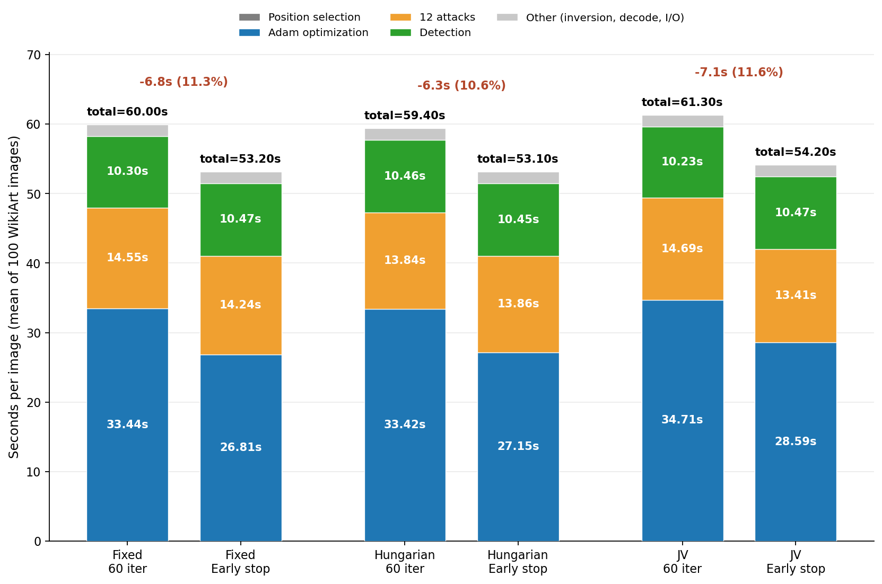
Backup - Runtime breakdown
Notes:
Only the Adam stage responds to early stopping; attacks ~14 s and detection ~10 s are constant, which is why the saving is bounded at 11%.

Slide 16
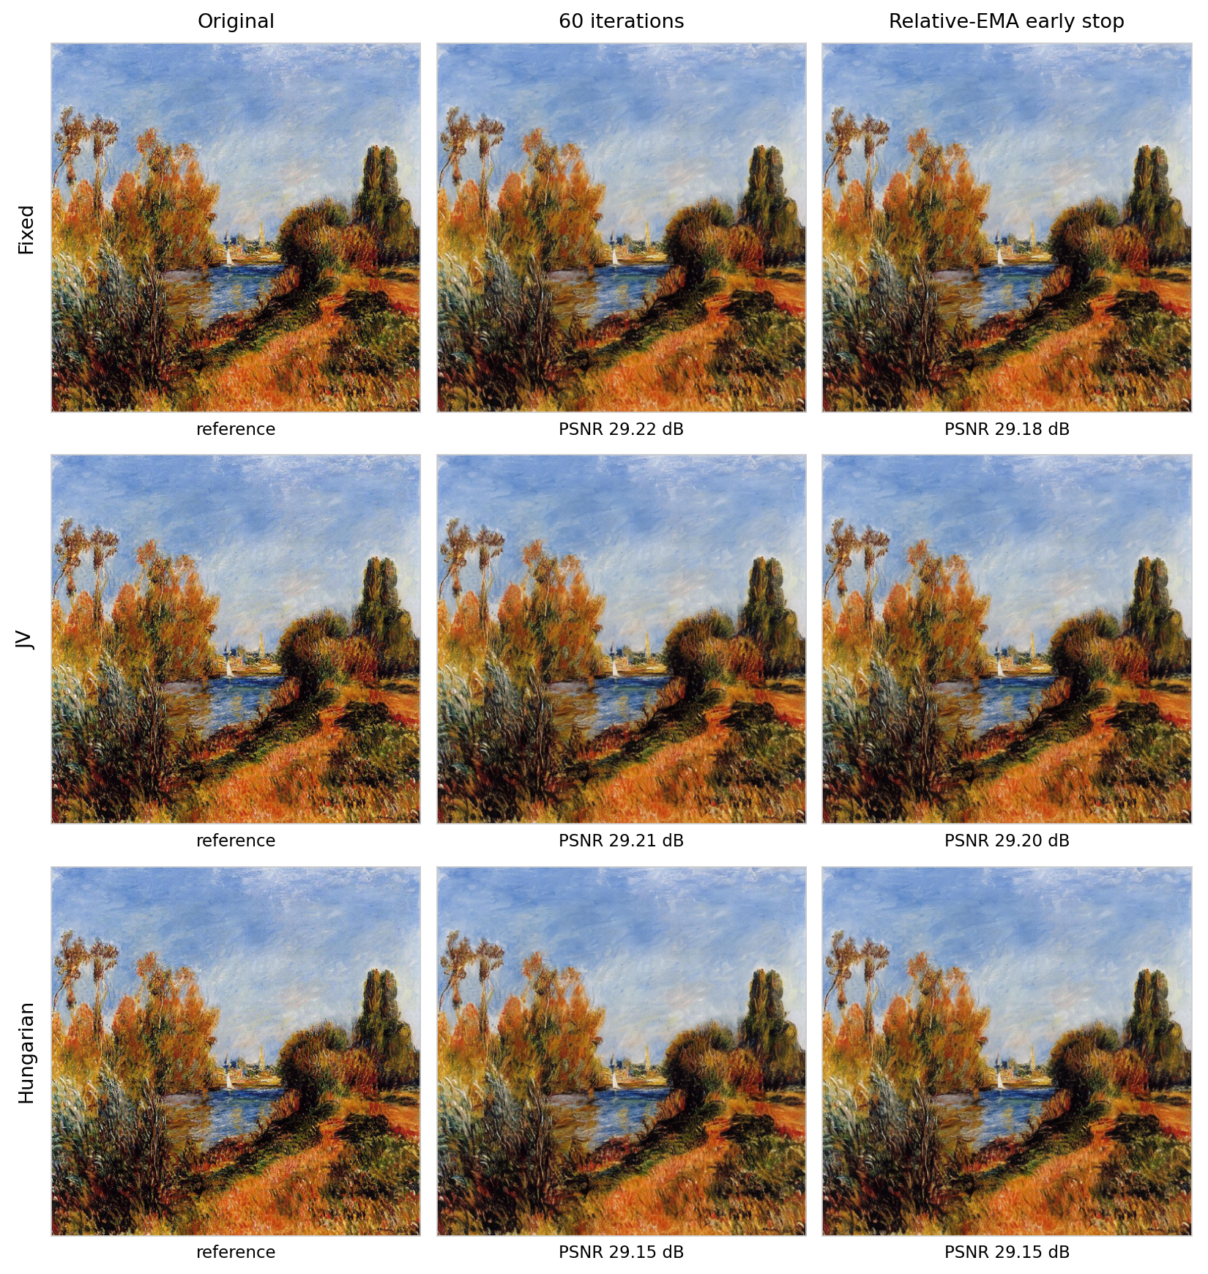
Backup — final image quality
Notes:
PSNR is measured after the SSIM-targeted mixing stage, which is why it exceeds the pre-mixing values in Table I.

