Slide 1
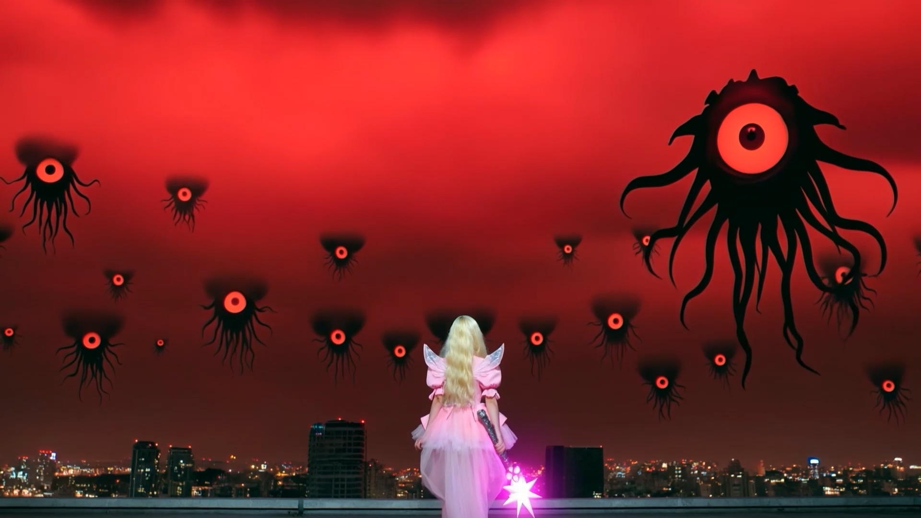
Wake Up, MAGICAL!
A GENERATIVE AI SHORT FILM
Deconstructing the Magical Girl Fantasy through a Generative AI Short Film
Directed by YunSeo Park
Notes:
Hello everyone. My name is YunSeo Park. Today I will talk about my AI short film, Wake Up, MAGICAL! In this film, I take the classic magical girl story and turn it upside down.

Slide 2
An old genre meets a new tool
01 · INTRODUCTION
The genre
The question
The tool
Popular in Japanese animation for 50+ years. An ordinary girl becomes a magical hero and fights evil.
Since the 2010s, creators ask about the hidden cost behind the bright transformation.
Generative AI lets small teams make fantasy scenes that once needed big studios.
My film: the magical girl look + a twist like The Matrix.
Wake Up, MAGICAL!
02
Notes:
First, some background. The magical girl genre has been popular in Japanese animation for more than fifty years. The basic story is simple: an ordinary girl gets magic powers and fights evil. But since the 2010s, some creators have started to question this happy story. They point to the hidden cost behind the bright transformation. At the same time, generative AI now lets small teams like mine make big fantasy scenes. My film stands right where these two things meet. It uses the magical girl look, and then adds a twist like The Matrix.

Slide 3
How the magical girl changed
02 · BACKGROUND
1992
1998–2004
2011
Sailor Moon
Sakura & Pretty Cure
Madoka Magica
The girl becomes a warrior, with staged transformations and the moon as a symbol.
The classic codes are fixed: pink costumes, ribbons, wands and sparkles.
The genre is taken apart. The system that gives the girls power also uses them.
Wake Up, MAGICAL!
03
Notes:
Let me show you how the genre changed in Japan. Sailor Moon, in 1992, made the magical girl a warrior. She had a big transformation scene, and the moon was her symbol. Next, Cardcaptor Sakura and Pretty Cure fixed the classic codes: pink dresses, ribbons, wands, and sparkling light. Then, in 2011, Madoka Magica broke the genre apart. In that show, the system that gives the girls power also uses them. The cute surface hides something dark.

Slide 4
Korean magical girls
02 · BACKGROUND
Title | Medium (Year) | What it does
Secret Jouju | TV animation (2012) | Classic transformation codes for preschoolers
Catch! Teenieping | TV animation (2020) | A princess and fairy partners catch emotion fairies
KPop Demon Hunters | Animated film (2025) | Magical girls as a K-pop idol trio with an active role
My film follows the critical line of Madoka Magica and adds the escape-and-wake-up structure of The Matrix (1999).
Wake Up, MAGICAL!
04
Notes:
Korea has its own magical girls, too. Secret Jouju and Catch! Teenieping keep the classic style for young children. KPop Demon Hunters, from 2025, turns magical girls into a K-pop idol group, and gives them a more active role. My film follows the critical line of Madoka Magica. And I added the escape-and-wake-up structure of The Matrix.

Slide 5
One girl, three worlds
03 · SYNOPSIS
1 · Fantasy
Rainy classroom → neon street → pink vortex → battle under a red sky
2 · Capsule
The moon turns black → she wakes in a glass capsule → a corridor of sleeping girls
3 · Reality
She tears off the pink costume → walks into a ruined gray city
Figure 1. A magical girl who battles evil
Wake Up, MAGICAL!
05
Notes:
Here is the story. On a rainy day, a schoolgirl looks out of the classroom window. That night, a monster attacks her on an empty neon street. A pink vortex surrounds her, and she becomes a blonde magical girl with a wand. She fights one-eyed creatures under a red sky. But then, the moon turns black. She wakes up underwater, inside a glass capsule. She breaks out and runs down a long corridor full of capsules. In each one, a girl is sleeping. Her magical girl self appears, and a pink costume wraps around her body. She tears it off, and walks out into a gray, ruined city.

Slide 6
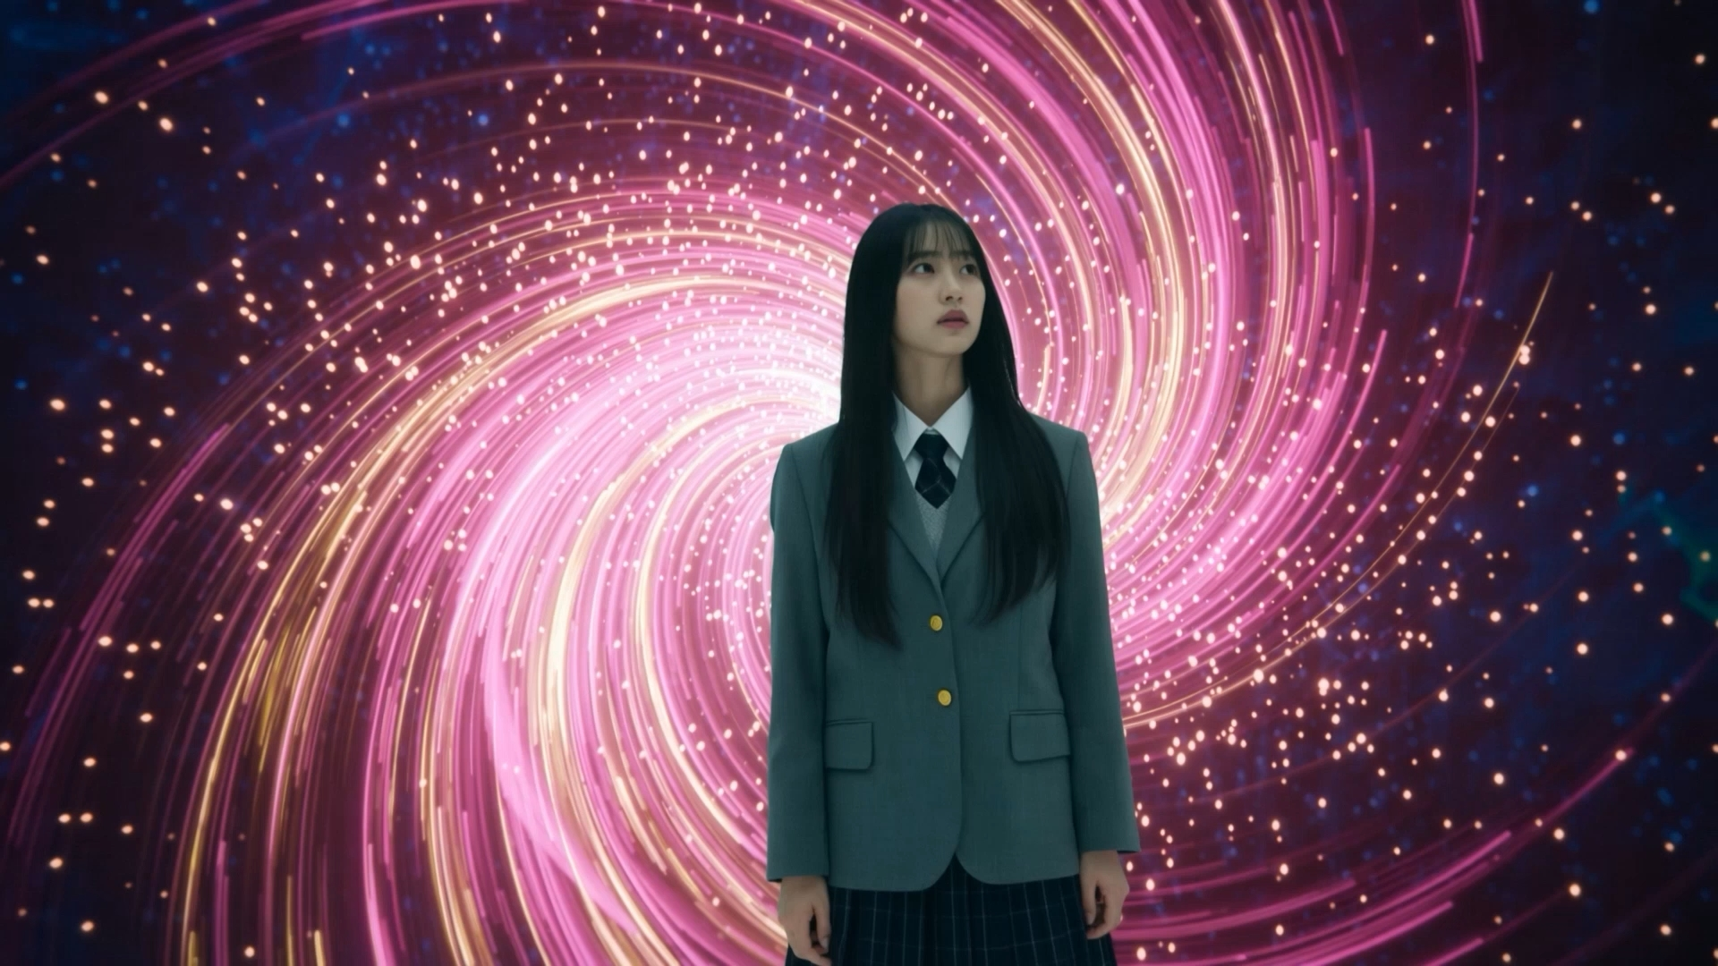
Two selves in one girl
03 · CHARACTER
Ordinary self
Black hair, gray uniform. Reality and her own choice.
Magical girl self
Blonde hair, wings, pink dress. The genre’s promise of beauty and power.
The twist: that promise is mass-produced. It keeps girls asleep.
Figure 2. A magical girl transforming
Wake Up, MAGICAL!
06
Notes:
The main character has two selves. The ordinary self has black hair and a gray uniform. She stands for reality and for her own choices. The magical girl self has blonde hair, wings, and a pink dress. She is the genre’s promise of beauty and power. But the capsule corridor shows that this promise is mass-produced. It keeps girls asleep. So when she rips off the costume, she says no to that role. And the title, Wake Up, speaks to her, and also to us, the audience.

Slide 7
Color tells the story
03 · COLOR
Pink & magenta
Cyan
Gray
Pink → red
The fantasy world
The capsule facility
The real world
The violence under the cute surface
Wake Up, MAGICAL!
07
Notes:
I also used color to tell the story. Pink and magenta mean the fantasy world. Cyan means the capsule facility. And gray means the real world. When the pink costume bursts into red particles, the film shows the violence hidden under the cute surface.

Slide 8
A generative AI pipeline in 3 steps
04 · PRODUCTION PROCESS
01
02
03
Plan
Generate
Finish
Story split into three worlds
Storyboard
Character sheets for both selves
Color script for each world
Key frames from prompts and character references
Image-to-video with set camera moves
Symmetrical shots to reduce distortion
Fast battle, slow awakening
Color grading and effects
Sound design for each world
Hardest part: keeping her face the same in every shot, which took many generations and careful selection.
Wake Up, MAGICAL!
08
Notes:
Now, how did I make this film? I used a generative AI pipeline in three steps. First, I planned. I split the story into three worlds. I made a storyboard, character sheets for both selves, and a color script for each world. Second, I generated. I made key frames as still images from prompts and character references. Then I turned them into video, with set camera moves. Symmetrical shots, like the capsule corridor and the neon street, helped reduce strange distortions. Third, I finished the film. I edited the battle to feel fast and the awakening to feel slow. Then color grading, effects, and sound design tied each world together. The hardest part was keeping her face the same in every shot. I had to generate many times and choose the best results.

Slide 9
The climax is not transformation.
It is de-transformation.
05 · CONCLUSION
Meaning
Method
Next
Heroism means refusing the ideal self and facing reality.
Generative AI can support genre-critical stories through clear worlds and a color script.
Audience reception and character consistency in AI filmmaking.
Wake Up, MAGICAL!
09
Notes:
To wrap up. In my film, the transformation, the wand, the moon, and the pink dress are not rewards. They are the interface of a system that keeps girls asleep. So the climax is not the transformation. It is the de-transformation. The real hero is the girl who says no to the perfect self and faces reality. I also learned that generative AI can support this kind of genre-critical story, with clearly divided worlds and a color script. Next, I want to study how audiences react to the film, and how to keep characters consistent in AI filmmaking.

Slide 10
Thank you
Notes:
Thank you for listening. I’m happy to take your questions.

